Slide 1
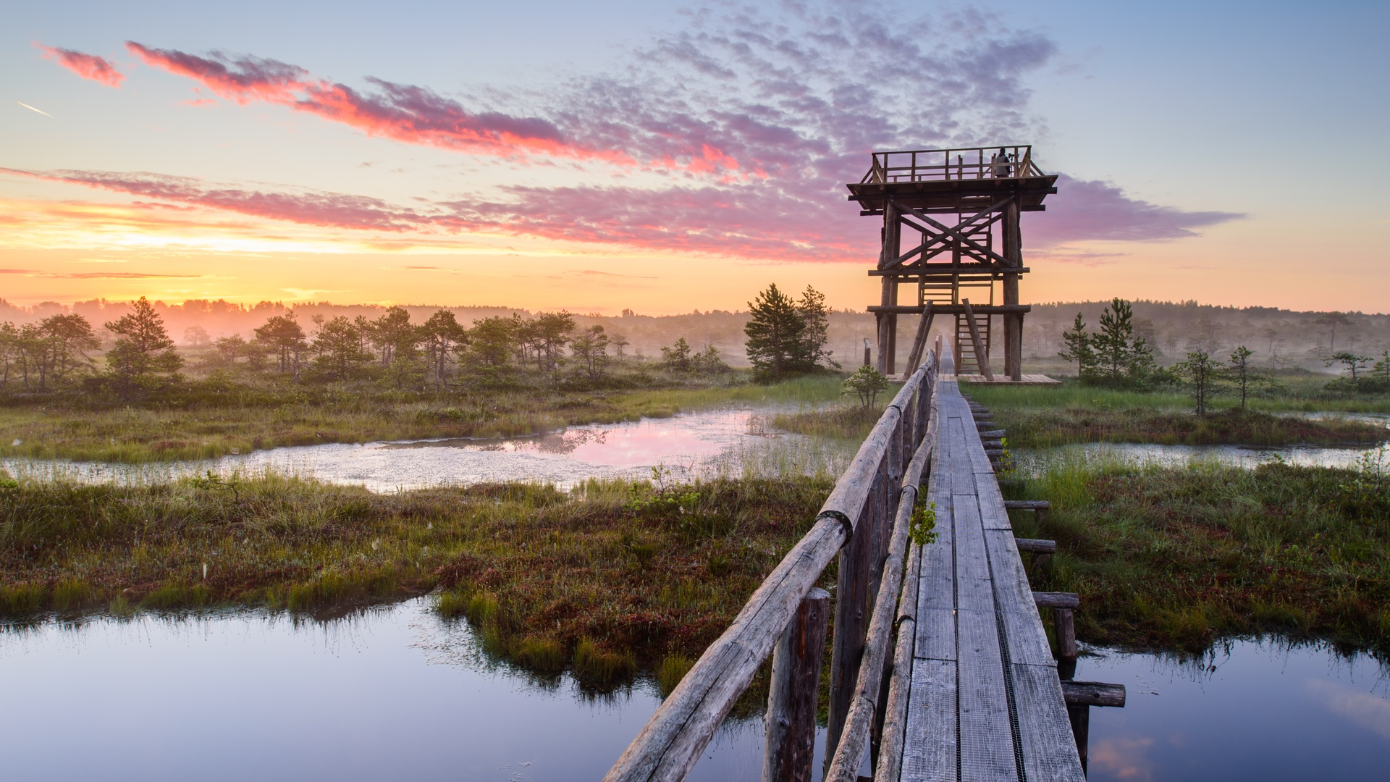
























meet ESTONIA small in size big in experiences
© Sven Zasec

Slide 2
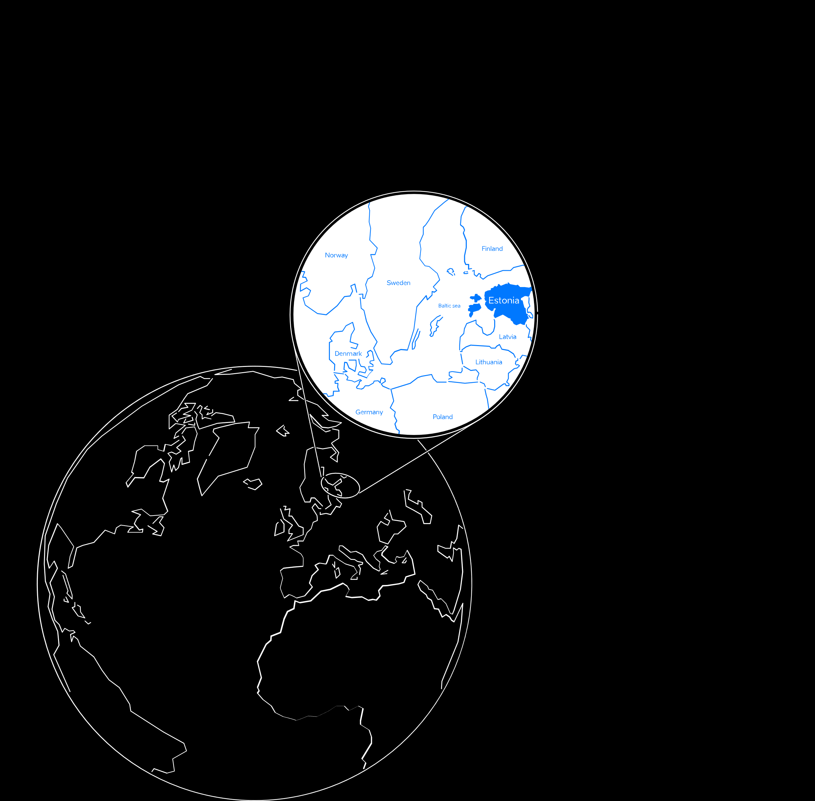
Estonia in a nutshell
population: 1.3 million
currency: EUR
official language: Estonian, English widely spoken
member of: EU, Eurozone, OECD, NATO and Schengen
capital city: Tallinn (450,000)

Slide 3
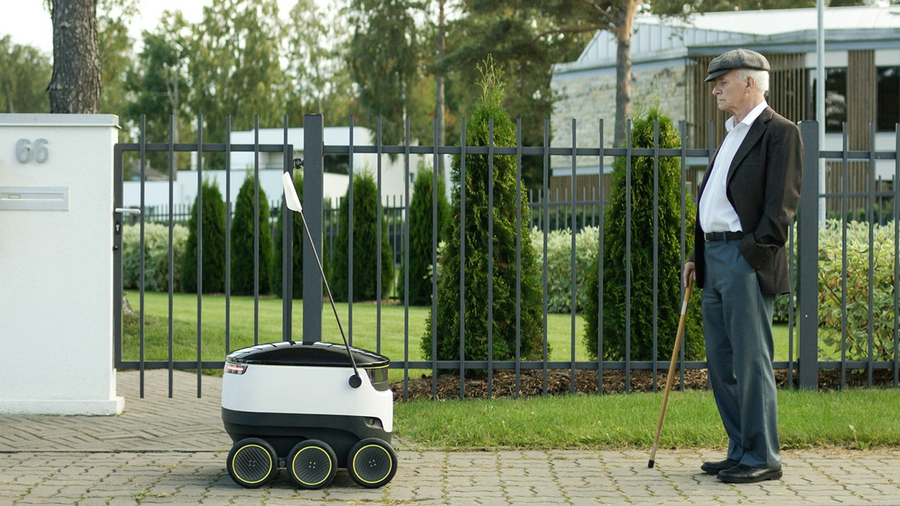
most advanced digital society in the world
99% of state services are online
electronic ID, I- voting, E-health, E-School, E-Tax
documents signed digitally in seconds since 2002
Estonians have I-voted online since 2005
digital signature saves a 300-meter stack of paper each month
hassle-free e-taxation
e-Residency – Estonian e-services to every world citizen
© Ajujaht

Slide 4







world’s most advanced digital society
starting a business
childbirth
buying
a car
driving
licence
start of
school
unemployment
& job search
marriage
divorce
disability
military
service
change of residence
retirement
death (succession)
building
houses
falling victim to an accident
falling victim to a crime
Notes:
Estonia is know all around the world as the world’s most advanced digital society where 99% of the public services are online.
The only thing you can’t do online is a divorce
The logic for proactive government services is quite simple: Yes, most of our services are available online, but how about government approaches us to offer them to us when it knows that we are entitled to them? This would also further decrease the burden of bureaucracy for both the people and the state.
The first of these services actually came online in October 2019 – since then, parents automatically get a notification after their child is born to ask them to which bank account they would like their child benefits transferred.
Compared to current e-services, the new seamless services will function automatically and are more user-centred. If the first step of developing e-services meant enabling different systems to communicate with each other, then life-event/business-event services are activated automatically based on the events taking place in a person’s life.
Currently available pro-active services:
Childbirth – In its final form, the service would start when a pregnancy is detected at the clinic by a doctor who then makes the entry to the health registry. This entry triggers family planning services (info, including a partner, benefits planning calculator, etc.), health services for pregnant women, maternity and fraternity leave planning calculator and offers, birth services by the hospital and registration of the new citizen. Parts of this service are already available and offered proactively, like the birth benefit, is offered for the parent after the newly-born is being registered in the population registry, also an only service where the parent can give a name to the child online. This service is a work in progress, but the proactive elements are already there.
Starting a business – An event-logic-based service for starting a business is already available on the entrepreneur portal. The service combines the company registration process, applying for the VAT nr and registration of employees. By the end of 2021, the government is developing the service to make it available from eesti.ee and include services like applying for various business permits.
Proactive services, that are currently planned or in development:
Becoming a pensioner – this is the first life-event service that will be fully implemented and piloted. At least 6 months before reaching the retirement age a person would receive an offer from the government to the eesti.ee portal about this life event occurring. The offer will layout various paths regarding their pensions savings, will give a total amount of what the person will be receiving from the state as an old-age pension. On that life-event page, a person could also either postpone the pension (continue working) or apply for an early leave. The citizen will go through the planning within a single interface, but in the back, at least four institutions are offering more than six services services.
Change of residence (moving, selling or buying property) or building houses – as these life-events usually mean plenty of paperwork, especially building, so being able to handle them in a single gateway saves time, and being up to date in real-time how far the administrative process is, should also save some nerves.
Driving license and buying a car – this service will gather application for driver licenses, change of licenses, health-related documentation regarding licenses, vehicle ownership and the change of ownership into a single source.
Military service – as the service is mandatory for most men in Estonia, every year more than 3000 citizens encounter this life-event. Here we have gathered the information regarding the service as well as the application process, so from the first info letter about a youngster being listed, an invitation to medical examination, expressing preferences regarding the type of service, etc. This also includes the services needed while being in the service and after the service, in the reserve.
Most difficult services to develope:
Marriage – the first life-event based service launched for two persons to express their intention to get married digitally, also decide upon the date, who will carry whose name, the marital assets agreement and then only show up on the designated date to say „I do“. On that date, the person whose name changed will get the new ID-card and other documents already made to the new name since the agencies invovled already knew the change was about. As there was a need to fundamentally change the family law, the amendmends were previously passed in Estonia’s Parliament and service came to effect in December 2022.
Death of a close one – also falls to the difficult category, because of legal challenges and multiple stakeholders / rooted processes. At the moment the state issues the death certificate, digitally of course and at the same time makes the necessary registration to the population registry. Local government is also involved with funeral subsidy and the burial place, then the private sector offers burial related services – each of these stakeholders use a different system, so for the person handling the event, it seems fragmented and complicated. Life-event of this mournful case should make it easier to fulfill the wishes of the one who left (burial grounds, ceremony, etc.), to handle the paperwork regarding the funeral and aid offered by the local municipality, and offer the private companies their way in as well. As we want this service to be as intuitive as possible for the citizen, it will take more time to figure out the most effortless and painless route.

Slide 5
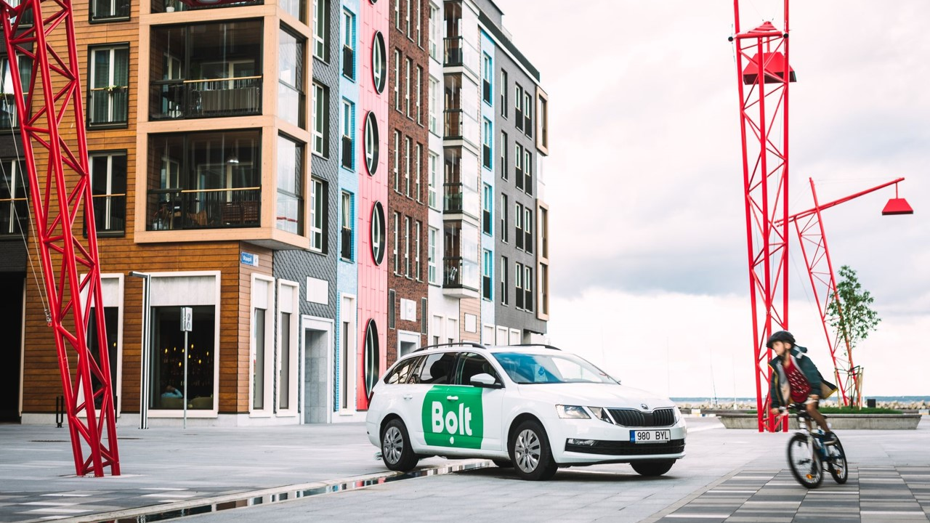
land of startups
1500+ startups
10 unicorns - #1 per capita in Europe
raised around € 4B in funding since 2010
Estonian Startup Visa & Scale-up Visa
supportive ecosystem
Nordic Deep Tech Valley
© Bolt

Slide 6
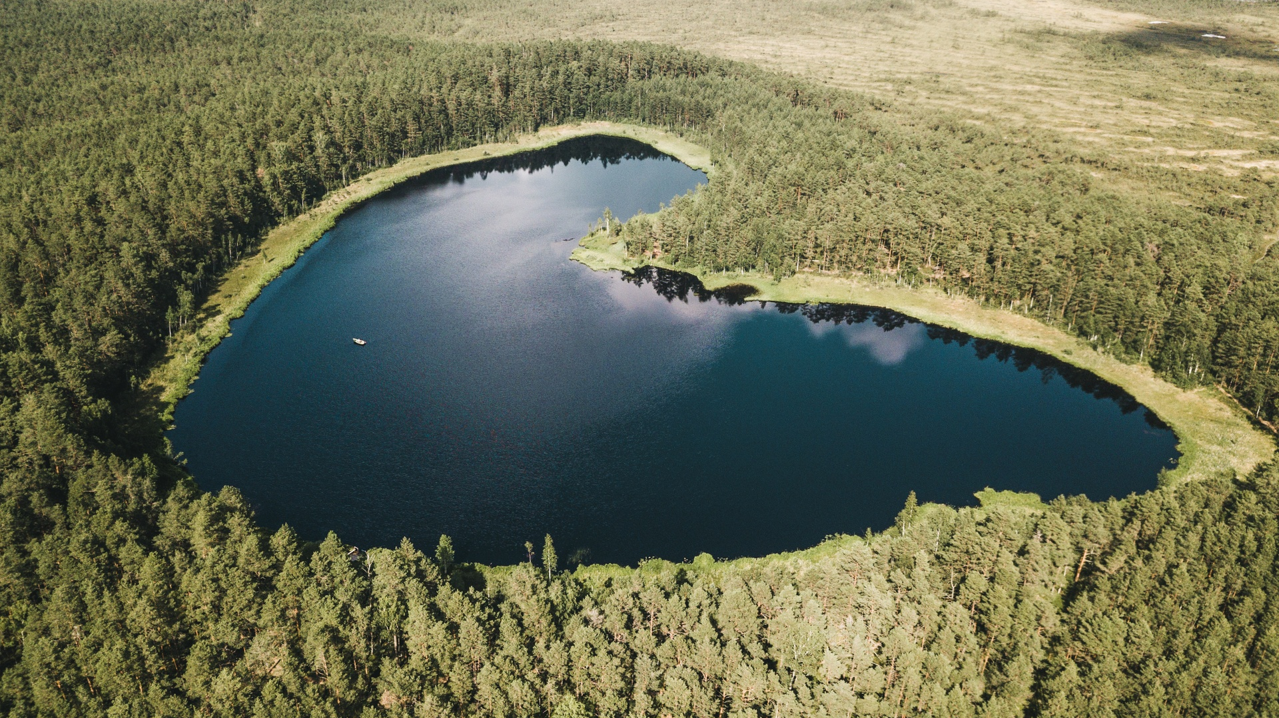
green and clean
70% of the country covered by wilderness (forests, wetlands)
more than 2,300 islands
one of the the cleanest air in the world
Green Key certified hotels, restaurants and venues
Michelin green star restaurant
#4th in global sustainability travel index
© Priidu Saart

Slide 7
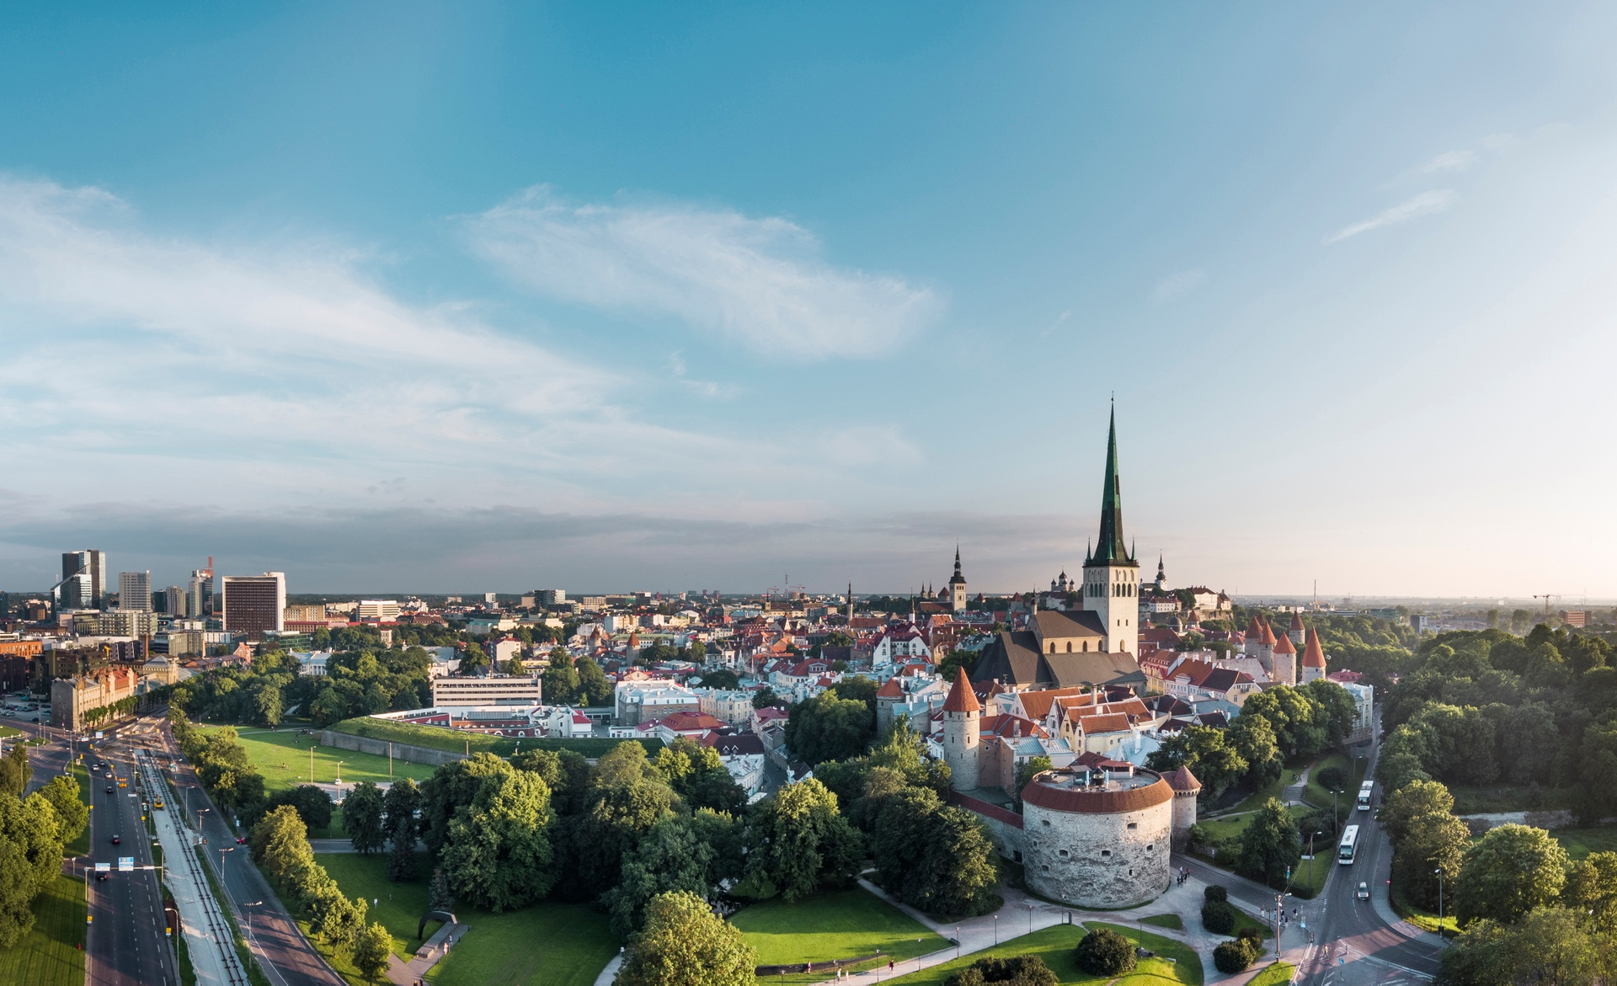
cosy and compact
most sights, hotels, venues, restaurants are within walking distance
© Rasmus Jurkatam

Slide 8
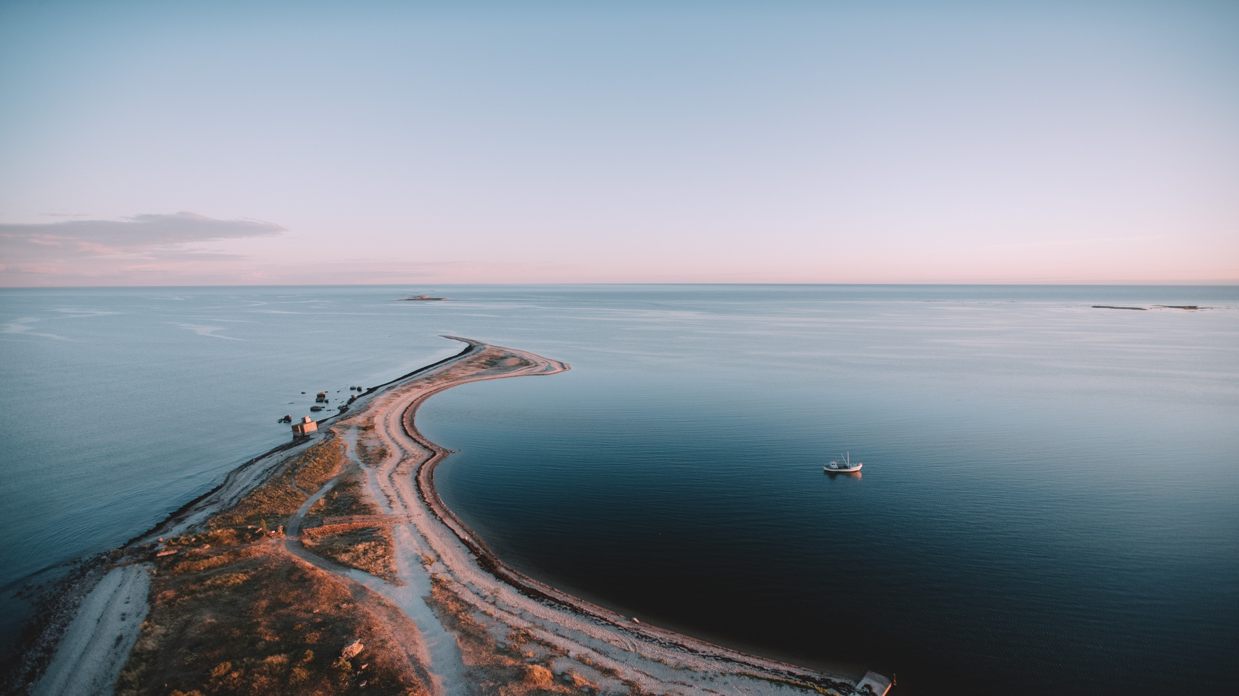
a fresh destination
mostly undiscovered
full of positive surprises
combination of old and new, medieval and modern
© CP Creatives

Slide 9
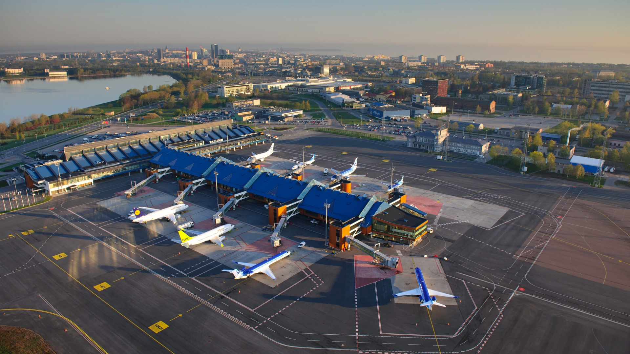
the world’s cosiest airport
Tallinn Lennart Meri International Airport is located just 4 km from the old town
10 min by taxi or bus and you are in your hotel room
2023 Best Airport in the world, among those serving 2-5 million passengers per year (by Airports’ Council International)
© Sven Zacek

Slide 10
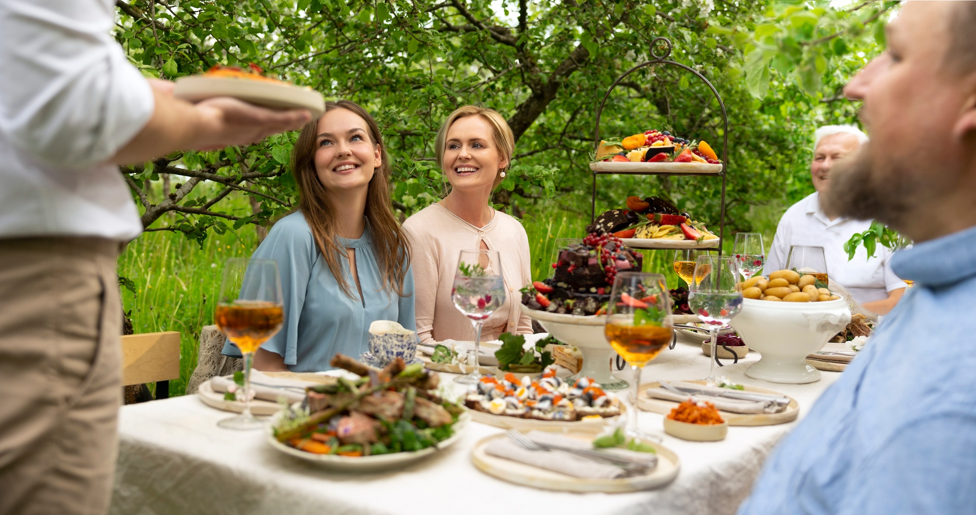
good value for money
5-star quality at 4-star prices
© Hele-Mai Alamaa

Slide 11
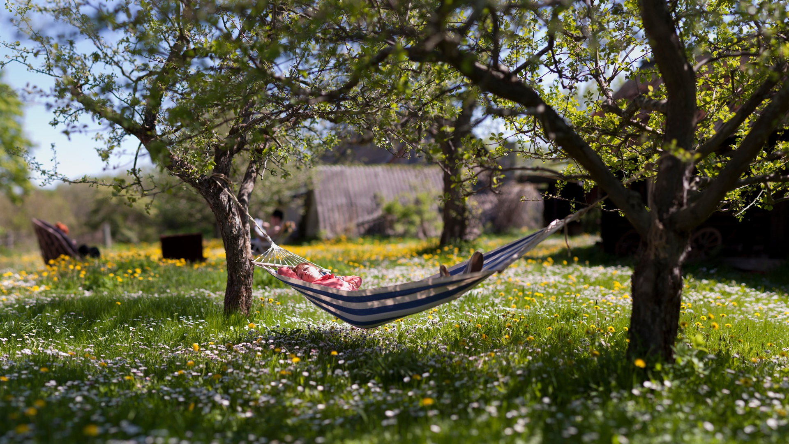
easy organising
nordic work culture
can-do attitude
flexible solutions
English widely spoken
promises are kept
no hidden costs
no bureaucracy
© Renee Altrov

Slide 12
key sectors of excellence
‘the most advanced digital
society in the world’
by Wired
the first country in the world to offer
e-residency
Europe’s leader in cybersecurity,
home to NATO Cyber Defense Centre
Europe’s leading
startup nation
Europe’s leader in
Digital Health
one of the world’s
most open
and competitive business environments
attractive environment
for research and development
Europe’s leader in education
OECD PISA Tests 2022
one of the world’s cleanest AIR
EUROMONITOR 2023
#4 sustainable travel
index

Slide 13
local support for conferences
Enterprise Estonia
Tallinn City
Tartu City
support sum max 30,000 euros
minimum estimated international delegates 75/120 depending on the month
duration min 2 consecutive days
free public transportation for conferences and events in Tallinn
support sum max 5,000 euros
min 200 international delegates
duration min 2 consecutive days
conference is held in the city of Tartu
support sum 15,000 - 30,000 euros, max 70 % of the total costs
minimum 100/200 international delegates depending on the city/location
duration of the conference program at least two consecutive days

Slide 14
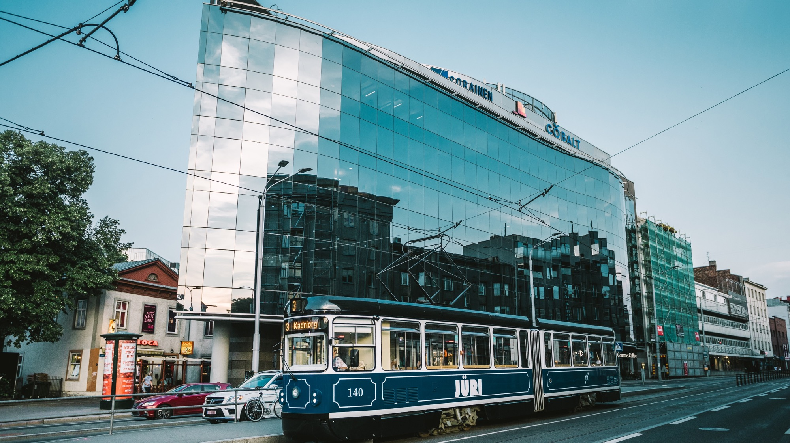
Tallinn city offers free of charge public transportation for conference delegates

Slide 15
Why Estonia for international conferences and incentive events?
new and fresh destination in Europe
world’s leading digital society
key sectors of excellence including e-Health
Estonian Health Tech Cluster & vibrant startup scene
cosy and compact with easy logistics
excellent quality business hotels
multifunctional unique event venues
amazing food (seasonal, local, short-travelled)
great value for money
easy organising: euro as a currency, English widely spoken, Nordic business culture
green and clean, sustainability is a way of life
Tartu European Capital of Culture 2024

Slide 16
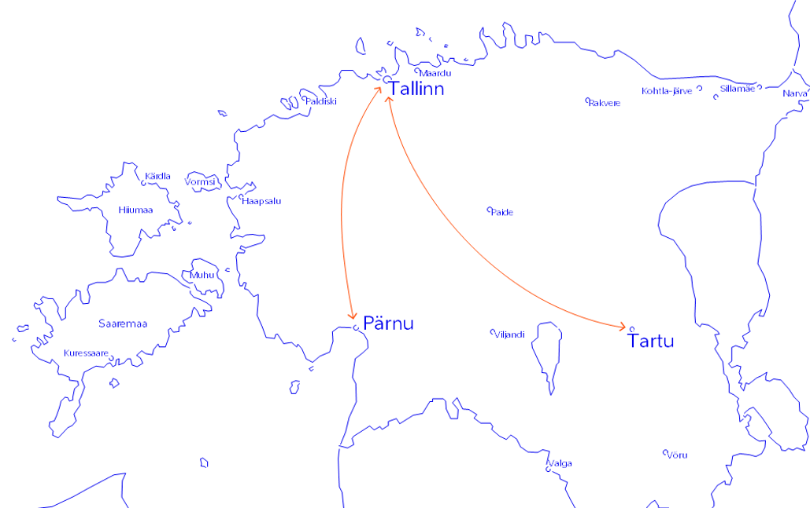

main cities for events
Tallinn, the capital city
Tartu, European Capital of Culture 2024
Pärnu, wellness and spa capital

Slide 17
Tallinn

Slide 18
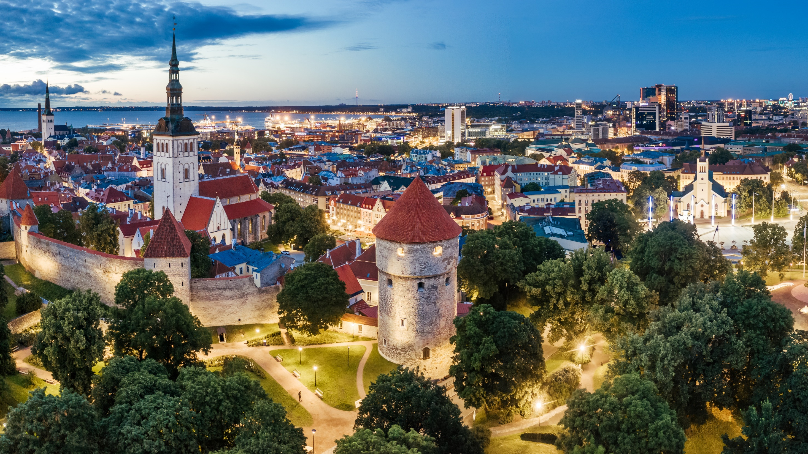
Tallinn the capital of Estonia
7 minute city
population 450 000
2h by ferry from Helsinki
© Kaupo Kalda

Slide 19
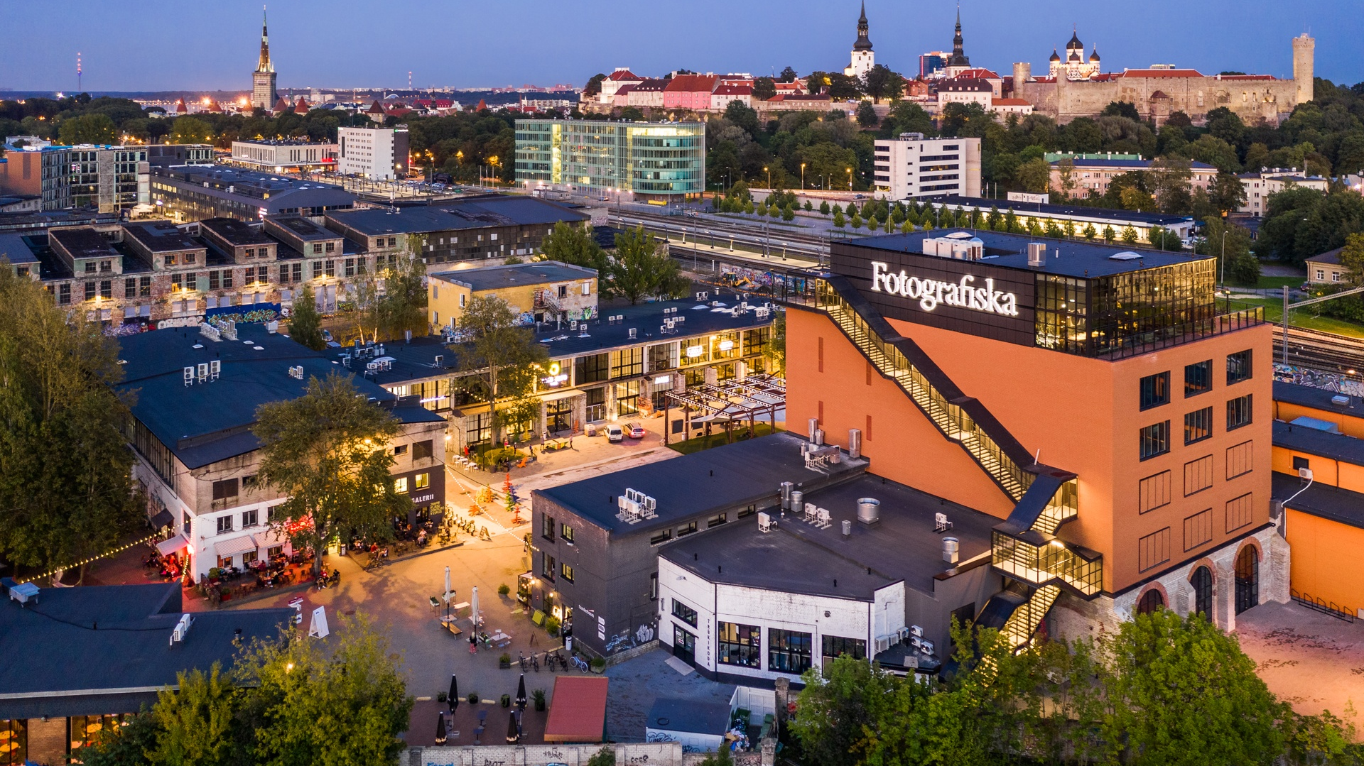
Tallinn a diversity of colourful neighbourhoods
Tallinn old town
Telliskivi creative city
Rotermanni quarter
Noblessner port district
Kadriorg park district
© Kaupo Kalda

Slide 20
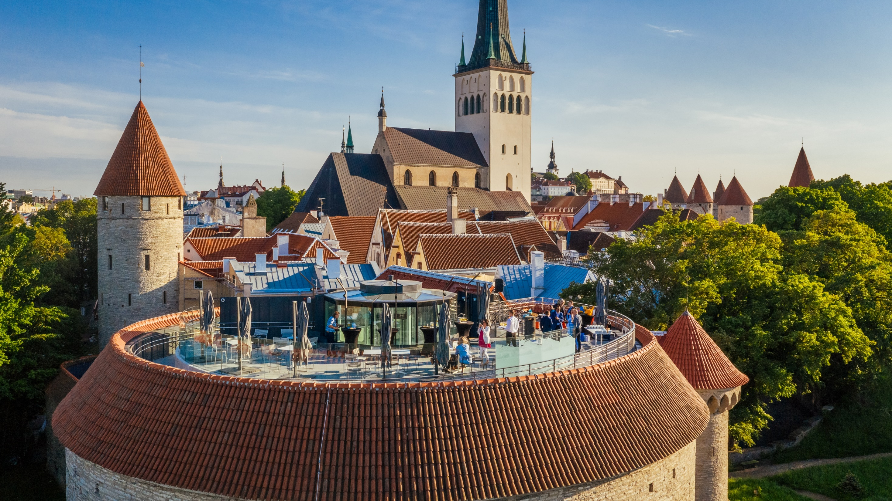
Tallinn old town
UNESCO Heritage listed medieval Old Town
© Kaupo Kalda

Slide 21
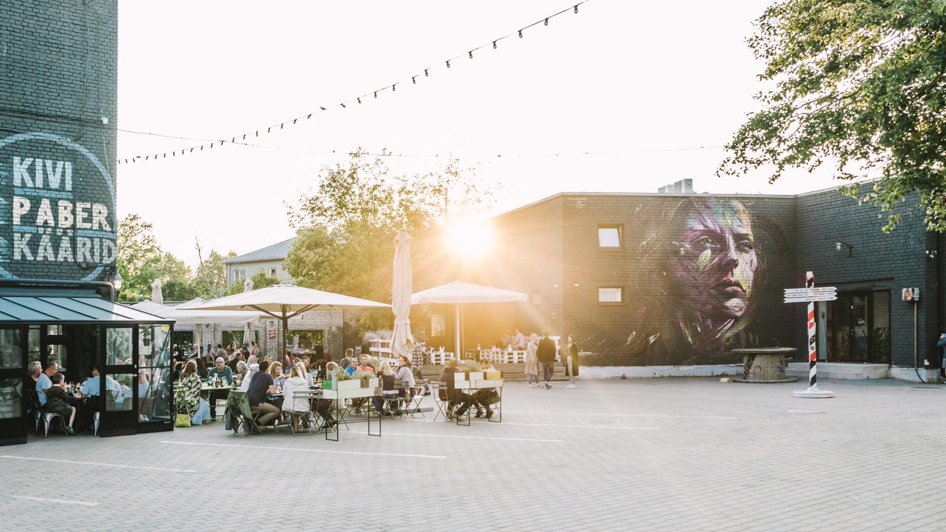
Telliskivi creative city
bohemian, funky, hipster district located in a former industrial complex
full of street art
© Rasmus Jurkatam

Slide 22
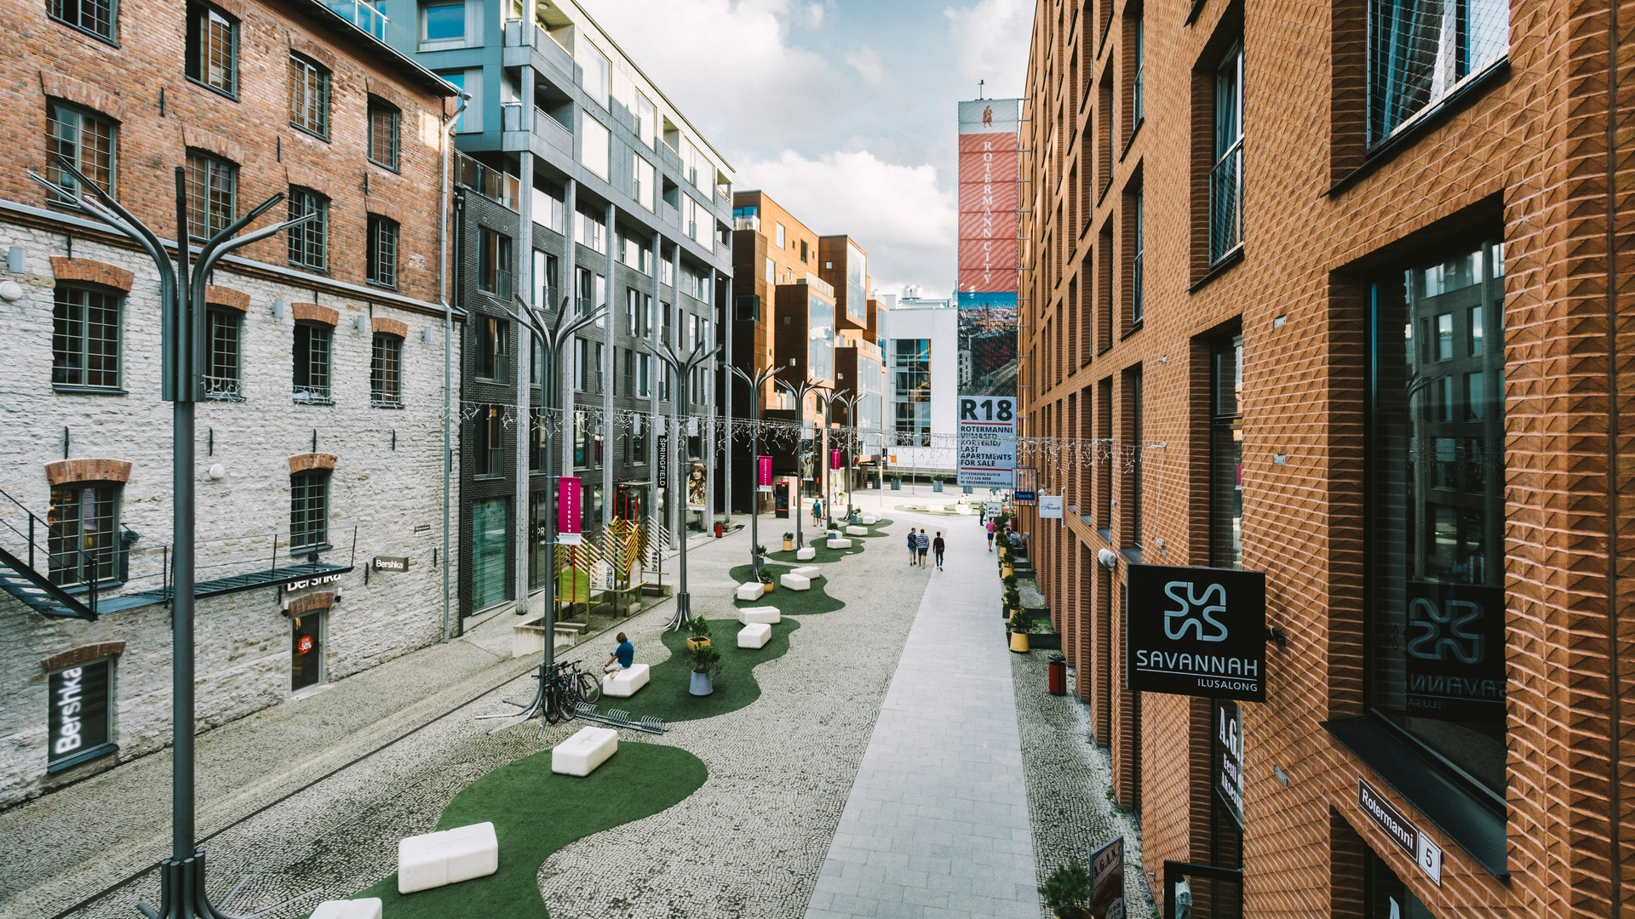
Rotermanni quarter
a reclaimed factory district now a fashionable residential and
office area with cool bars and restaurants loved by the locals
© Rasmus Jurkatam

Slide 23
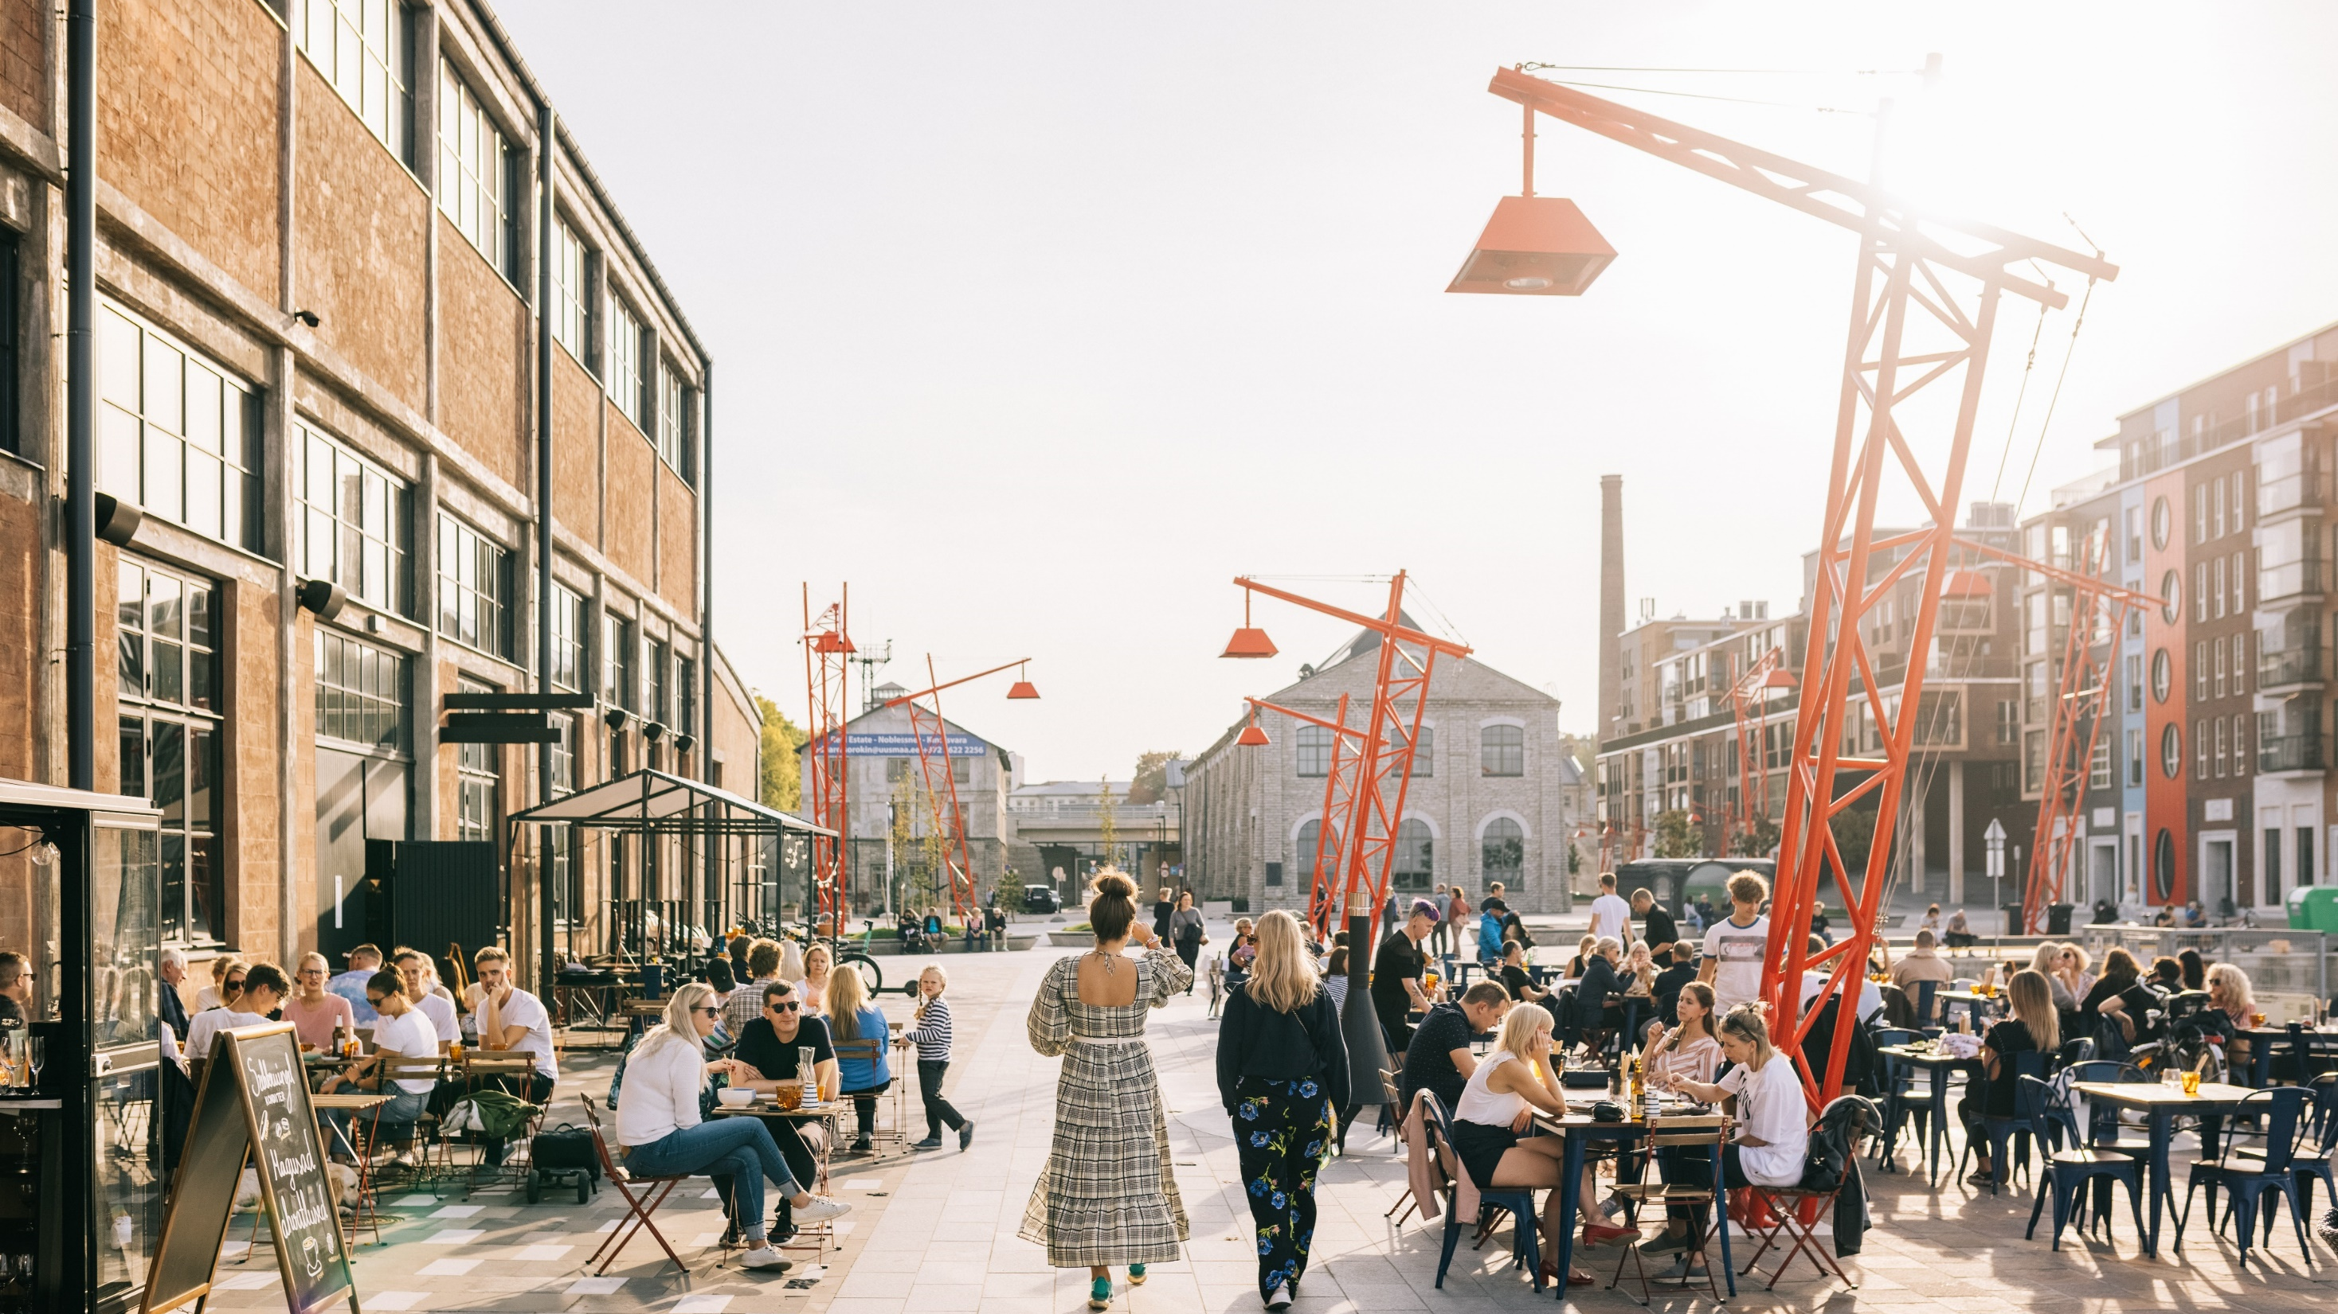
Noblessner port district
former submarine shipyard turned into popular seafront quarter
© Rasmus Jurkatam

Slide 24
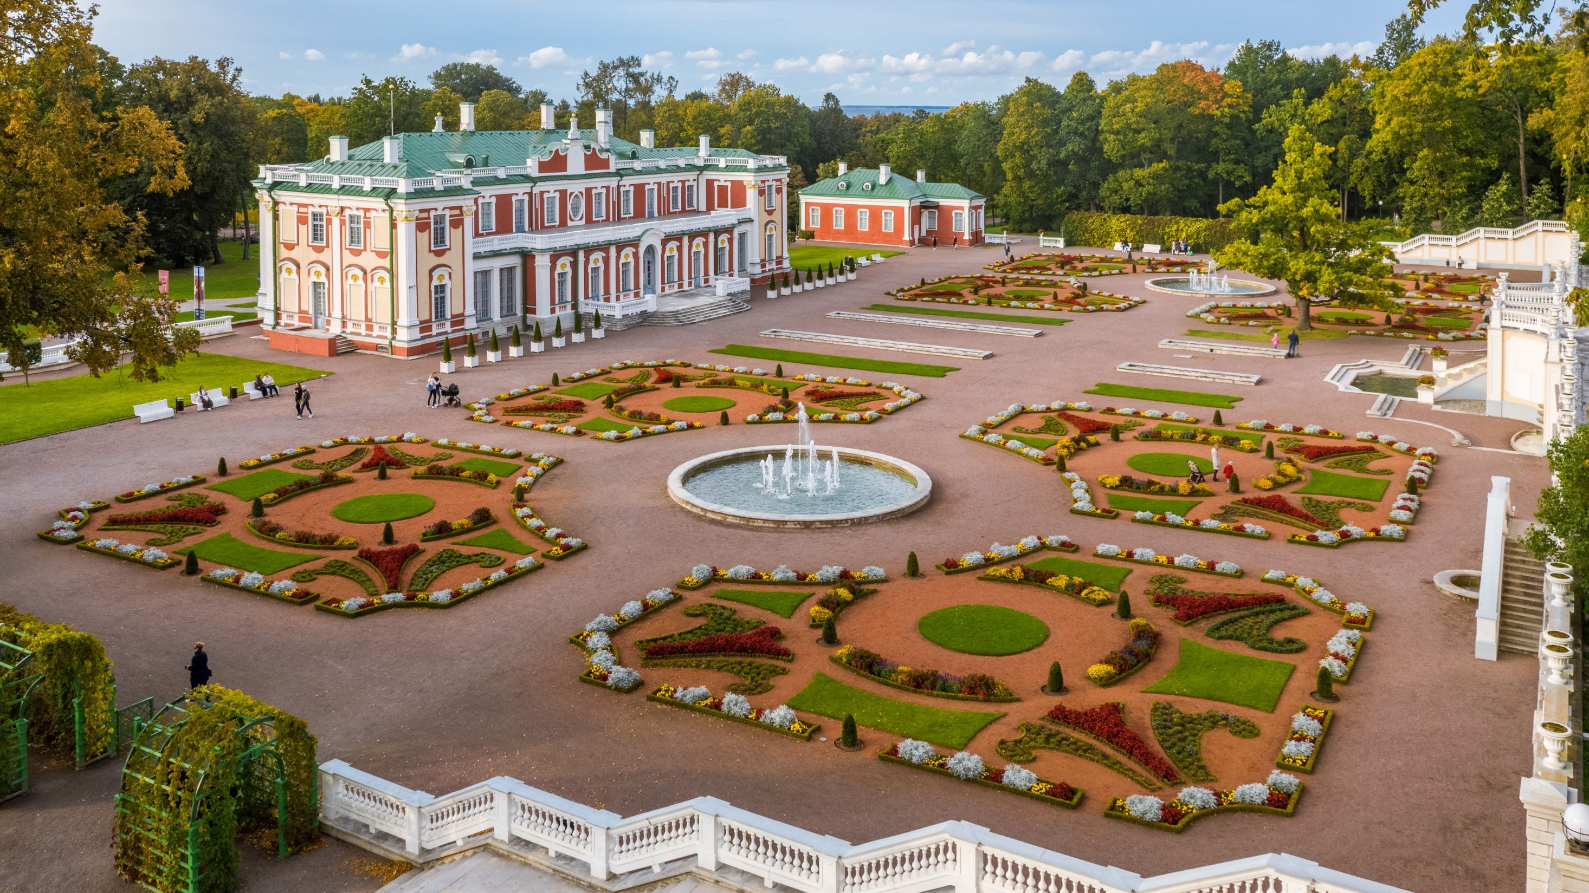
Kadriorg park district
most outstanding palatial and urban park in Estonia
home for a numerous museums
wooden architecture
© Kaupo Kalda

Slide 25
Tartu

Slide 26
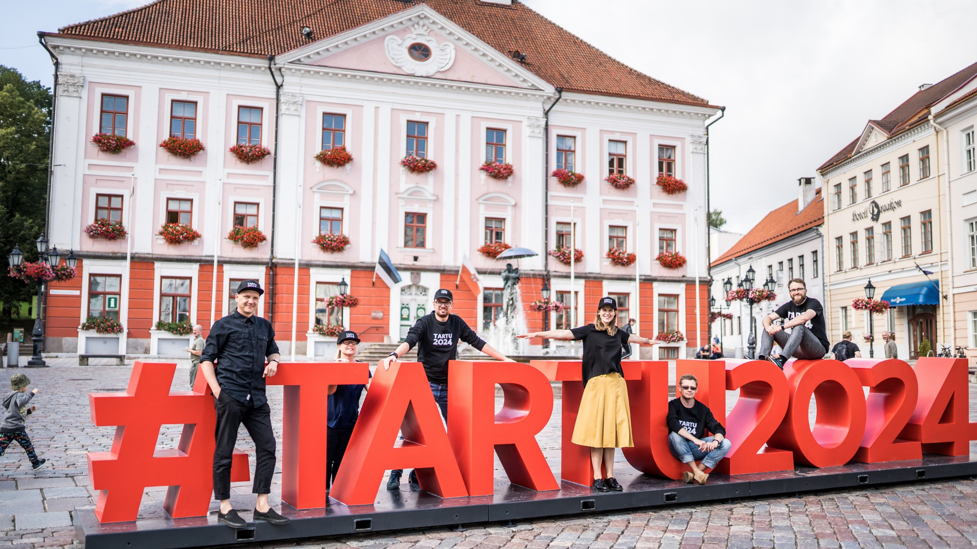
Tartu
European Capital of Culture 2024
Estonia´s 2nd largest city
Population 95,000
1,200 hotel rooms
Distance to Tallinn: 185 km
© Tartu 2024

Slide 27
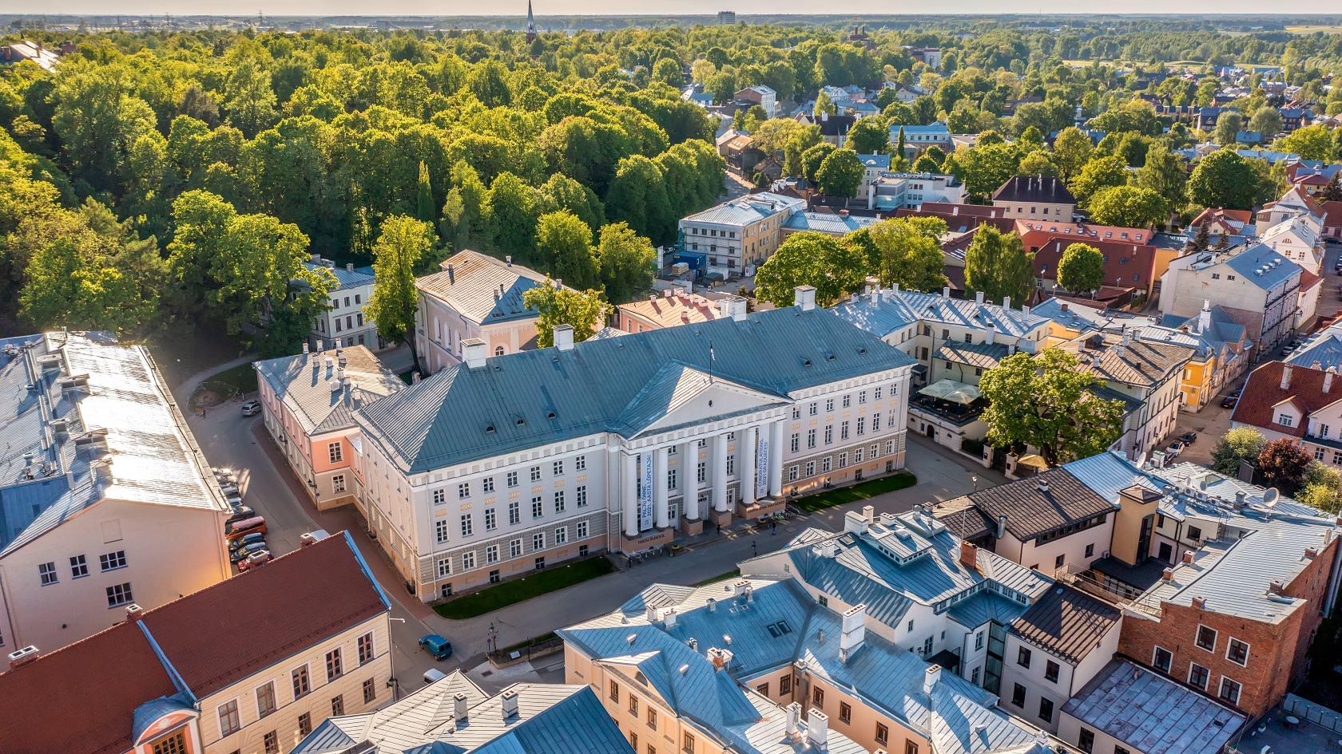
Tartu the university city
attracts conferences related to scientific and medical fields
11 educational & research institutions
Tartu University (1632) ranks among 1% best universities in the world
© Visit Tartu

Slide 28
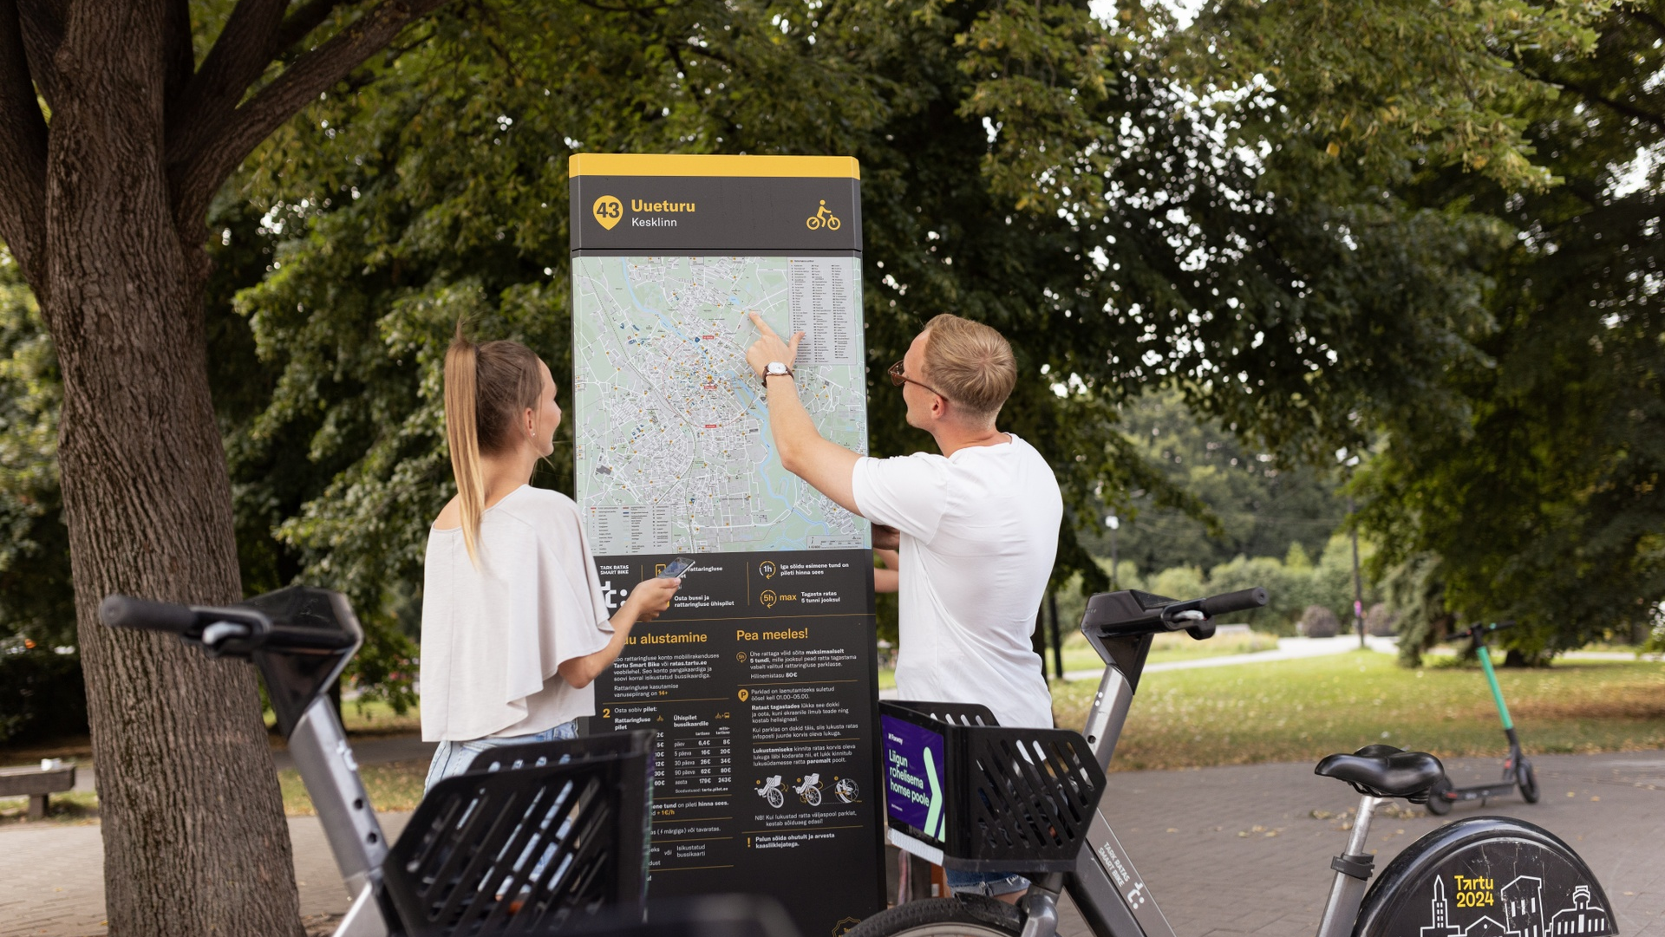
Tartu smart city
smart bike share with electrical bicycles
old apartement buildings turned into zero energy smartovkas
© Renee Altrov

Slide 29
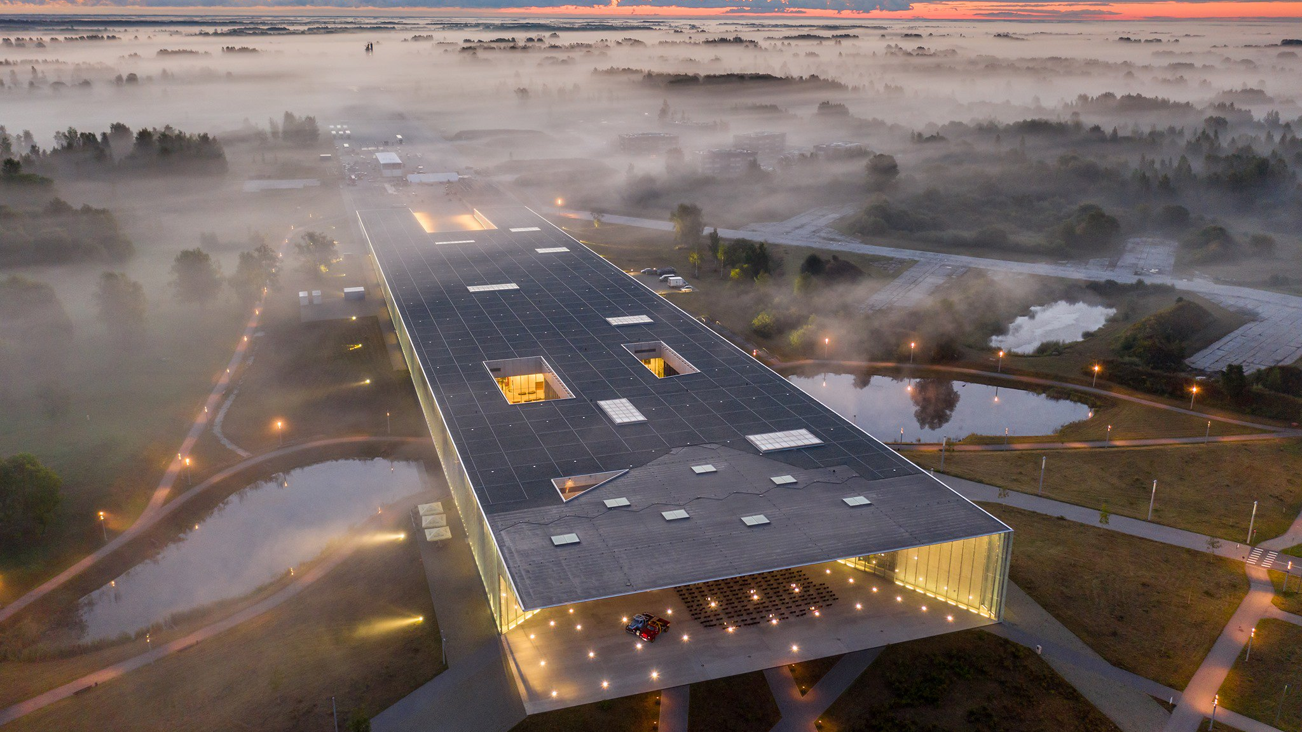
Tartu – home to Estonian National Museum
the largest museum in Estonia with nearly 6,000 m² of exhibition space
discover the everyday life of Estonians
learn about the life of the Finno-Ugric people
© Simo Sepp

Slide 30
Pärnu

Slide 31
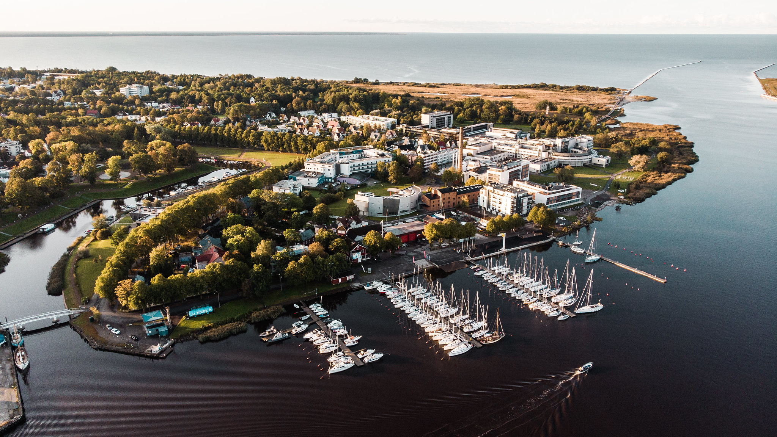
Pärnu the green summer capital
population 40,000
spa traditions since 1838
distance to Tallinn: 130 km
2, 500 hotel rooms
excellent networking activities
© Priidu Saart

Slide 32
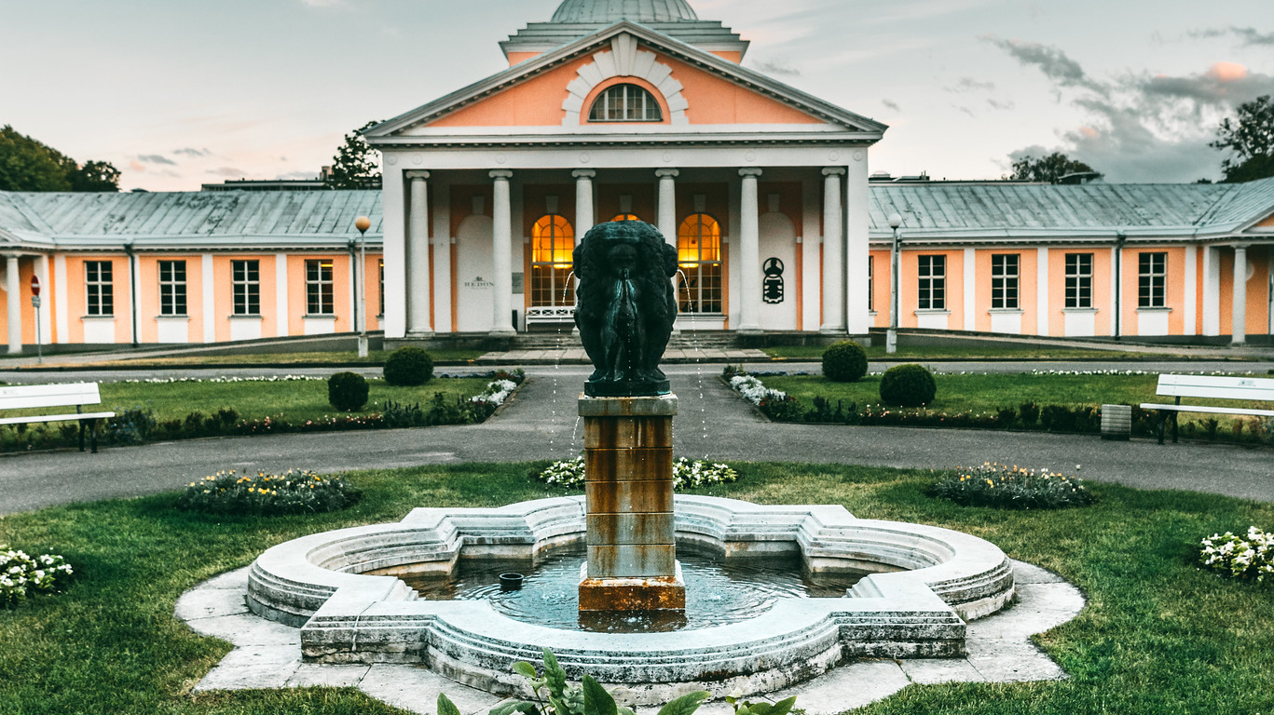
Pärnu the resort town
most of the hotels have spa facilities
© Karlis Buskevics

Slide 33
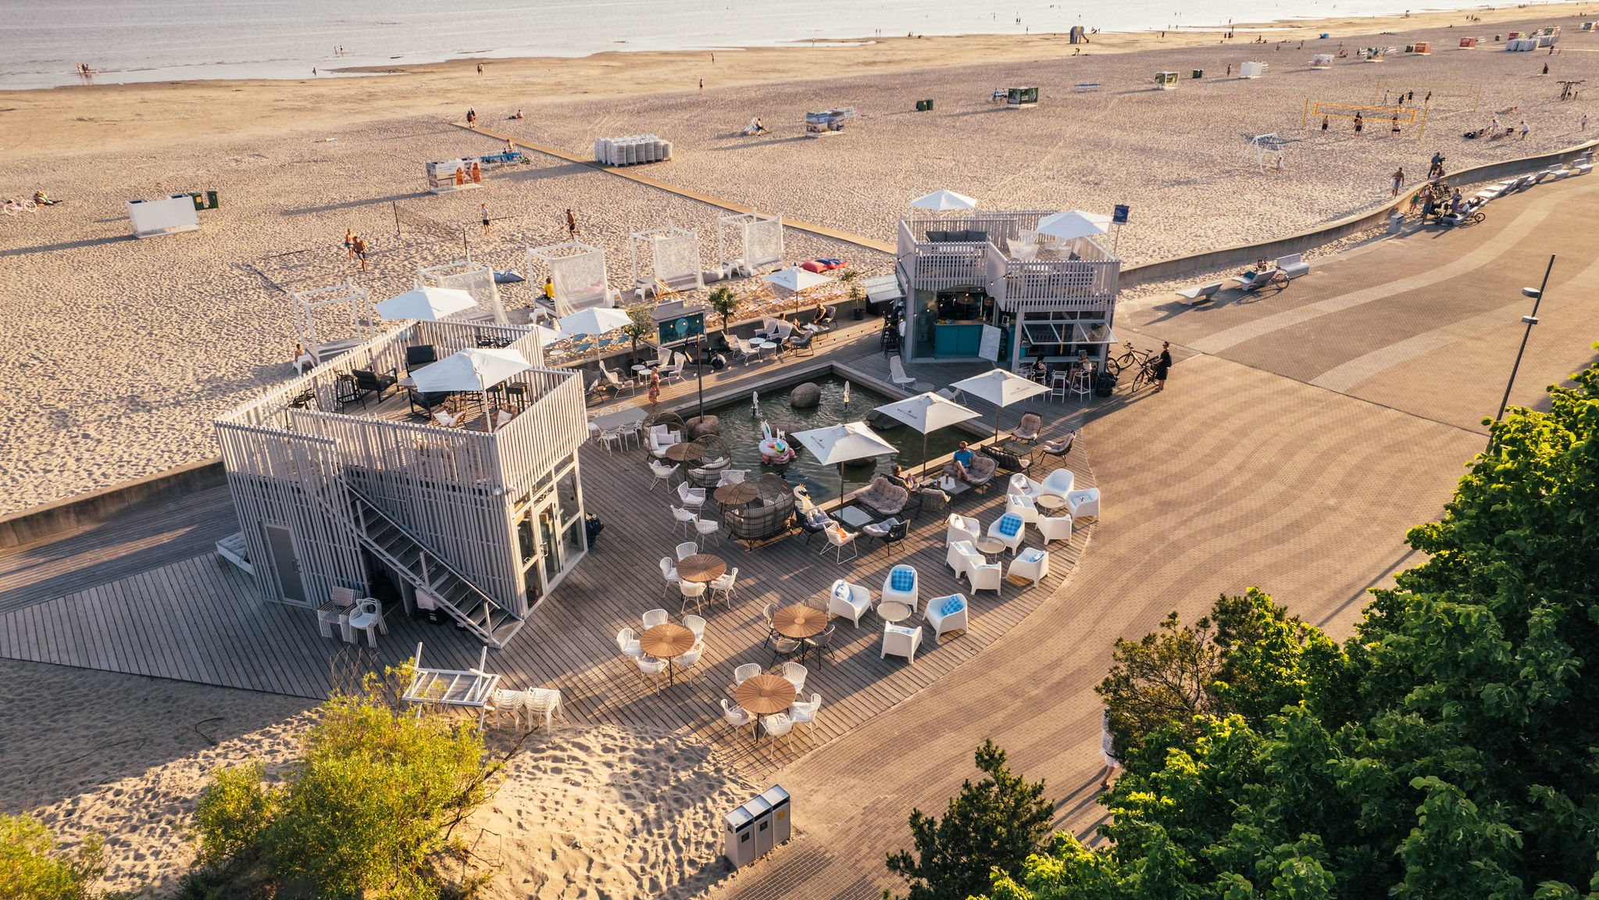
Pärnu where summer never ends
long sandy beaches
beachside bars and cafes
© Henri Holland

Slide 34
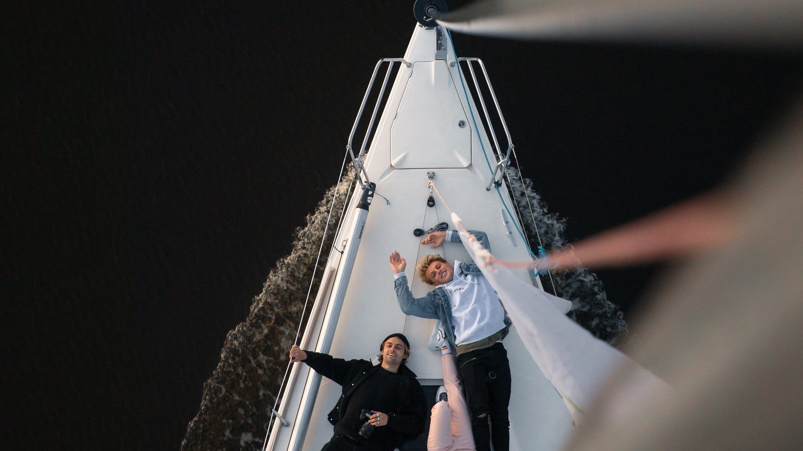
Pärnu pick your favorite water involved activity
fishing
sailing
kite surfing
SUP boarding
swimming
© DreamBeachMedia, Visit Pärnu

Slide 35
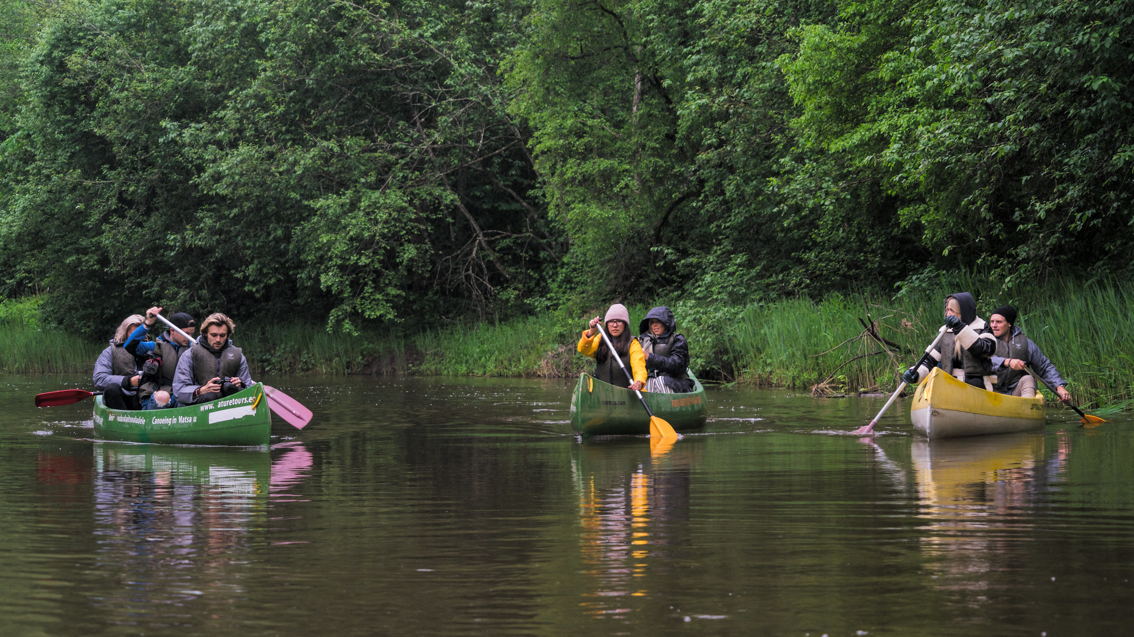
Pärnu pick your favorite water involved activity
fishing
sailing
kite surfing
SUP boarding
swimming
© Innervisionteam, Visit Pärnu

Slide 36
awe-inspiring unique event venues

Slide 37
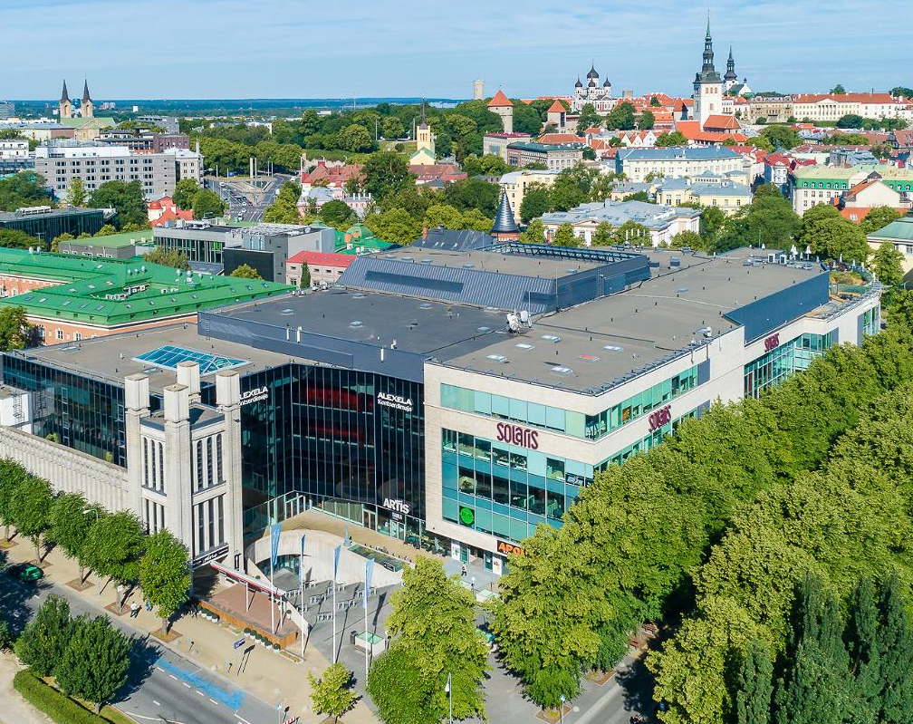
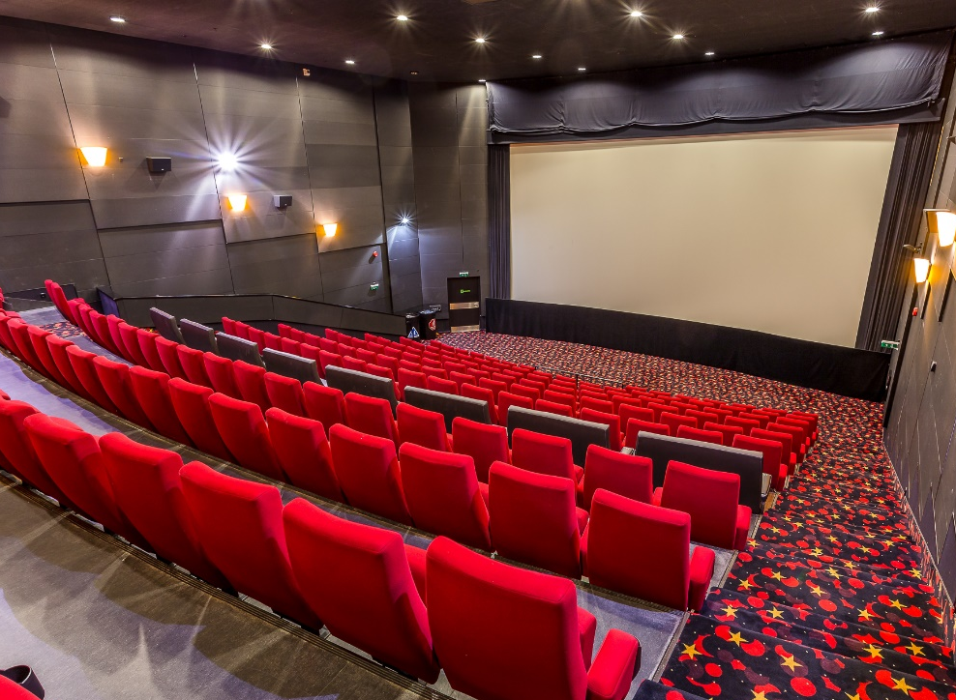
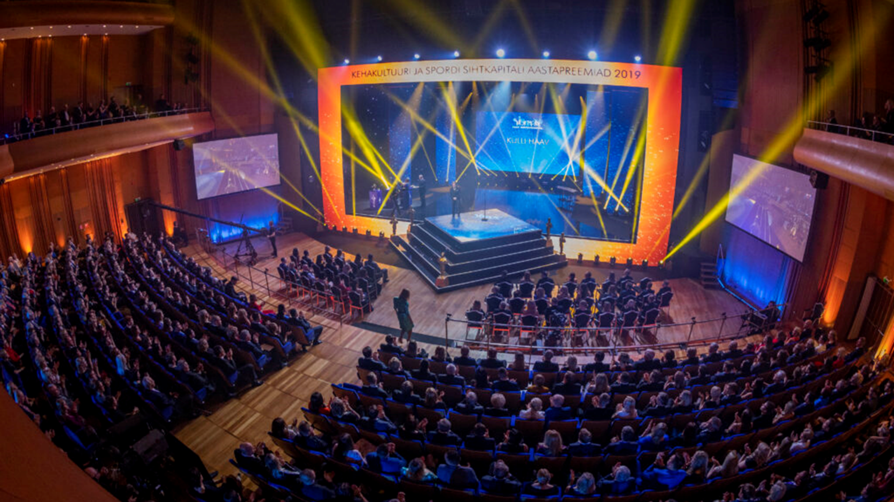
Alexela
Concert Hall
main hall capacity in theatre style: 1829
break out rooms: 9 cinema halls
3 300 m2 of multifunctional foyers
to city centre: in the centre
to airport: 10 min by taxi
Green Key
Our largest venue for conferences
© Alexela Concert Hall

Slide 38
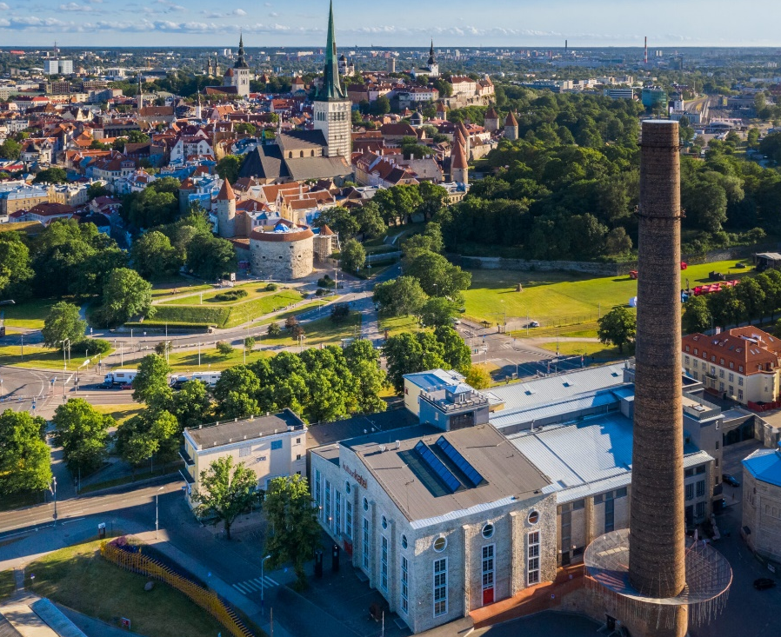
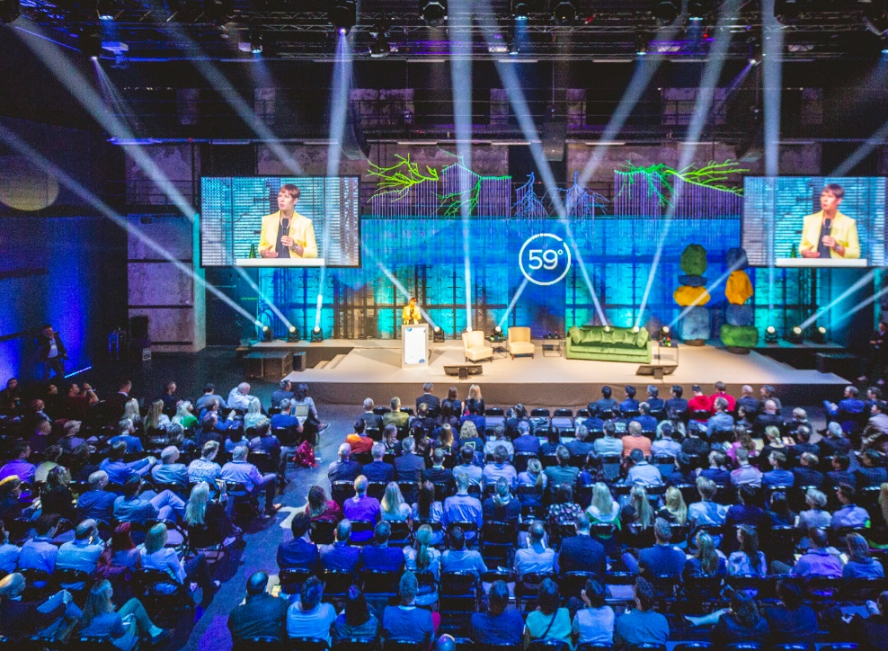
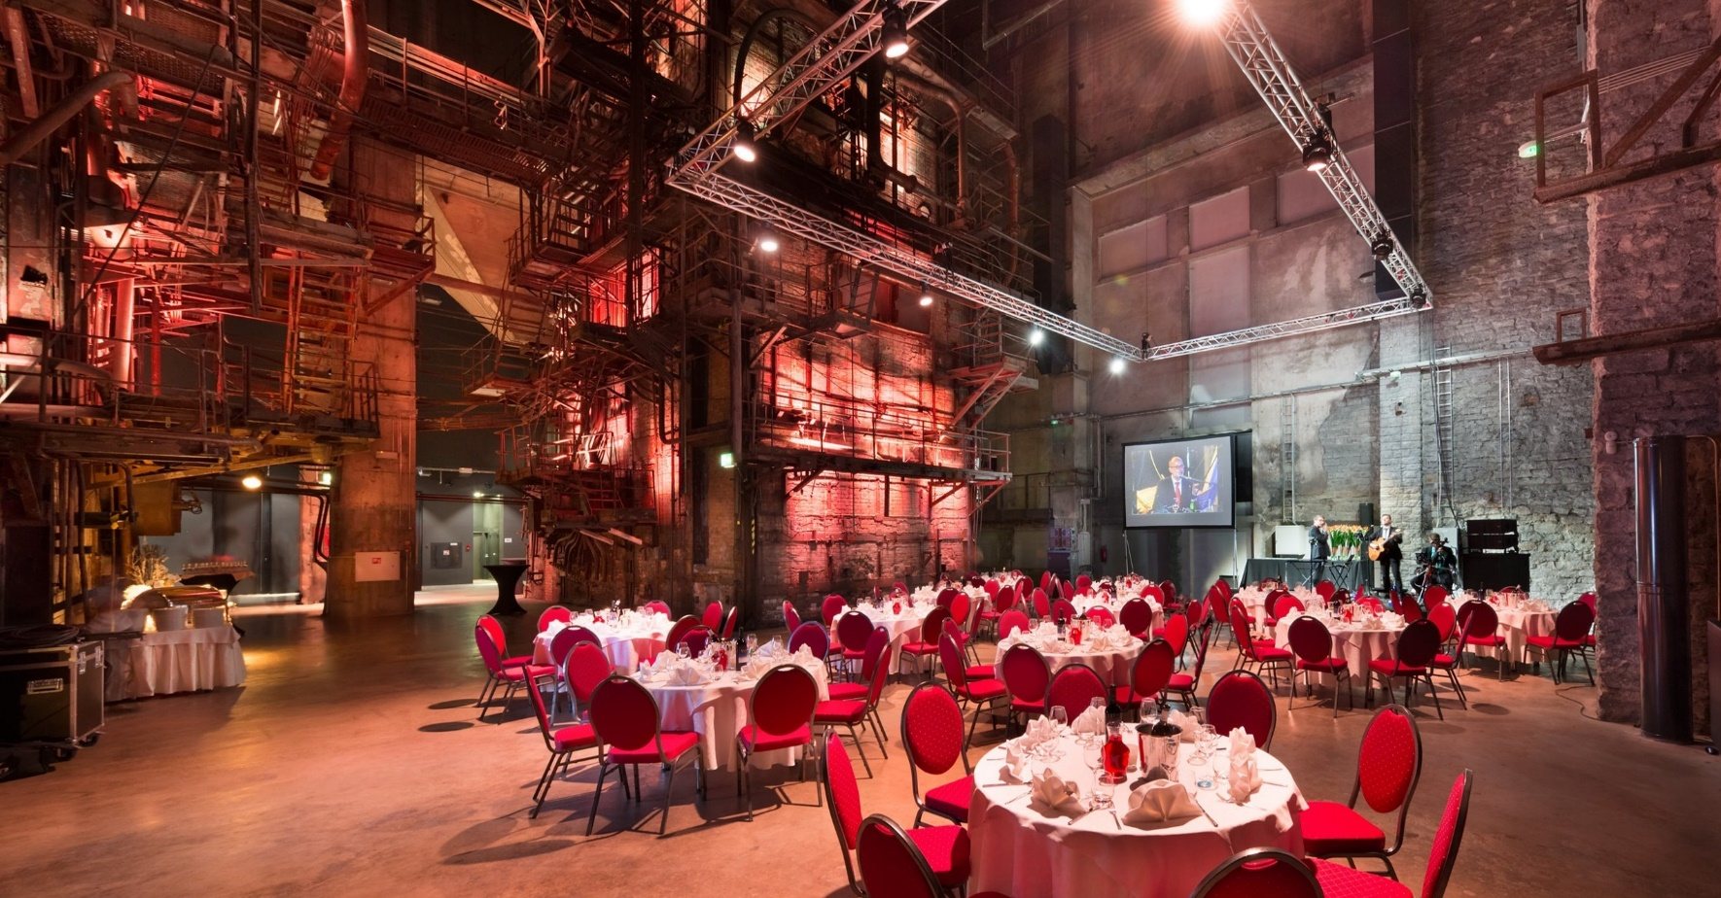
Tallinn
Creative Hub
black box in theatre style: 600
cauldron hall for gala dinner: 170
total number of meeting rooms: 17
to city centre: 14 min walking
to airport: 18 min by taxi
Green Key
A historic power station turned into a multifunctional event venue
© Tallinn Creative Hub

Slide 39
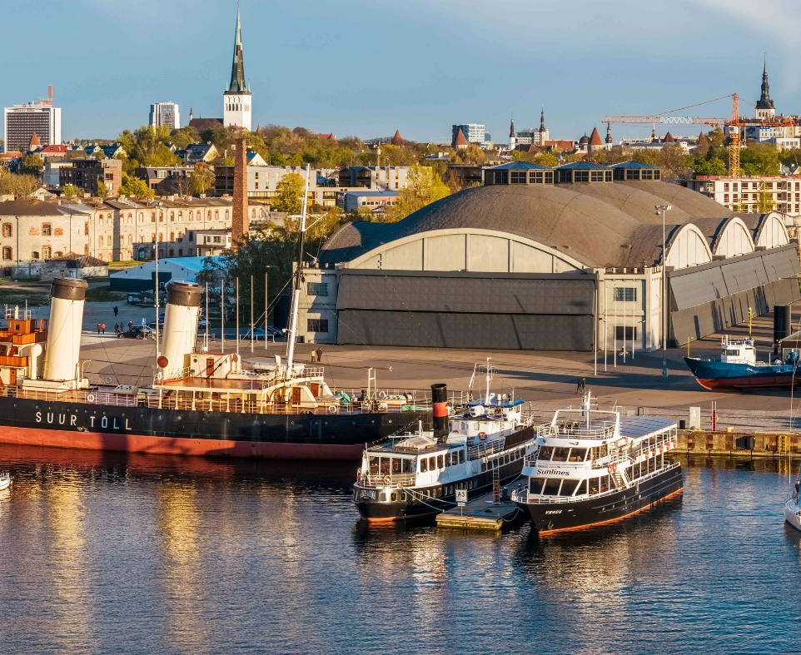
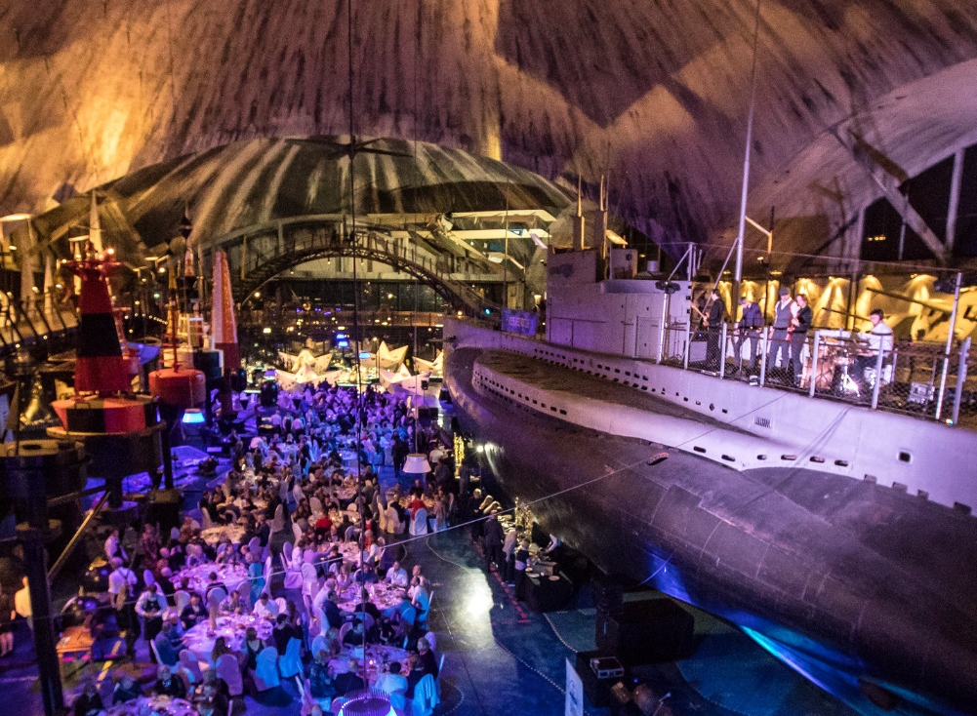
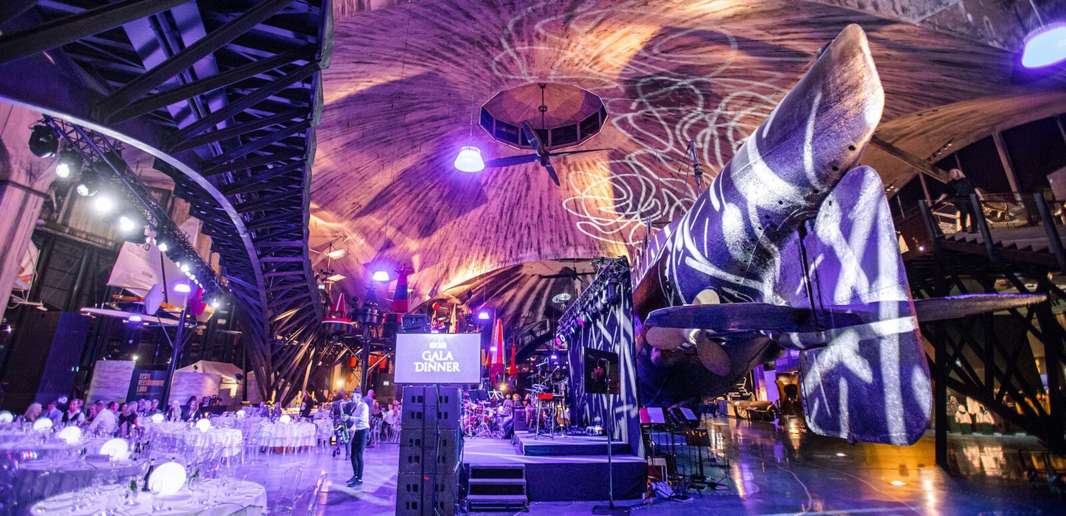
Seaplane Harbour
receptions: 1500
seated gala dinners: 700
to city centre: 30 min walking
to airport: 18 min by taxi
The most exciting maritime museum in Northern Europe
© Seaplane Harbour Maritime Museum

Slide 40
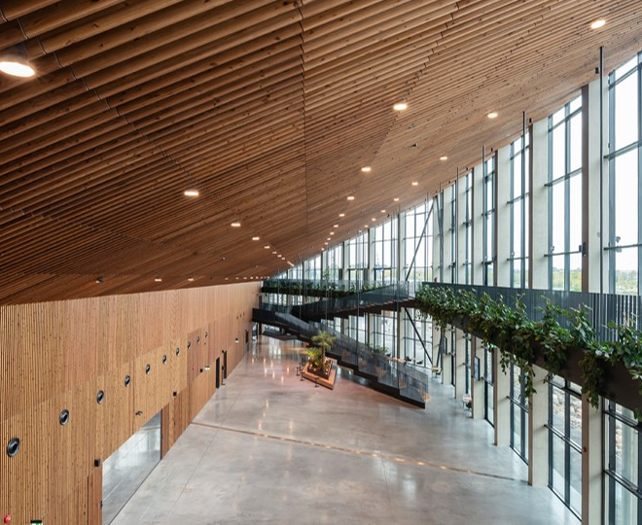
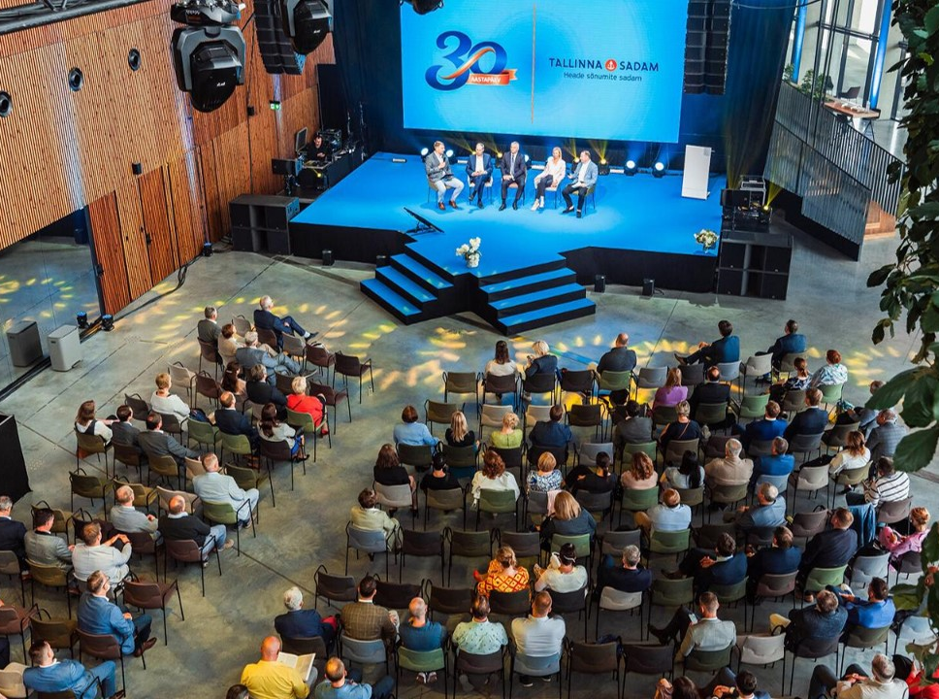
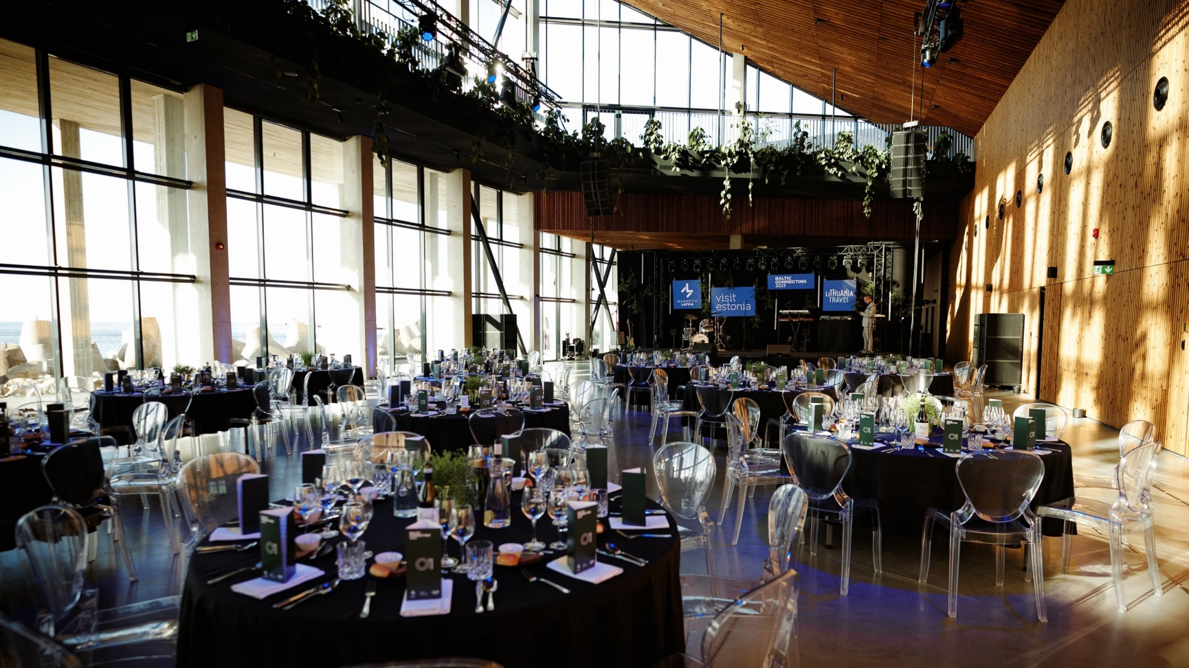
Port of Tallinn Cruise Terminal
total area: 1724 m²
total number of meeting rooms: 3
receptions: 1400
theatre style: 800
seated gala dinner: 740
to city centre: 21 min walking
to airport: 17 min by taxi
Green Key
Light-filled and spacious seafront venue
© Port of Tallinn Cruise Terminal

Slide 41
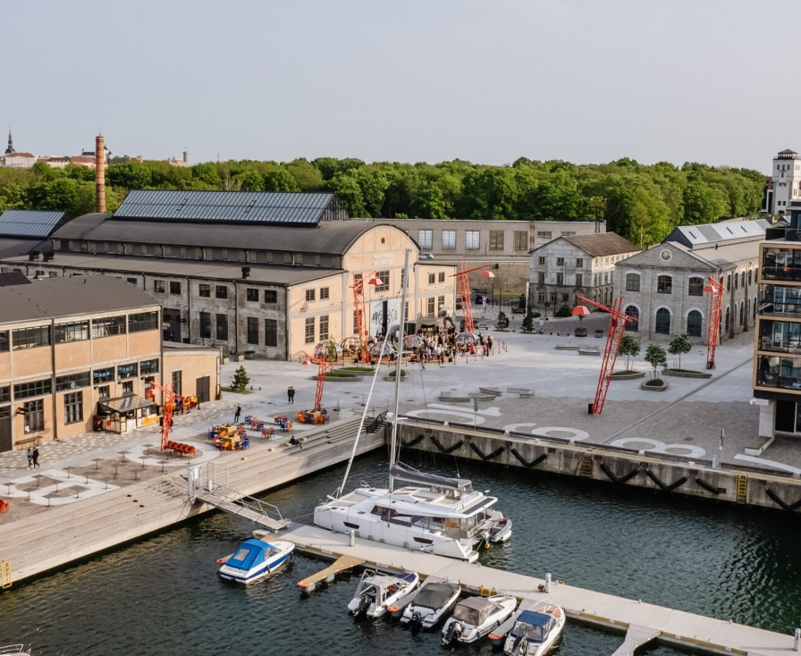
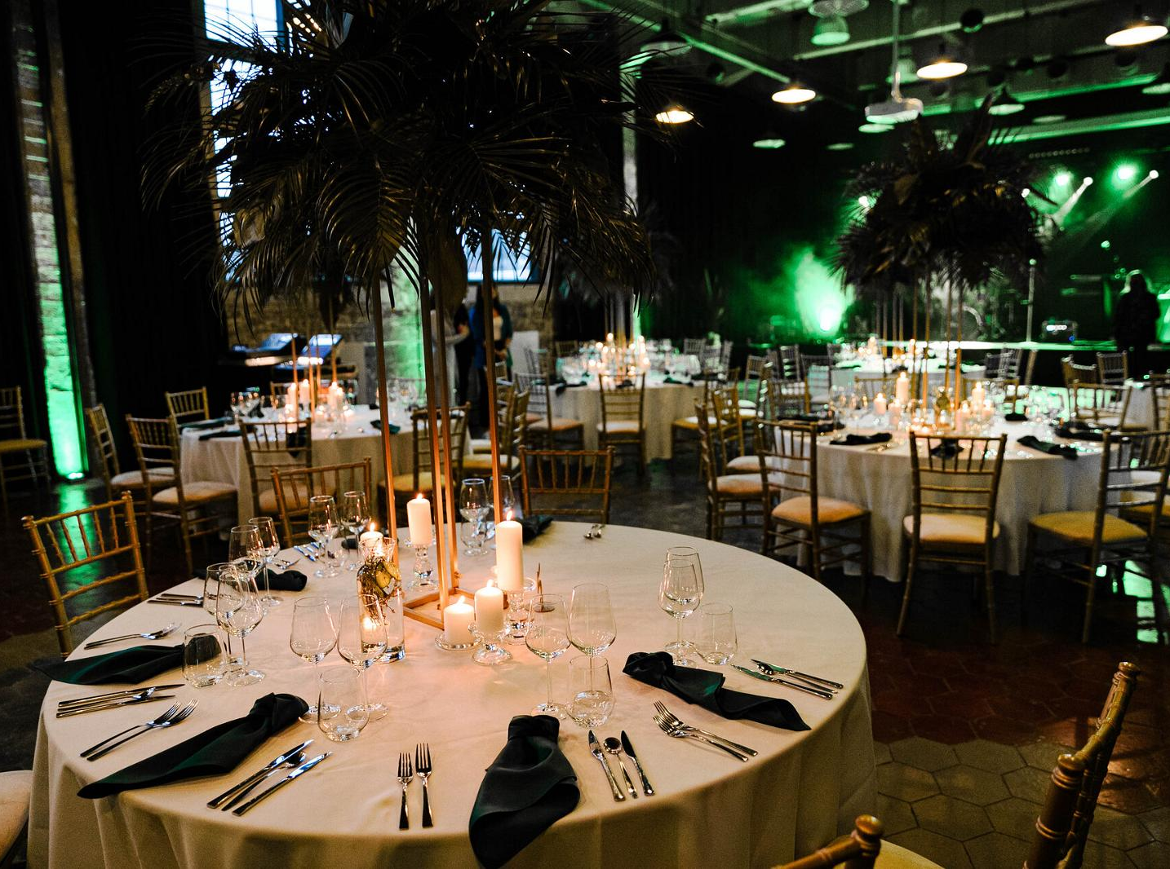
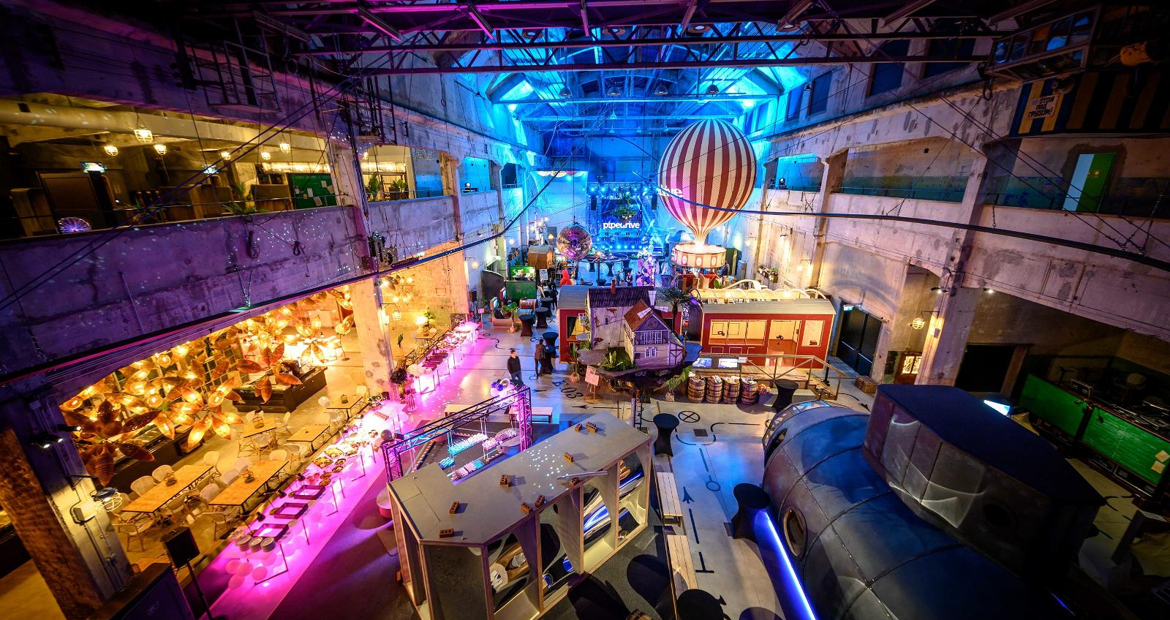
Proto Invention Factory
total number of meeting rooms: 6
receptions: 600
theatre style: 220
seated gala dinner: 200
location: Noblessner port district
to city centre: 21 min walking
to airport: 17 min by taxi
Green Key
Former submarine shipyard is now full of virtual reality discoveries and inventions from 19th-century
© Proto Invention Factory

Slide 42
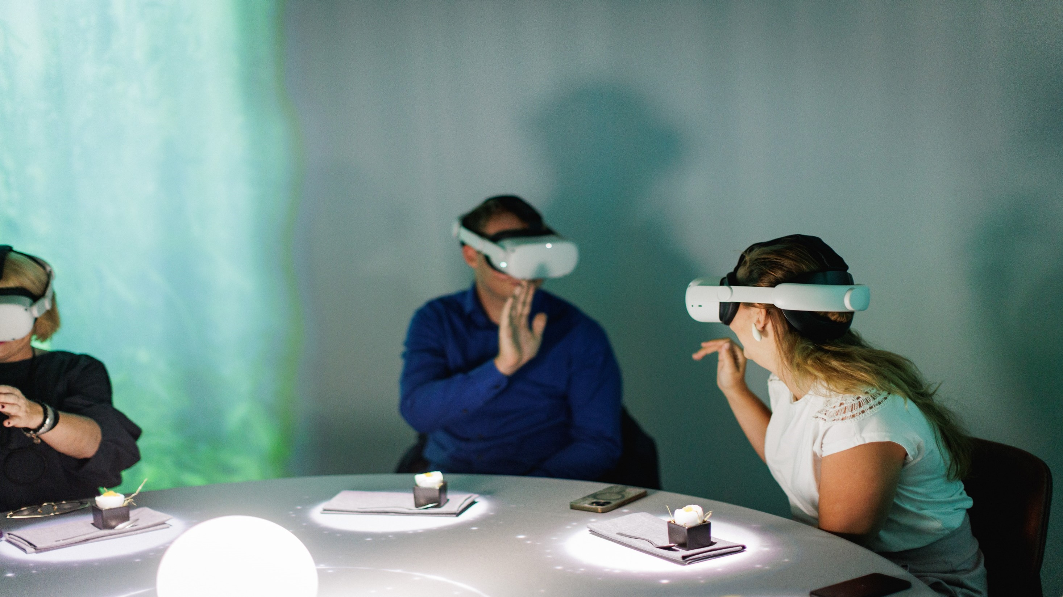
Proto Invention Factory
VR dinner experience
4-course journey through the flavours of Estonia
capacity 40 guests
© Proto

Slide 43
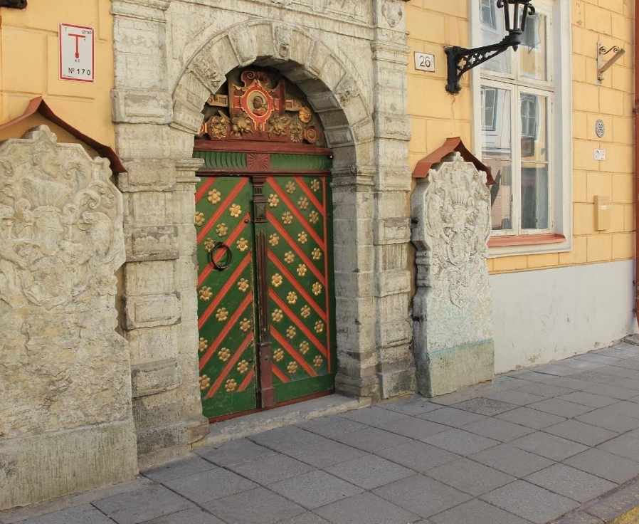
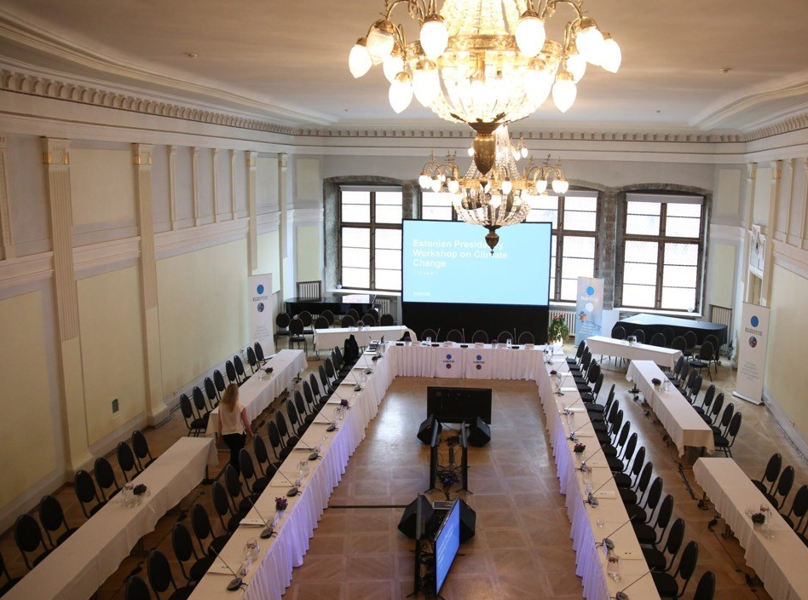
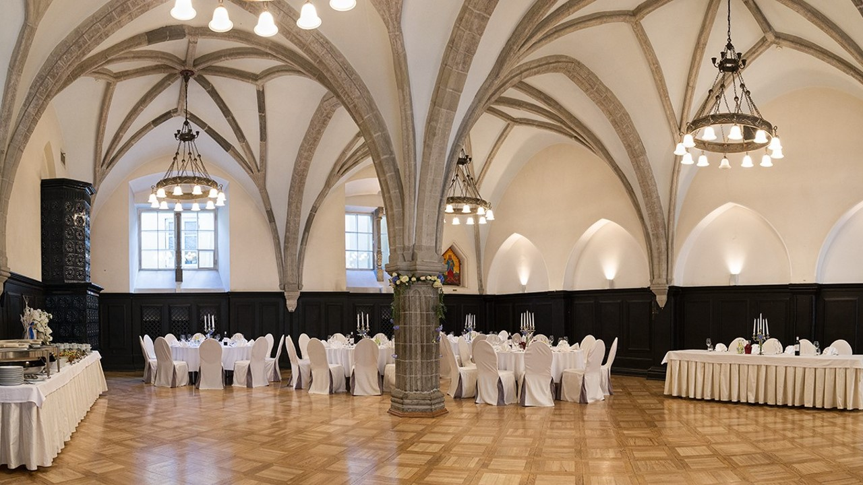
House of Brotherhood of Blackheads
total number of unique rooms: 8
receptions: 400 + 180
seated gala dinner: 200+90
location: Tallinn Old Town
to city centre: in the centre
to airport: 17 min by taxi
Historical guild for unmarried merchants and shipowners
© House of Brotherhood of Blackheads

Slide 44
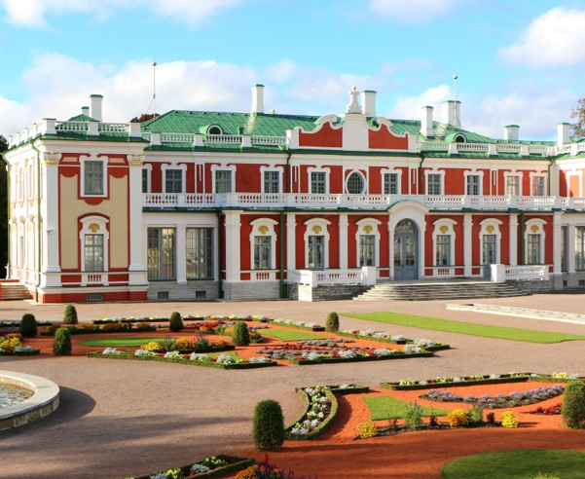
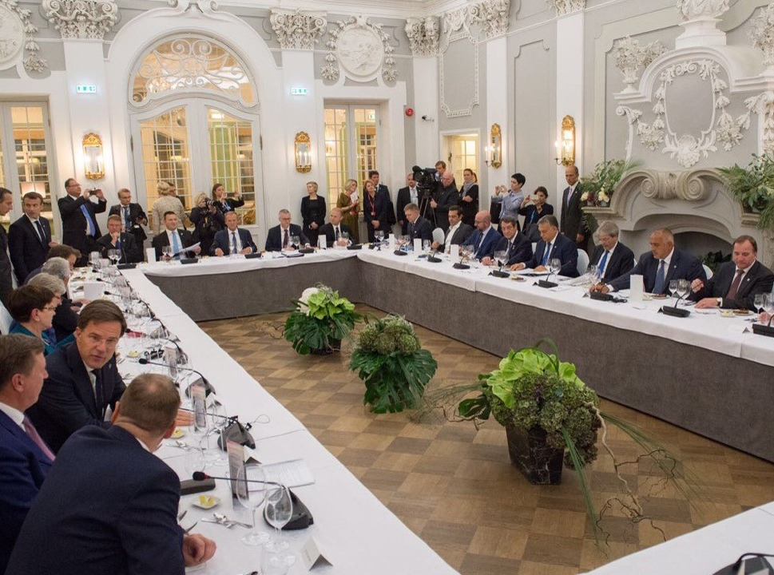
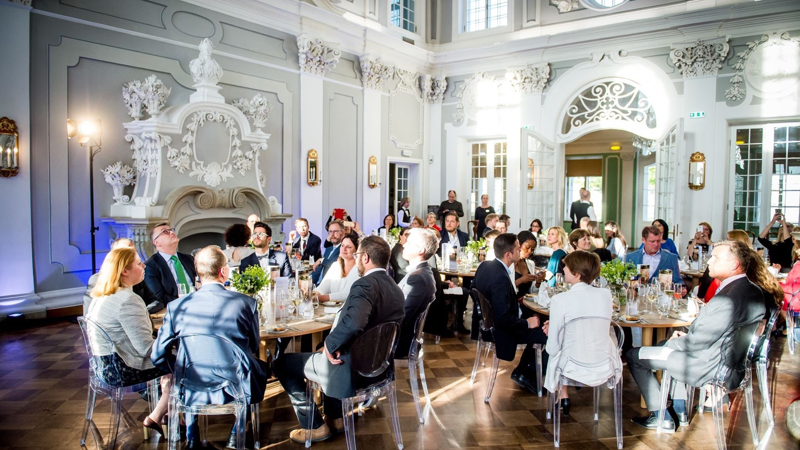
Kadriorg Palace Art Museum
The only Baroque palace and park ensemble in Estonia built in 1718
total number of unique rooms: 8
receptions: 100+150
board: 50+25
location: Kadriorg district
to city centre: 36 min walking
to airport: 12 min by taxi
Kadriorg Palace Art Museum

Slide 45



Fotografiska Tallinn
Satellite gallery of Stockholm’s renowned Fotografiska photography museum
total number of unique rooms: 2
receptions: 400
theatre: 260
Seated gala: 130
location: Telliskivi Creative City
to city centre: 20 min walking
to airport: 20 min by taxi
© Visit Tallinn, Kaupo Kalda, Fotografiska

Slide 46

Club of Different Rooms
located in Telliskivi Creative City
equipped with an extensive multimedia system
green-screen studio
reception 250 guests
theatre 150 guests
© Club of Different Rooms

Slide 47
excellent quality business-class hotels

Slide 48

recently renovated hotels
© Tallink Hotels

Slide 49



spacious rooms, great value for money
wide range of 3-5 star hotels
from international chains to boutique properties
7,600 hotel rooms in total in Tallinn
plenty of Green Key hotels
© Mövenpick Hotel Tallinn, Radisson Blu Hotel Olümpia, Nordic Hotel Forum

Slide 50

boutique hotels in Tallinn old town
© Nunne Boutique Hotel

Slide 51



modern meeting facilities in hotels
up to 530 guests theatre style;
breakout rooms for parallel sessions
© Hilton Tallinn Park, Swissôtel Tallinn, Mövenpick Hotel Tallinn

Slide 52

many hotels have spa or relaxation area

Slide 53













ECB member hotels

Slide 54
mouthwatering restaurants for all flavour seekers

Slide 55



Michelin star fine dining restaurants
restaurant capacity: 40 seats
Michelin: two stars
prebookings only
style: international & fusion
interior: sea view
location: Noblessner district,
to city centre: 10 min by car
180° by Matthias Diether restaurant
© Lauri Laan

Slide 56



street food restaurants
restaurant capacity: 32 seats
style: streetfood
interior: locomotive
location: Telliskivi Creative City
to city centre: 15 min walking
Locomotive restaurant Peatus
© Peatus restaurant

Slide 57



medieval feast at rich merchant’s home
restaurant capacity: 300 seats
floors: 3
private floor: 80 seats
style: medieval feast
interior: authentic medieval
location: Tallinn old town
Olde Hansa restaurant
© Olde Hansa restaurant

Slide 58



zero waste dinner
restaurant capacity: 80 seats
Michelin: Green star
style: zero waste, international
interior: rooftop
location: Telliskivi Creative City,
to city centre: 15 min walking
Fotografiska restaurant
© Fotografiska, Lauri Laan

Slide 59



located in reused industrial buildings & districts
restaurant capacity: 90 seats
Michelin: Bib Gourmand
style: modern classics
interior: industrial
location: Noblessner port district
to city centre: 10 min by taxi
Lore Bistro
© Peatus restaurant

Slide 60
extraordinary group activities

Slide 61

medieval legends walking tour
location:Tallinn Old Town
duration: 2h
group size: max 50
type: sightseeing with costumed performance
© Estonian Convention Bureau

Slide 62

treasure hunt city game
location:Tallinn Old Town
duration: 2h
group size: 10-700
season: all year round
type: team building in small groups
© Renee Altrov

Slide 63

food sightseeing tours
location:Tallinn city or North Coast
duration: 4 h
group size: 6-14, tailored offer for larger groups
season: all year round
type: sightseeing, food, flavours
© Estonian Convention Bureau)

Slide 64

Tallinn bike tour
location:Tallinn
duration: 3-4 h
group size: min 10
season: spring, summer, autumn
type: sightseeing, active, green, bike
© Estonian Convention Bureau

Slide 65


make your own souvenir
© Toomas Tuul
location:Tallinn
duration: 2 h
group size: 5-15
season: all year round
type: workshop, creative, souvenir, Estonian design, zero waste, leather

Slide 66

jewellery workshop with local designer
location:Tallinn
duration: 2 h
group size: 6- 16
season: all year round
type: workshop, creative, souvenir, Estonian design
© New Vintage by Kriss

Slide 67

brewery tour
location:Tallinn city or all over Estonia
duration: 1-2 h
group size: min 6
season: all year round
type: degustation, flavours, drinks, craft beer
© Patrik Tamm

Slide 68

artisan gin distillery tour
location:Tallinn city or all over Estonia
duration: 1-2 h
group size: min 6
season: all year round
type: degustation, flavours, drinks, artisan gin
© Alina Birjuk

Slide 69

hands-on orienteering game with retro jeeps
location: Kõrvemaa (40 min from Tallinn)
duration: 5h incl. transfer
group size: max 100
season: all year round, except extreme weather conditions
type: adrenaline, retro jeeps, off-road, adventure, orienteering
© Hans Markus Antson

Slide 70

rally racing
location: Laitse (45 min from Tallinn)
duration: 5h incl. transfer
group size: min 6
season: all year round, except extreme weather conditions
type: adrenaline, rally racing, adventure, speed
© Ken Mürk

Slide 71

Porsche experience
location: Audru near Pärnu (1,5 h from Tallinn)
duration: 6h incl. transfer
group size: min 2
season: depending on the weather
type: adrenaline, rally racing, adventure, speed, Porsche car
© Marko Lõhmus

Slide 72

bogshoe walk
location: outside of Tallinn
duration: min 3 h including transfer
group size: min 6
season: all year round, except from April 23 til June 23
type: bogshoe, nature, hiking, wetlands, forest, wooden path, view tower
© Patrik Tamm

Slide 73

wellness and yoga
location: all over Estonia
duration: min 1 h
group size: min 4
season: all year round, outside in the nature from May until September
type: nature, wellness, yoga, SUP board, bog lake
© Hans Markus Antson

Slide 74

surprise choire concert in the bog
location: all over Estonian
duration: part of nature hike, max 10 min
group size: min 4
season: all year round
type: nature, surprice, concert, choir, music, singing nation
© Alari Teede

Slide 75

pop-up forest restaurant
location: all over Estonian
duration: 1-2h
group size: max 15
season: all year round
type: nature, picnic, lunch, pop-up restaurant, forest restaurant
© Ken Mürk

Slide 76

e-fatbike tours
location: all over Estonia
duration: min 3 h including transfer
group size: min 10
season: all year round
type: nature, bike, electrical, fatbike, sightseeing
© Toomas Tuul

Slide 77

golf
location: all over Estonia
duration: min 3 h including transfer
group size: min 2
season: all year round
type: nature, golf
© Riku Kylä

Slide 78

cooking classes
location:Tallinn city
duration: 4 h
group size: 6-14, tailored offer for larger groups
season: all year round
type: sightseeing, food, flavours
© Ken Mürk

Slide 79

igloo sauna & wild swimming
location: Noblessner district
duration: 2 h
group size: 6-10, tailored offer for larger groups
season: all year round
type: sauna, igloopark, ice swimming, wild swimming
© Iglupark

Slide 80

Rummu quarry experiences
location: Rummu, 45 min from Tallinn
duration: min 3h incl. transfer
group size: min 6
season: all year round depending on the activity
type: adventure, history, special landscape, old quarry
© Kaupo Kalda

Slide 81

lighted raft tours in Rummu quarry
location: Rummu, 45 min from Tallinn
duration: min 3h incl. transfer
group size: min 6
season: spring to autumn
type: adventure, history, special landscape, old quarry, underwater prison, lighted raft
© Visit Harju

Slide 82

CSR programmes
plant a tree
give a helping hand in local community
charity activities, fundraisers
nature cleaning hikes with educational information
© Visit Estonia

Slide 83


experienced partners at your assistance
Estonian Tourist Board, Visit Estonia
Estonian Convention Bureau
Visit Tallinn Convention Bureau
Baltcoming
Hilton Tallinn Park Hotel
Mövenpick Hotel Tallinn
Nordic Hotel Forum
Radisson Blu Hotel Olümpia
Radisson Collection Hotel, Tallinn
Swissôtel Tallinn
Tallink Silja Line
© Visit Estonia

Slide 84


Thank you!
Dana Noormets
Kadri Karu
dana.noormets@eas.ee
Kadri.Karu@ecb.ee
www.visitestonia.com
www.ecb.ee

