Slide 1
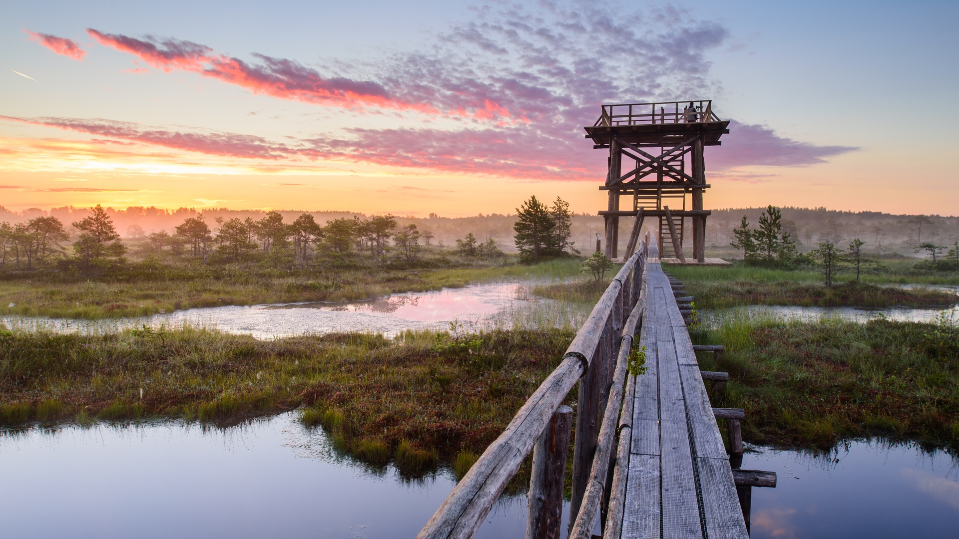
MEET IN ESTONIA
© Sven Zasec

Slide 2
MEET IN TALLINN
Kaupo Kalda

Slide 3
MEET IN TARTU
Kaader.ee/Ragnar Vutt

Slide 4
MEET IN PÄRNU
Priidu Saart, Visit Pärnu

Slide 5
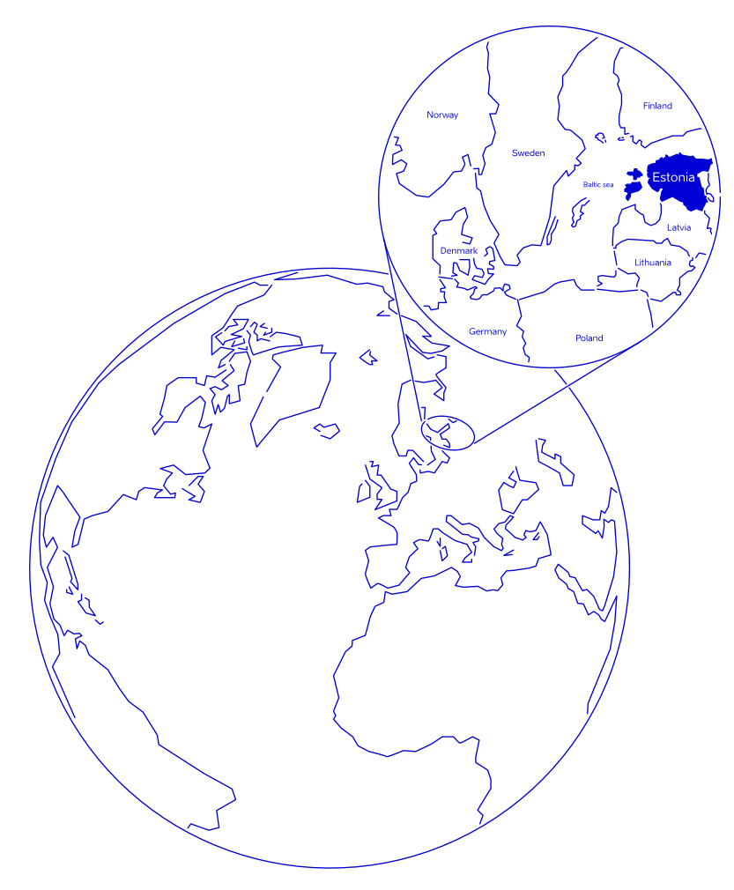
Estonia in a nutshell
population: 1.3 million
currency: EUR
official language: Estonian, English widely spoken
member of: EU, Eurozone, OECD, NATO and Schengen
capital city: Tallinn (450,000)

Slide 6
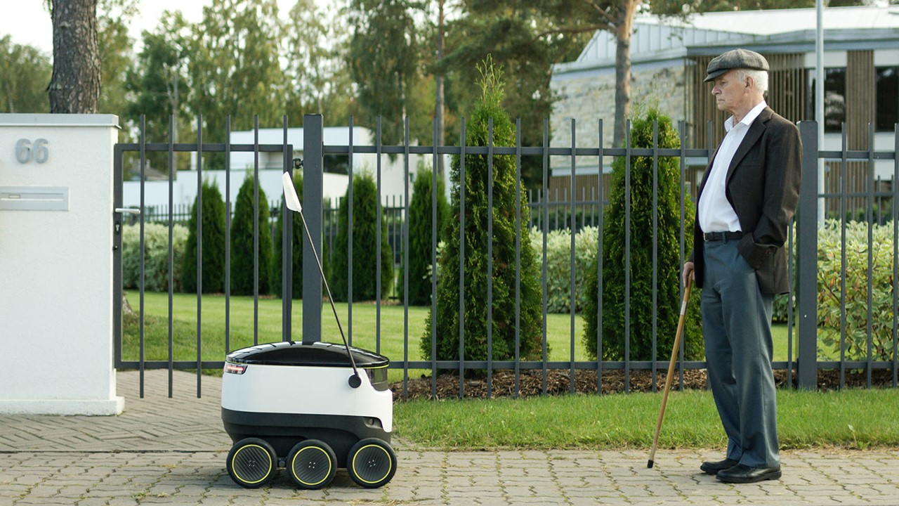
Most advanced digital society in the world
99% of state services are online
electronic ID, I- voting, E-health, E-School, E-Tax
documents signed digitally in seconds since 2002
Estonians have I-voted online since 2005
digital signature saves a 300-meter stack of paper each month
hassle-free e-taxation
e-Residency – Estonian e-services to every world citizen
© Ajujaht

Slide 7
World’s most advanced digital society
starting a business
childbirth
buying
a car
driving
licence
start of
school
unemployment
& job search
marriage
disability
military
service
change of residence
retirement
death (succession)
building
houses
falling victim to an accident
falling victim to a crime
Notes:
The only thing you can’t do online is a divorce
The logic for proactive government services is quite simple: Yes, most of our services are available online, but how about government approaches us to offer them to us when it knows that we are entitled to them? This would also further decrease the burden of bureaucracy for both the people and the state.
The first of these services actually came online in October 2019 – since then, parents automatically get a notification after their child is born to ask them to which bank account they would like their child benefits transferred.
Compared to current e-services, the new seamless services will function automatically and are more user-centred. If the first step of developing e-services meant enabling different systems to communicate with each other, then life-event/business-event services are activated automatically based on the events taking place in a person’s life.
Currently available pro-active services:
Childbirth – In its final form, the service would start when a pregnancy is detected at the clinic by a doctor who then makes the entry to the health registry. This entry triggers family planning services (info, including a partner, benefits planning calculator, etc.), health services for pregnant women, maternity and fraternity leave planning calculator and offers, birth services by the hospital and registration of the new citizen. Parts of this service are already available and offered proactively, like the birth benefit, is offered for the parent after the newly-born is being registered in the population registry, also an only service where the parent can give a name to the child online. This service is a work in progress, but the proactive elements are already there.
Starting a business – An event-logic-based service for starting a business is already available on the entrepreneur portal. The service combines the company registration process, applying for the VAT nr and registration of employees. By the end of 2021, the government is developing the service to make it available from eesti.ee and include services like applying for various business permits.
Proactive services, that are currently planned or in development:
Becoming a pensioner – this is the first life-event service that will be fully implemented and piloted. At least 6 months before reaching the retirement age a person would receive an offer from the government to the eesti.ee portal about this life event occurring. The offer will layout various paths regarding their pensions savings, will give a total amount of what the person will be receiving from the state as an old-age pension. On that life-event page, a person could also either postpone the pension (continue working) or apply for an early leave. The citizen will go through the planning within a single interface, but in the back, at least four institutions are offering more than six services services.
Change of residence (moving, selling or buying property) or building houses – as these life-events usually mean plenty of paperwork, especially building, so being able to handle them in a single gateway saves time, and being up to date in real-time how far the administrative process is, should also save some nerves.
Driving license and buying a car – this service will gather application for driver licenses, change of licenses, health-related documentation regarding licenses, vehicle ownership and the change of ownership into a single source.
Military service – as the service is mandatory for most men in Estonia, every year more than 3000 citizens encounter this life-event. Here we have gathered the information regarding the service as well as the application process, so from the first info letter about a youngster being listed, an invitation to medical examination, expressing preferences regarding the type of service, etc. This also includes the services needed while being in the service and after the service, in the reserve.
Most difficult services to develope:
Marriage – the first life-event based service launched for two persons to express their intention to get married digitally, also decide upon the date, who will carry whose name, the marital assets agreement and then only show up on the designated date to say „I do“. On that date, the person whose name changed will get the new ID-card and other documents already made to the new name since the agencies invovled already knew the change was about. As there was a need to fundamentally change the family law, the amendmends were previously passed in Estonia’s Parliament and service came to effect in December 2022.
Death of a close one – also falls to the difficult category, because of legal challenges and multiple stakeholders / rooted processes. At the moment the state issues the death certificate, digitally of course and at the same time makes the necessary registration to the population registry. Local government is also involved with funeral subsidy and the burial place, then the private sector offers burial related services – each of these stakeholders use a different system, so for the person handling the event, it seems fragmented and complicated. Life-event of this mournful case should make it easier to fulfill the wishes of the one who left (burial grounds, ceremony, etc.), to handle the paperwork regarding the funeral and aid offered by the local municipality, and offer the private companies their way in as well. As we want this service to be as intuitive as possible for the citizen, it will take more time to figure out the most effortless and painless route.

Slide 8
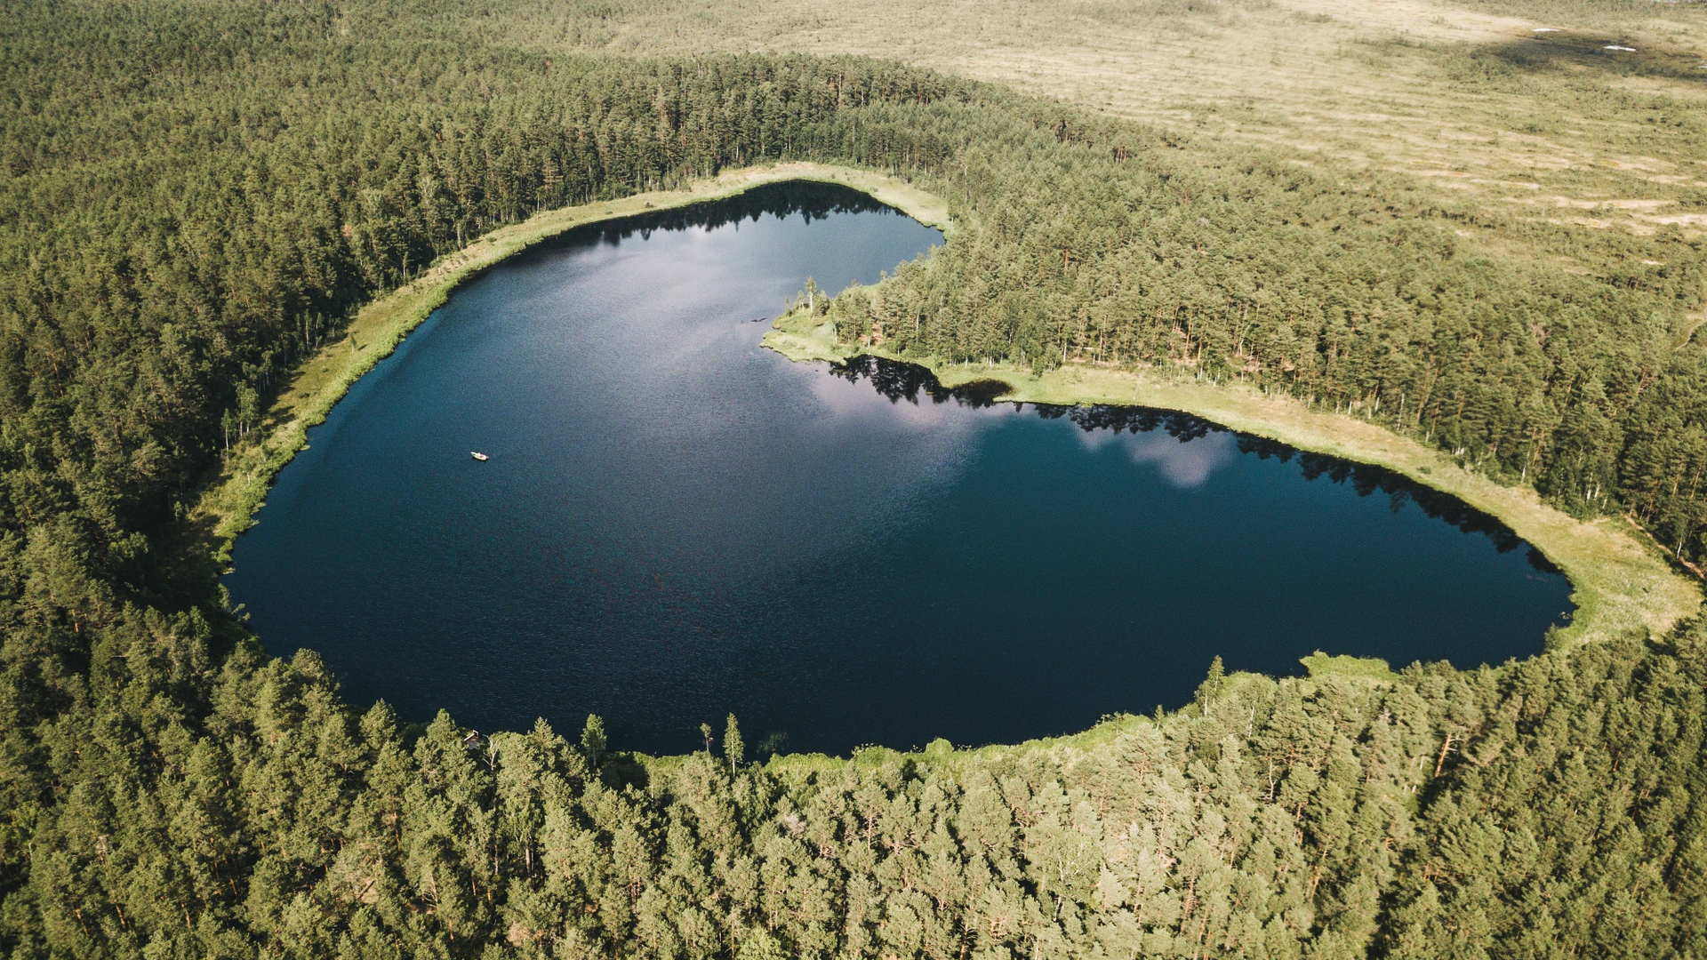
Living Green
Ranked the world’s most environmentally friendly country by the Environmental Performance Index 2024,
70% of the country covered by wilderness (forests, wetlands)
Cleanest air in the world
15-minutes cities, walkable distances
Green Certified hotels, venues and suppliers
#4th in global sustainability travel index
© Priidu Saart

Slide 9
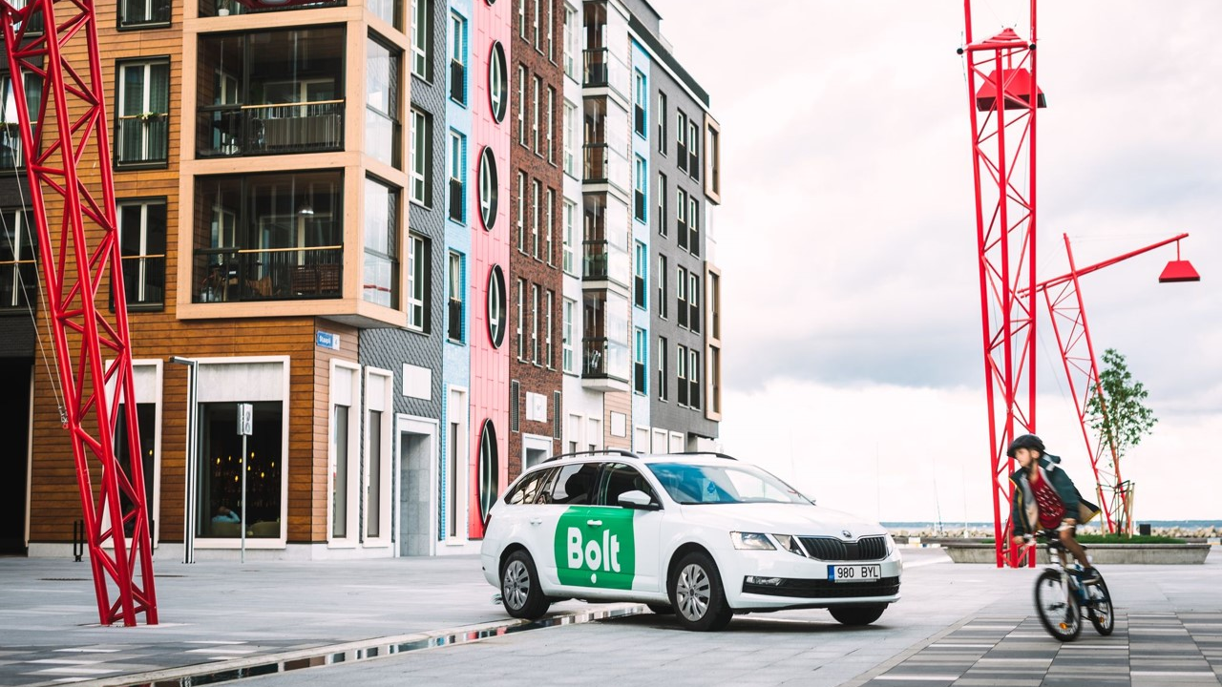
Land of startups
1500+ startups
10 unicorns - #1 per capita in Europe
raised around € 4B in funding since 2010
Estonian Startup Visa & Scale-up Visa
supportive ecosystem
Nordic Deep Tech Valley
© Bolt

Slide 10
Leading HUB of innovation
Estonia’s compact size and innovative spirit makes it the perfect testbed for new projects. Estonia invites anyone around the world to come and build or test their groundbreaking new ideas, prototypes, products or whole new digital services, in a world-leading digital government setting.
© Bolt, Auvetech, Renee Altrov

Slide 11
Key sectors of excellence
‘the most advanced digital society in the world’ by Wired
the first country in the world to offer
e-residency
Europe’s leader in cybersecurity,
home to NATO Cyber Defense Centre
Europe’s leading
startup nation
Europe’s leader in
Digital Health
one of the world’s most open and competitive business environments
attractive environment
for research and development
Europe’s leader in education OECD PISA Tests 2022
one of the world’s cleanest AIR
EUROMONITOR 2023
#4 sustainable travel index

Slide 12
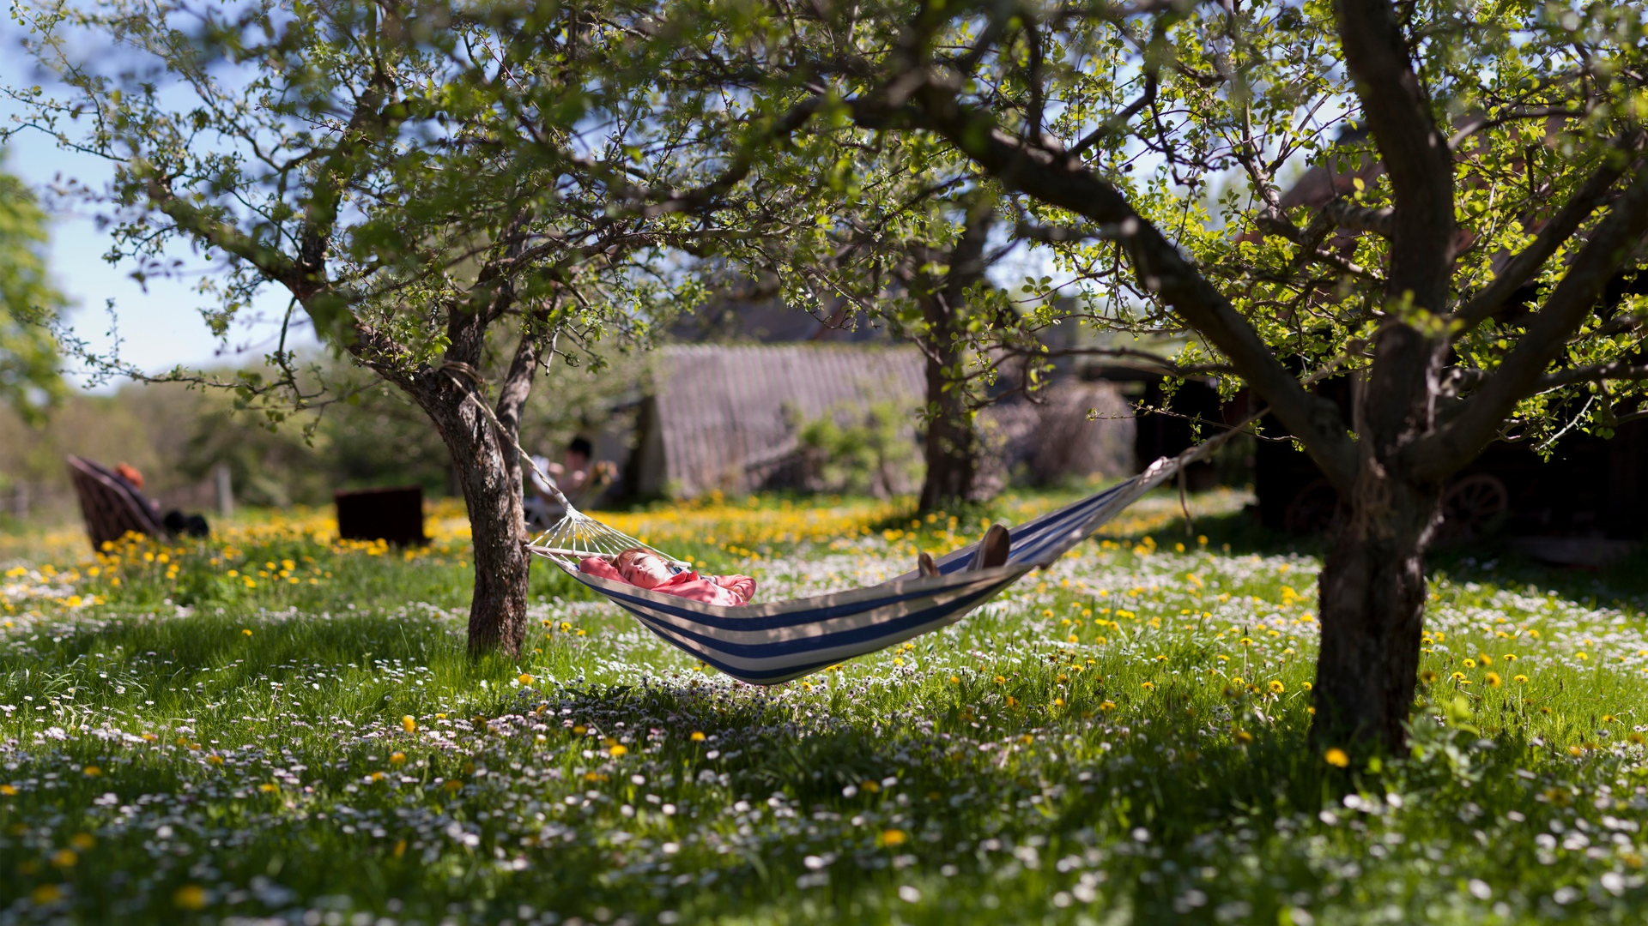
Easy organising
Schengen Visa Zone Country
Euro as a currency
Nordic work culture , tech-savvy mindset
can-do attitude and flexible solutions
English widely spoken
no hidden costs
promises are kept
no bureaucracy
© Renee Altrov

Slide 13
Good value for money
5-star quality at 4-star prices

Slide 14
Why Estonia for international conferences and incentive events?
new and fresh destination in Europe
world’s leading digital society
key sectors of excellence including e-Health
Estonian Health Tech Cluster & vibrant startup scene
cosy and compact with easy logistics
excellent quality business hotels
multifunctional unique event venues
amazing food (seasonal, local, short-travelled)
great value for money
easy organising: euro as a currency, English widely spoken, Nordic business culture
green and clean, sustainability is a way of life
Tartu European Capital of Culture 2024

Slide 15
Local support for conferences
Tallinn City
Estonian Business and Innovation Agency
support sum max 30,000 euros
minimum estimated international delegates 75/120 depending on the month
duration min 2 consecutive days
free public transportation for conferences and events in Tallinn
support sum 15,000 - 30,000 euros, max 70 % of the total costs
minimum 100/200 international delegates depending on the city/location
duration of the conference program at least two consecutive days
Notes:
VAHETADA ÄRA EASI logo: uus logo asub aadressil: https://brand.estonia.ee/eis/

Slide 16
Conference calendar
© Bolt
Our Conference Calendar at www.ecb.ee features a comprehensive list of international association conferences held annually in Tallinn, Tartu, Pärnu and beyond. Browse through to find inspiration and see how other organisations have successfully hosted their events in Estonia.

Slide 17
Main cities for events
Tallinn, the capital city
Tartu, European Capital of Culture 2024
Pärnu, wellness and spa capital
TALLINN
PÄRNU
TARTU

Slide 18
Tallinn

Slide 19
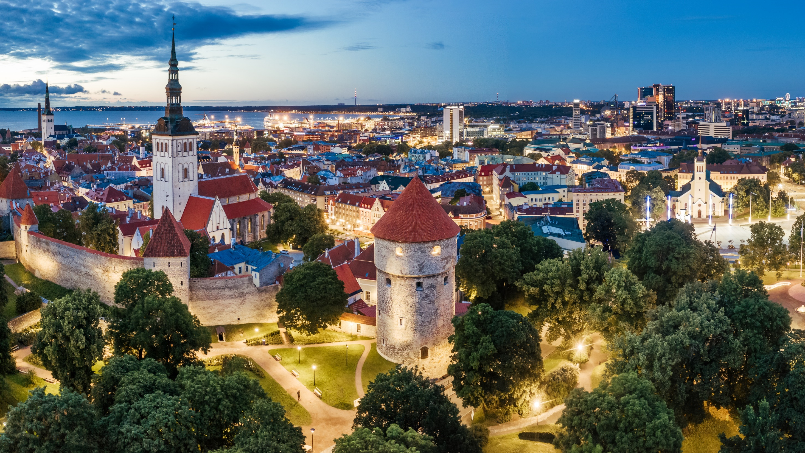
Tallinn the capital of Estonia
Tallinn, Estonia’s capital, is famed for its UNESCO-listed Old Town, one of Europe’s best-preserved medieval city centres. Beyond the cobblestone streets, the city boasts modern architecture, vibrant culture, and reclaimed industrial areas filled with design shops, art galleries, cosy restaurants, and microbreweries. Compact, sustainable, and seaside, Tallinn was proudly "European Green Capital 2023."
© Kaupo Kalda

Slide 20
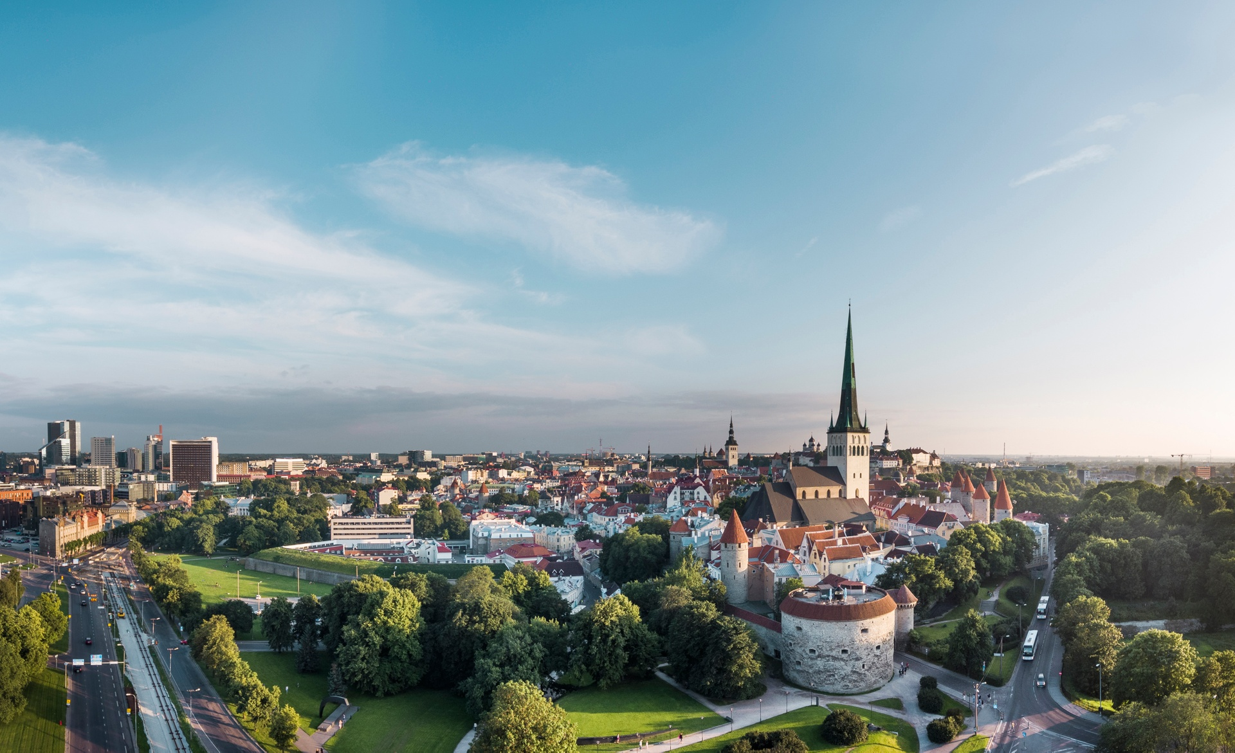
15-minutes city
most sights, hotels, venues, restaurants are within walking distance
© Rasmus Jurkatam

Slide 21
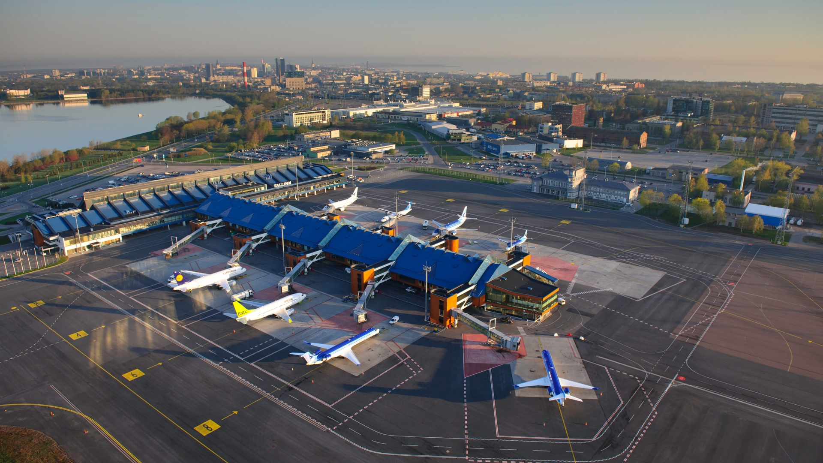
Tallinn International Airport
Tallinn Lennart Meri International Airport is located just 4 km from the city centre
10 min by taxi or bus and you are in your hotel room
2023 Best Airport in the world, among those serving 2-5 million passengers per year (by Airports’ Council International)
© Sven Zacek

Slide 22
Flight Connections

Slide 23
Flight times to Tallinn

Slide 24
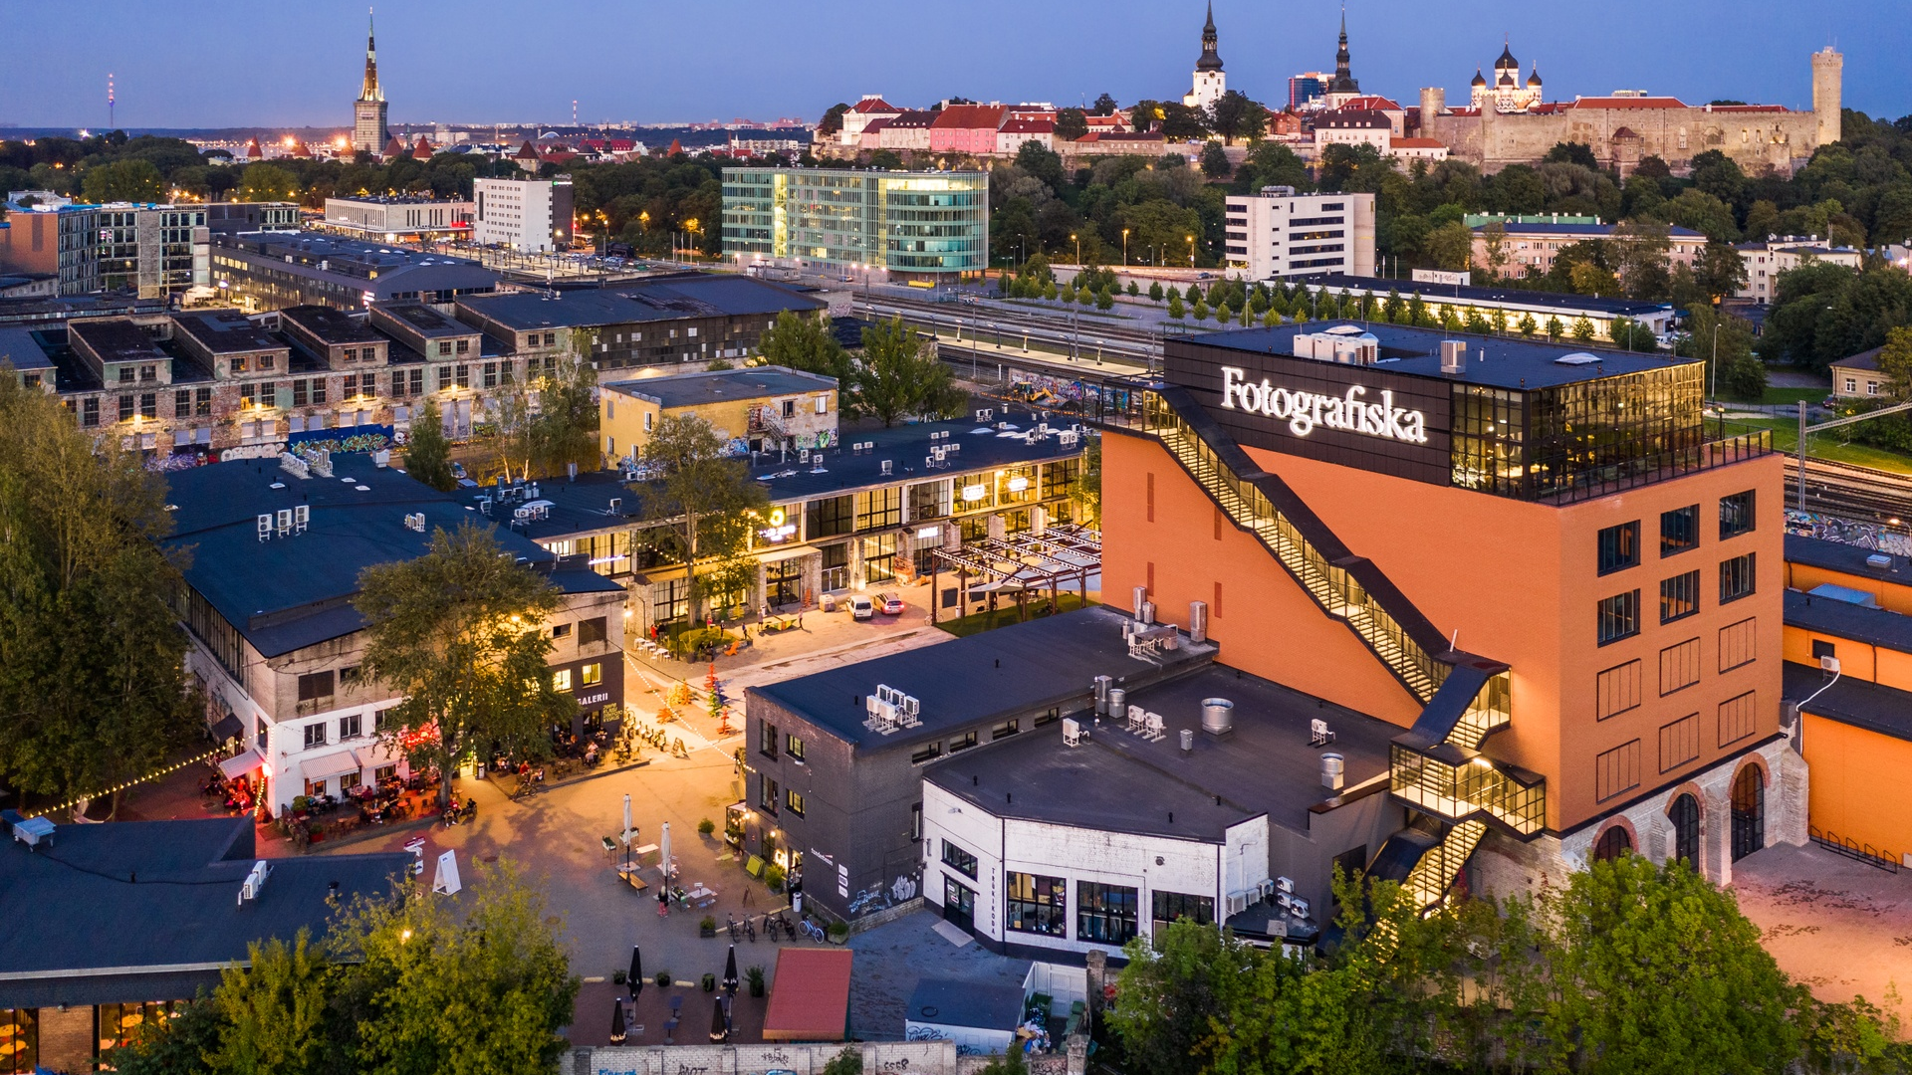
Vibrant Urban Districts
Away from the Old Town’s cobblestone streets, the city of Tallinn has a modern feel, with offbeat architecture and a vibrant cultural life. The newly reclaimed industrial areas are locals’ favourite places to hang out, offering numerous design shops, art galleries, bohemian cafés, cosy restaurants, and microbreweries to choose from.
© Kaupo Kalda

Slide 25
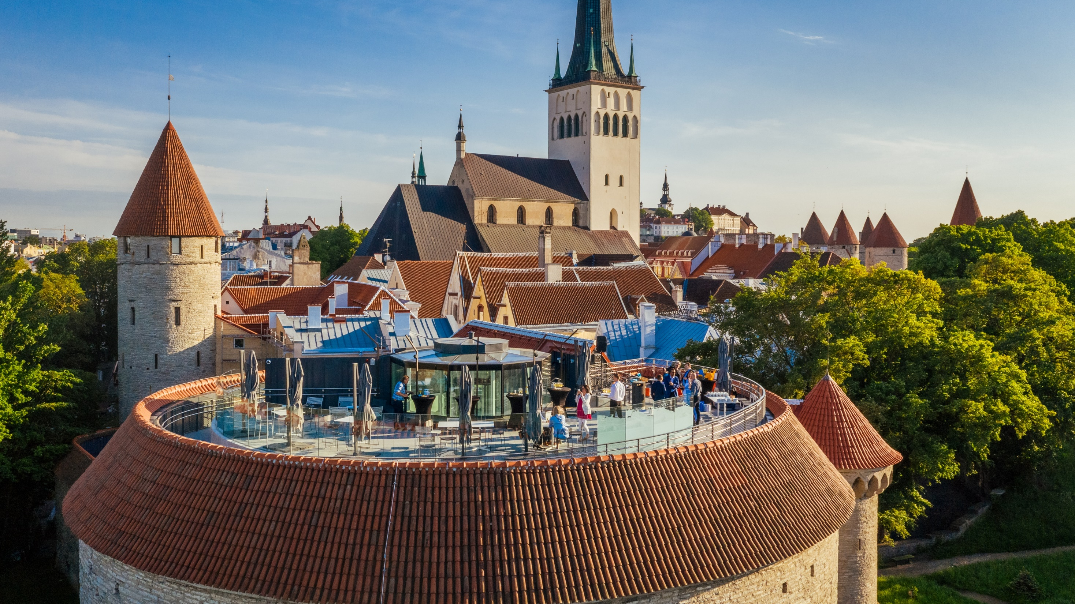
Tallinn old town
© Kaupo Kalda
UNESCO Heritage listed medieval
Old Town

Slide 26
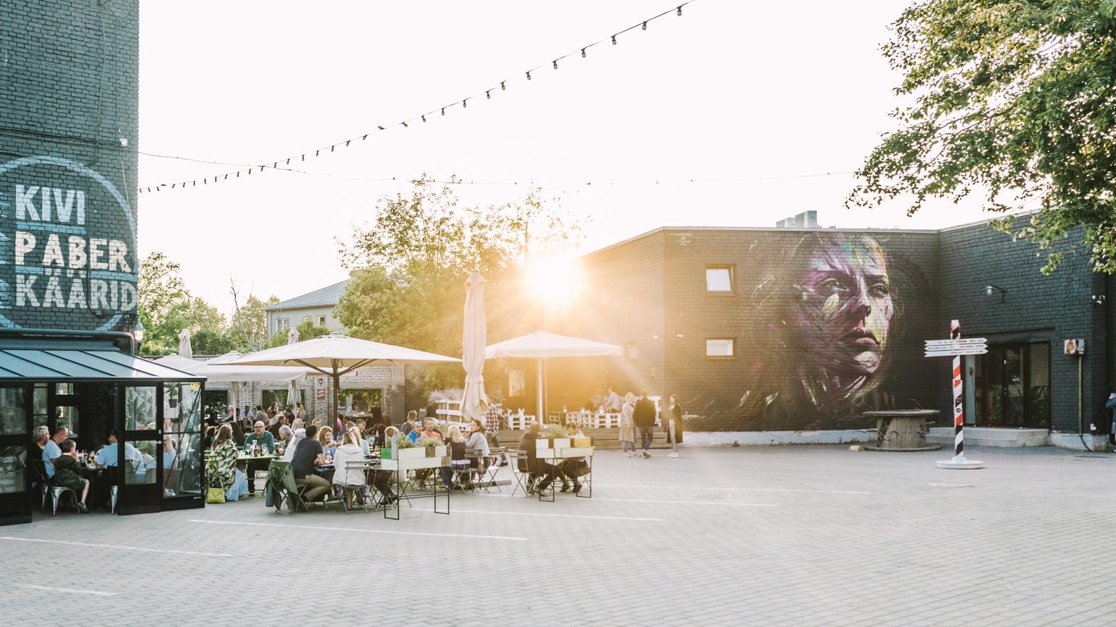
Telliskivi creative city
Bohemian, funky, hipster district located in a former industrial complex. Full of street art.
© Rasmus Jurkatam

Slide 27
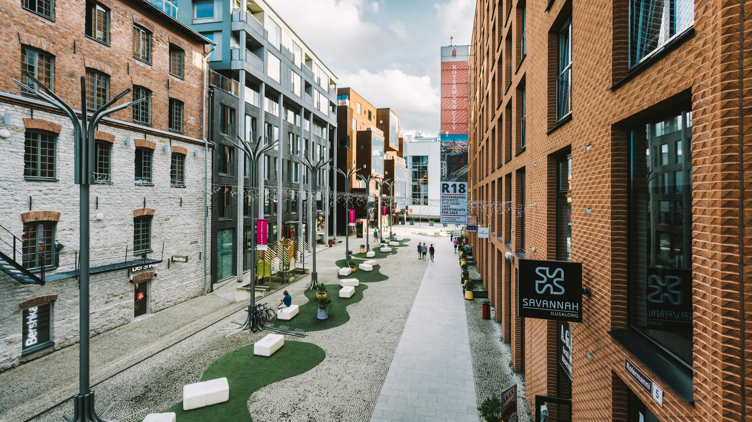
Rotermanni quarter
© Rasmus Jurkatam
A reclaimed factory district now a fashionable residential and office area with cool bars and restaurants loved by the locals

Slide 28
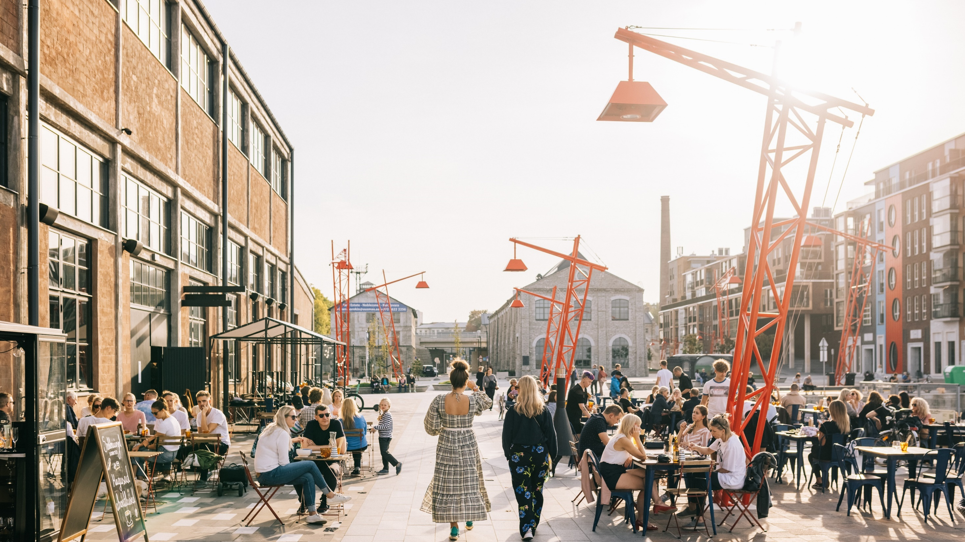
Noblessner port district
© Rasmus Jurkatam
Former submarine shipyard turned into popular seafront quarter

Slide 29
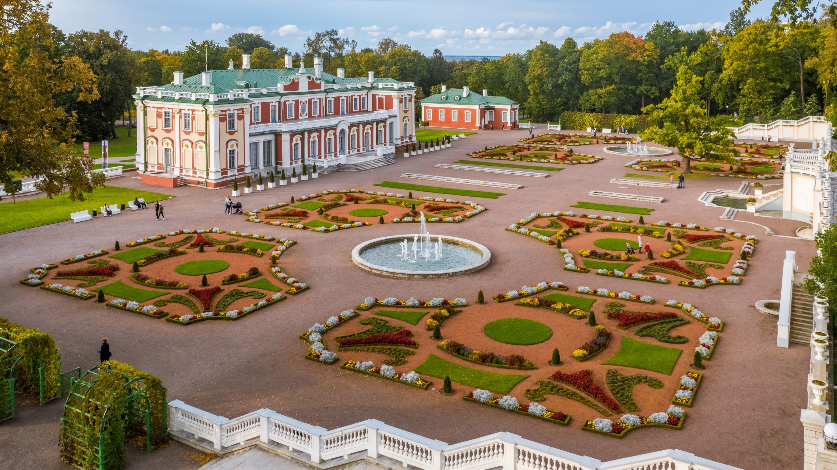
Kadriorg park district
Most outstanding palatial and urban park in Estonia. Home for a numerous museums.
Wooden architecture
© Kaupo Kalda

Slide 30
Vibrant Urban Districts
© Kaupo Kalda

Slide 31
Free public transport for conferences offered by Tallinn City

Slide 32
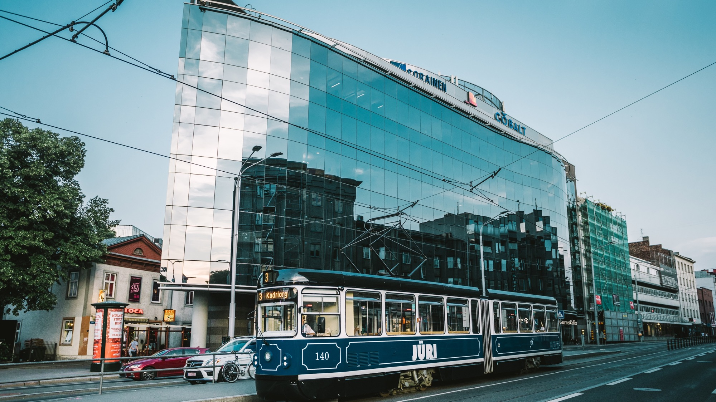
Free public transport for conferences

Slide 33
Why Tallinn
new and fresh destination in Europe
well-connected with direct flights from major European cities
cosy and compact with easy logistics
easy organising: euro as a currency, English widely spoken, Nordic business culture
excellent quality business hotels
great value for money
amazing food (seasonal, local, short-travelled)
green and clean, sustainability is a way of life
professional and flexible local suppliers
a good mix of 4- to 5-star hotels in downtown

Slide 34
Map of Tallinn

Slide 35
Map of Tallinn & Viimsi

Slide 36
Venues

Slide 37
Tallinn Creative Hub
Homepage
black box in theatre style: 600 guests
cauldron hall for gala dinner: 170 guests
total number of meeting rooms: 17
to city centre: 14 min walking
within walking distance of major hotels
black box in theatre style: 600
cauldron hall for gala dinner: 170
total number of meeting rooms: 17
to city centre: 14 min walking
to airport: 18 min by taxi
Green Key
A historic power station turned into a multi- functional event venue

Slide 38
Alexela Concert Hall
Homepage
main hall capacity in theatre style: 1829
break out rooms: 9 cinema halls
3 300 m2 of multifunctional foyers
to city centre: in the centre
to airport: 10 min by taxi
Our largest venue for conferences

Slide 39
Seaplane Harbour
Homepage
receptions: 1500 guests
seated gala dinners: 700 guests
to city centre: 30 min walking
to airport: 18 min by taxi
The most exciting maritime museum in Northern Europe

Slide 40
Proto Invention Factory
Homepage
total number of meeting rooms: 6
receptions: 600 guests
theatre style: 220 guests
seated gala dinner: 200 guests
location: Noblessner port district
Former submarine shipyard, now full of vr-discoveries and inventions from 19th- century

Slide 41
Port of Tallinn Cruise Terminal
Homepage
total area: 1724 m²
total number of meeting rooms: 3
receptions: 1400 guests
theatre style: 800 guests
seated gala dinner: 740 guests
Light-filled and spacious seafront venue

Slide 42
Fotografiska Tallinn
Homepage
number of event rooms: 1 (2 when divided)
receptions: 400 guests
theatre style: 260 guests
seated gala dinner: 130 guests
location: Telliskivi Creative City
to city centre: 20 min walking
Satellite gallery
of Stockholm’s renowned Fotografiska photography museum

Slide 43
Club of Different Rooms
Homepage
total number of event rooms: 4
reception: 250 guests
theatre: 150 guests
green-screen studio
located in Telliskivi Creative City
Combination of bohemian atmosphere, great technical solutions and personalized approach

Slide 44
Tallinn TV Tower
Homepage
total number of meeting rooms: 4
outdoor area: 4000 guests
tunnel on the ground: 250 guests
inside: 100 guests
distance to City center: 20 min
distance to Airport: 25 min
At height of 314 meters, the Tallinn TV Tower is the tallest building in Estonia

Slide 45
Tallinn University Conference Centre
Homepage
max capacity: 400 guests
no. of conference rooms: 36
Distance to Airport: 15 min by taxi
located in the centre of Tallinn, near Kadriorg Park and the harbour.
The largest university of humanities and the third largest public university in Estonia

Slide 46
Viimsi Artium
Homepage
total number of meeting rooms: 4
receptions: 600 guests
theatre style: 420 guests
seated gala dinner: 180 guests
location: 12 km from downtown Tallinn, in a scenic area
Cultural hub located close enough, yet away from the hustle and bustle of the city

Slide 47
Activities

Slide 48
Bogshoe walk
Discover the nature of Estonia, enjoy fresh and clean air and tone your body.
Bogshoes help to take you to places you can’t reach with hiking boots or rubber boots alone.
Location: hiking trails of varying degrees of difficulty across Estonia.
Breathe in the clean bog air and enjoy the mystical landscape of Estonian wetlands.

Slide 49
Medieval legends walking
Sightseeing with costumed performance.
Wander through historic churches, guild houses, hidden courtyards, and winding cobblestone streets.
Guide entertains you with the fascinating history of the area through captivating legends.
Old Town is packed with historic charm and tops the list of sightseeing priorities for first-time visitors.

Slide 50
Treasure hunt city game
Digital scavenger hunt, that combines physical activity, brain-teasing puzzles, teamwork and modern technology.
This game will guide your guests through the historic Old Town, challenging them to discover hidden gems and clues leading to the city’s most popular attractions.
Experience Tallinn’s picturesque Old Town in a fun team-building activity!

Slide 51
Food sightseeing tours
Combines a personalized city tour with visits to various locations serving typical regional food and drinks.
Explore some of the most picturesque areas of Tallinn, accompanied by intriguing tales of Estonian history and contemporary life.
Features around six food and drink stops.
Get ready to experience the rich diversity of Estonian cuisine!

Slide 52
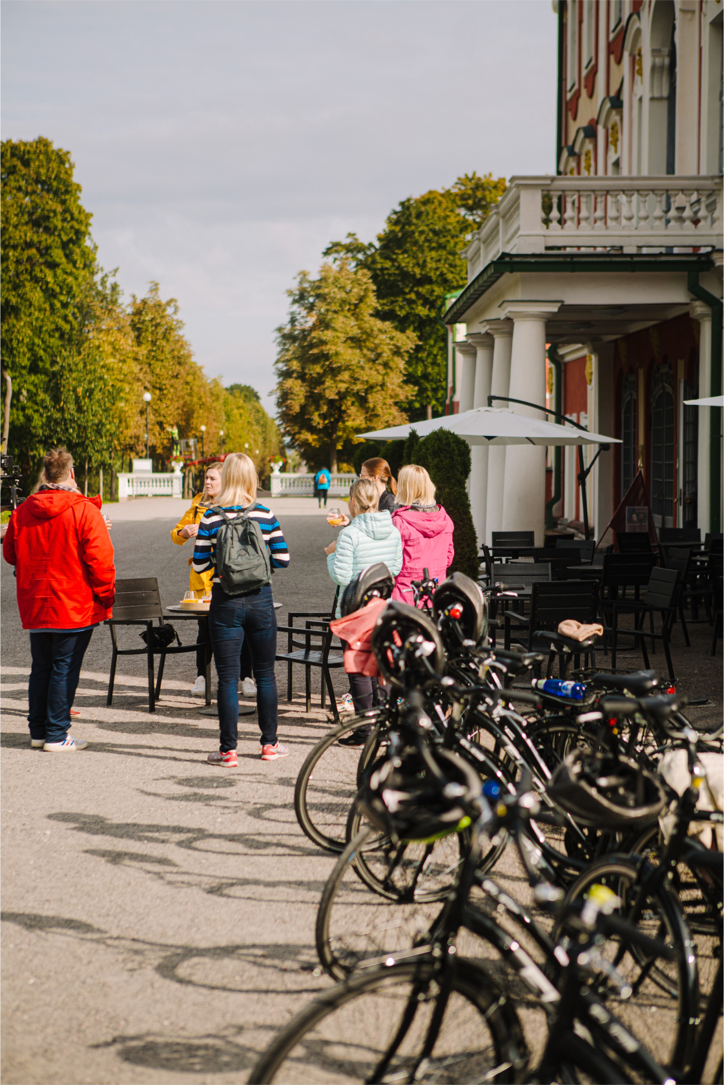
Tallinn bike tour
A guided bike tour to explore the city’s many attractions.
The journey will include Tallinn Creative Hub, Patarei prison, Seaplane Harbour, port of Noblessner, Baltic Station Market, Kadriorg park, Song Festival Grounds and Maarjamäe Memorial.
This tour covers approximately 20 km.
Explore the diverse districts of Tallinn on a captivating bike tour

Slide 53
Make your own souvenir
Stella Soomlais is famous Estonian designer who has a passion for leather craft.
Her studio in Telliskivi Creative City, Tallinn’s Hipsterville, offers leather workshops, where your group can make leather wristbands, watch straps, key holders and other accessories.
Create an item of genuine emotion for yourself or as unique gift
for someone special

Slide 54
Jewellery workshop with local designer
DIY workshop from renowned Estonian designer, Kriss Eglite.
During the session, she’ll not only share techniques and stories but also provide guidance as you embark on your first jewellery crafting adventure.
Craft a meaningful piece for yourself or a one-of-a-kind
gift for
someone
special

Slide 55
Brewery tour
Põhjala Brewery Tap Room offers a selection of 24 Põhjala and guest beers on tap.
45-minute exploration of the production facilities, beer-making techniques and the brewery’s operations, accompanied by tastings of 3–4 different beers.
Stop at a local craft brewery and learn about the art of beer making!

Slide 56
Artisan gin distillery tour
As the first open distillery of its kind in Estonia, Junimperium offers immersive tours for those curious about gin’s rich history and the craft of its creation.
Indulge in a sensory experience with nosing and tasting sessions of the finest offerings.
Have you ever tasted „RHUBARBRA STREISAND“ , „GINA TURNER“, or „FRANK GINATRA“?

Slide 57
Hands-on orienteering game with retro jeeps
Spend a couple of hours on a safari, hunting checkpoints, testing off road racing skills and communicating with your team to be the first over the finish line.
Location: Põhja-Kõrvemaa landscape reserve, 40 min drive from Tallinn.
The track features exciting off-road challenges as well as picturesque natural sites

Slide 58
Rally racing
Race nostalgic Ladas or BMWs, drive a tricky car on a slalom track, experience breathtaking co-drive next to a professional rally pilot, have racing competitions with your colleagues.
Location: LaitseRallyPark, 30-minute drive from the centre of Tallinn
Be the driver of a real rally car speeding on gravel, snow and in the forests

Slide 59
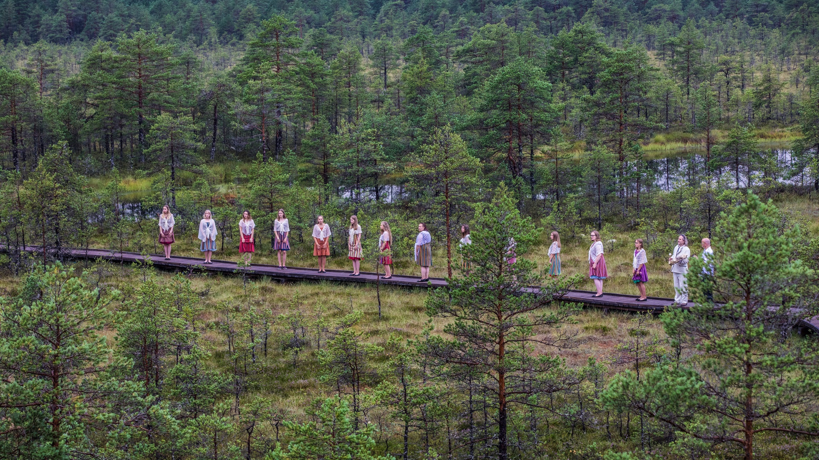
Surprise choir concert in the bog
Arrange a musical surprise in a bog, medieval church, or a baroque palace.
© Alari Teede
Arrange a musical surprise in a bog, medieval church, or a baroque palace.

Slide 60
Pop-up forest restaurant
Experience the best of Estonia with breathtaking landscapes, authentic outdoor adventures, and rustic (yet delicious!) cuisine.
Meals are prepared over a live fire and served in a picturesque natural setting—no plastic dishes, tents, or garden chairs here. Instead, enjoy wooden tableware, fire pans, and the comforting aroma of a steaming coffee pot.
Photo: Peter Paxx
Pair with outdoor activities like bog walking, hiking, fat biking, or kayaking.

Slide 61
fatbike tours
Further development of an off-road bicycle and its most distinctive elements are the oversized tires – you´ll spend less energy, pass a longer distance, and see much more!
Can go through deep water, sand, and mud; climb up mountains and rocks.
Perfect for team-building and adventure seekers alike.
Electric motor helps you climb uphill effortlessly, making it enjoyable for everyone!

Slide 62
Cooking classes
Cooking classes at Food Studio with an Estonian chef. Fits up to ten people.
Cook a dinner consisting of several courses and of course, at the end of this fun activity, you can eat it all.
Strengthen your team’s spirit while cooking together!

Slide 63
Igloo sauna & wild swimming
The steam is unique due to sauna’s curved shape. It travels upward to the ceiling, drifting softly downwards and filling the entire room.
Fits up to ten people.
Part of a unique Iglupark, that includes five IGLUSAUNAS, four seaside IGLUOFFICES and ten cabins, called IGLUHUTS.
Experience the heat in the wood-fired saunas at the wonderful seaside Iglupark

Slide 64
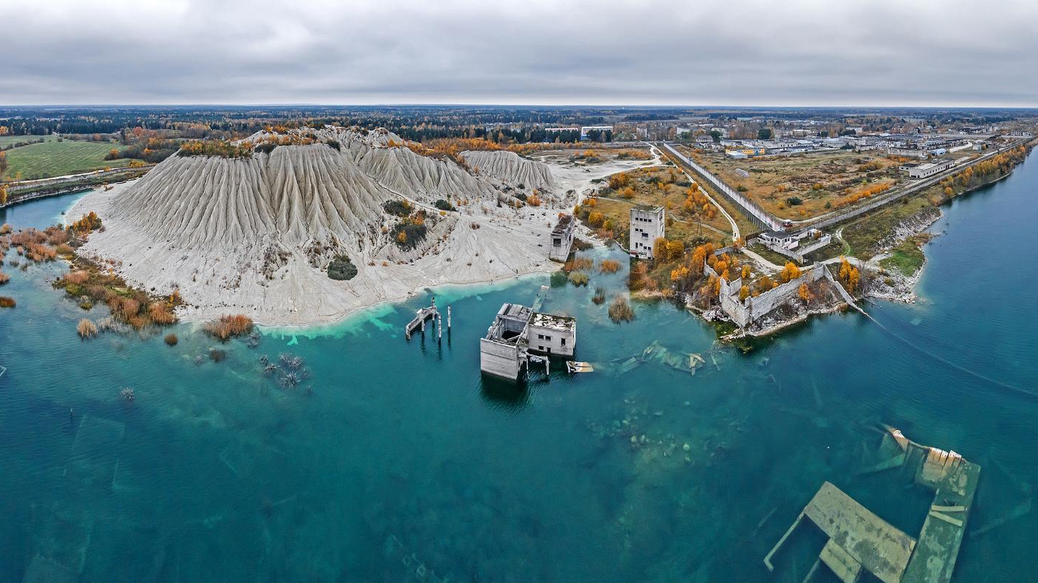
Rummu quarry experiences
location: Rummu, 45 min from Tallinn
duration: min 3h incl. transfer
group size: min 6
season: all year round depending on the activity
type: adventure, history, special landscape, old quarry
Hike around the mountain, enjoy a water park, pedal boats, SUP boards, a disc golf park, diving, concerts, sporting events, sunbathing and swimming.
© Kaupo Kalda
A popular recreation area, where you can enjoy various activities, like hiking, sunbathing, swimming, fatbike tours and public events.

Slide 65
Lighted raft tours in Rummu quarry
Rummu Lake is legendary for its scenes of beautiful nature mixed with the eerie remnants of buildings both above and below the waterline.
On this nighttime raft tour, you’ll get to ‘fly’ over this miniature Atlantis while coloured lights let you peek at the underwater sights.
Glide over underwater forests and buildings, including an abandoned
prison!

Slide 66
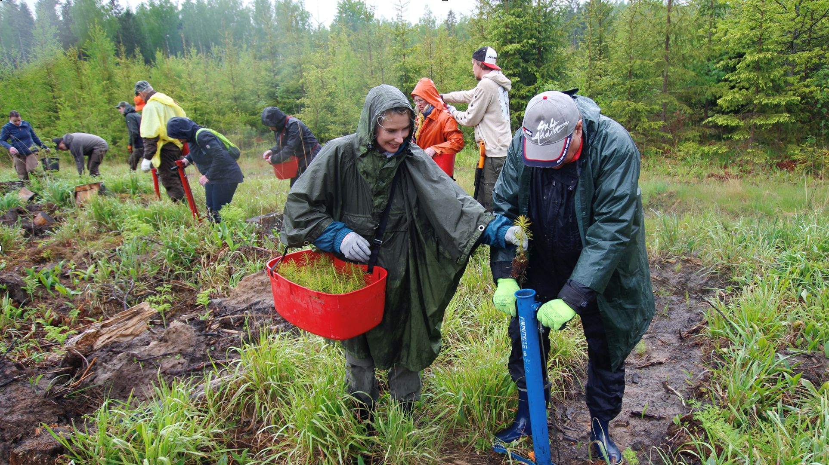
CSR programmes
plant a tree
give a helping hand in local community
charity activities, fundraisers
nature cleaning hikes with educational information
Make a difference in the community through planting trees, charity initiatives, clean up activities and more.
© Visit Estonia

Slide 67
Marzipan painting & chocolate making workshop
Did you know that, according to legend, marzipan was invented in Tallinn? Visit a marzipan workshop, explore the colorful history of marzipan in Tallinn, and paint your own marzipan figurine as a sweet souvenir of your time in Tallinn.
Dive into the world of chocolate and learn a tasty new skill!
Photo: Renee Altrov
Photo: Renee Altrov
Photo: Anu Vahtra

Slide 68
E-Estonia showroom visit
Estonia is hailed as the world’s most advanced digital society with I-voting, e-Residency, digital signature, just to name some digital solutions.
E-Estonia Briefing Centre in Tallinn gives presentations about E-Estonia for those interested in digitalisation.
Our e-story is unique and fascinates the international community.

Slide 69
Private tram tour
of Tallinn
Step abroad an historic tram and embark on an exclusive tour of Tallinn that will reveal sights and experiences beyond the ordinary.
Enjoy snacks and bevereges on board as you make your way through Tallinn’s diverse neighbourhoods.
Photo: Rasmus Jurkatam
Photo: Rasmus Jurkatam

Slide 70
Private curling
tournament
Curling is an exciting sport that combines both physical and mental skills. It is also one of the few sports in the world where people of all ages, genders, and abilities can compete on an equal footing.
Curling truly is great fun!
The modern Tondiraba Ice Rink provides Olympic-level excitement with top-quality ice and equipment, catering to both seasoned players and complete beginners.

Slide 71
Sailing on Tallinn bay
Why admire Tallinn’s skyline from land when it can be enjoyed from a yacht? Cruise past Old Town’s medieval towers, historic ports, and the serene Pirita coastline while sipping champagne on the bay.
For an extra thrill, turn the day into a sailing race!
Guided by expert skippers, teams will compete in an exciting lap race, testing their skills and teamwork.
Photo: Madis Palm
Photo: Madis Palm
Photo: Simo Sepp

Slide 72
Conference Tours

Slide 73
Medieval Walking Tour
Step back in time to the Middle Ages as you wander through our historic churches, guild houses, hidden courtyards, and winding cobblestone streets in one of the most well preserved medieval towns in the world.
Get to know about the lifestyle, clothing, occupations, eating and drinking habits of Tallinn’s medieval citizens as your guide entertains you with the fascinating history of this area through captivating legends.
Old Town is packed with historic charm and tops the list of sightseeing priorities for first-time visitors.

Slide 74
Bogshoe walk
Discover the nature of Estonia, enjoy fresh and clean air and tone your body.
Bogshoes help to take you to places you can’t reach with hiking boots or rubber boots alone.
Location: 40 min transfer from Tallinn
Breathe in the clean bog air and enjoy the mystical landscape of Estonian wetlands.

Slide 75
Food sightseeing tours
Combines a personalized city tour with visits to various locations serving typical regional food and drinks.
Explore some of the most picturesque areas of Tallinn, accompanied by intriguing tales of Estonian history and contemporary life. Location: 40 min transfer from Tallinn
Features around six food and drink stops.
Get ready to experience the rich diversity of Estonian cuisine!

Slide 76
Welcome to Tallinn Bike Tour
A guided bike tour to explore the city’s rich history and picturesque scenery
Visit the majestic Kadriorg Palace, built by Peter the Great; the official residency of Estonian President, Song Festival Grounds, and seaside promenade with a perfect view of Tallinn’s skyline
Explore the diverse districts of Tallinn on a captivating bike tour

Slide 77
Kadriorg- Art Tour of Tallinn
History, exquisite art and beautiful scenery are all on the agenda during this tour of Tallinn's famed park and museum district.
The tour covers the all area's attractions including the 290-year-old park itself, the stunning Kadriorg Palace built by Peter the Great, and the nation's premiere art museum, Kumu
Kadriorg Park is the most outstanding palatial and urban park in Estonia, covering around 70 hectares

Slide 78
Bohemian Tallinn
Telliskivi Creative City is a reclaimed factory area, now a buzzing center for art, design, and food, where industrial meets cool.
In Kalamaja, once a fishing community, wooden houses give way to bohemian vibes filled with hipsters, street art, and delightful cafes, offering charm at every corner.
Explore the city’s edgy and artistic side!

Slide 79
Design Tallinn
Welcome to Rotermann Quarter, a buzzing hotspot where old factory facades blend effortlessly with sleek, modern architecture. Filled with fashionable shops, innovative design, and trendy cafes, it’s the ultimate destination for those who appreciate contemporary style.
Don’t forget to visit the Tallinn Design House for a curated collection of Estonian creativity, and make a sweet stop at the Kalev Chocolate Shop for some local treats!
Tallinn’s lively urban retreat, where historic industrial buildings are transformed into a modern architectural masterpiece.

Slide 80
Hotels

Slide 81
Excellent quality business-class hotels

Slide 82
Excellent quality business-class hotels

Slide 83
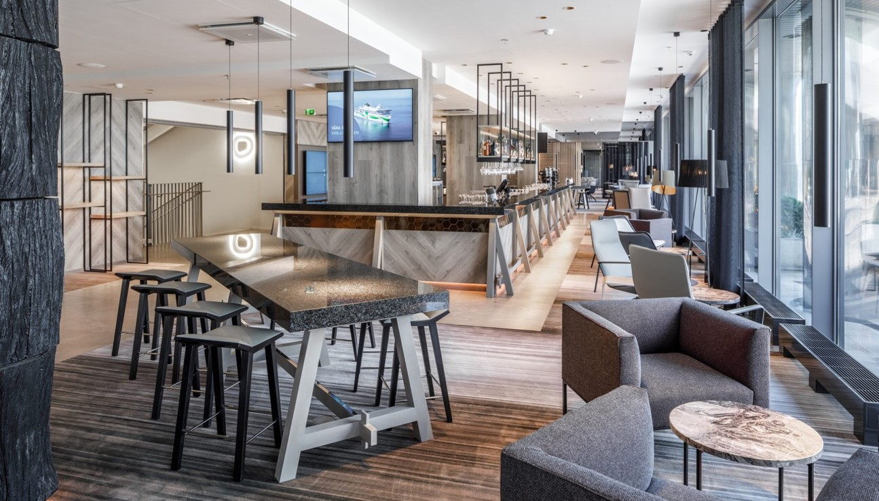
Recently renovated hotels
© Tallink Hotels

Slide 84
Homepage
Spacious rooms, great value for money
© Mövenpick Hotel Tallinn, Radisson Blu Hotel Olümpia, Nordic Hotel Forum
wide range of 3-5 star hotels
from international chains to boutique properties
7,600 hotel rooms in total in Tallinn
plenty of Green Key hotels

Slide 85
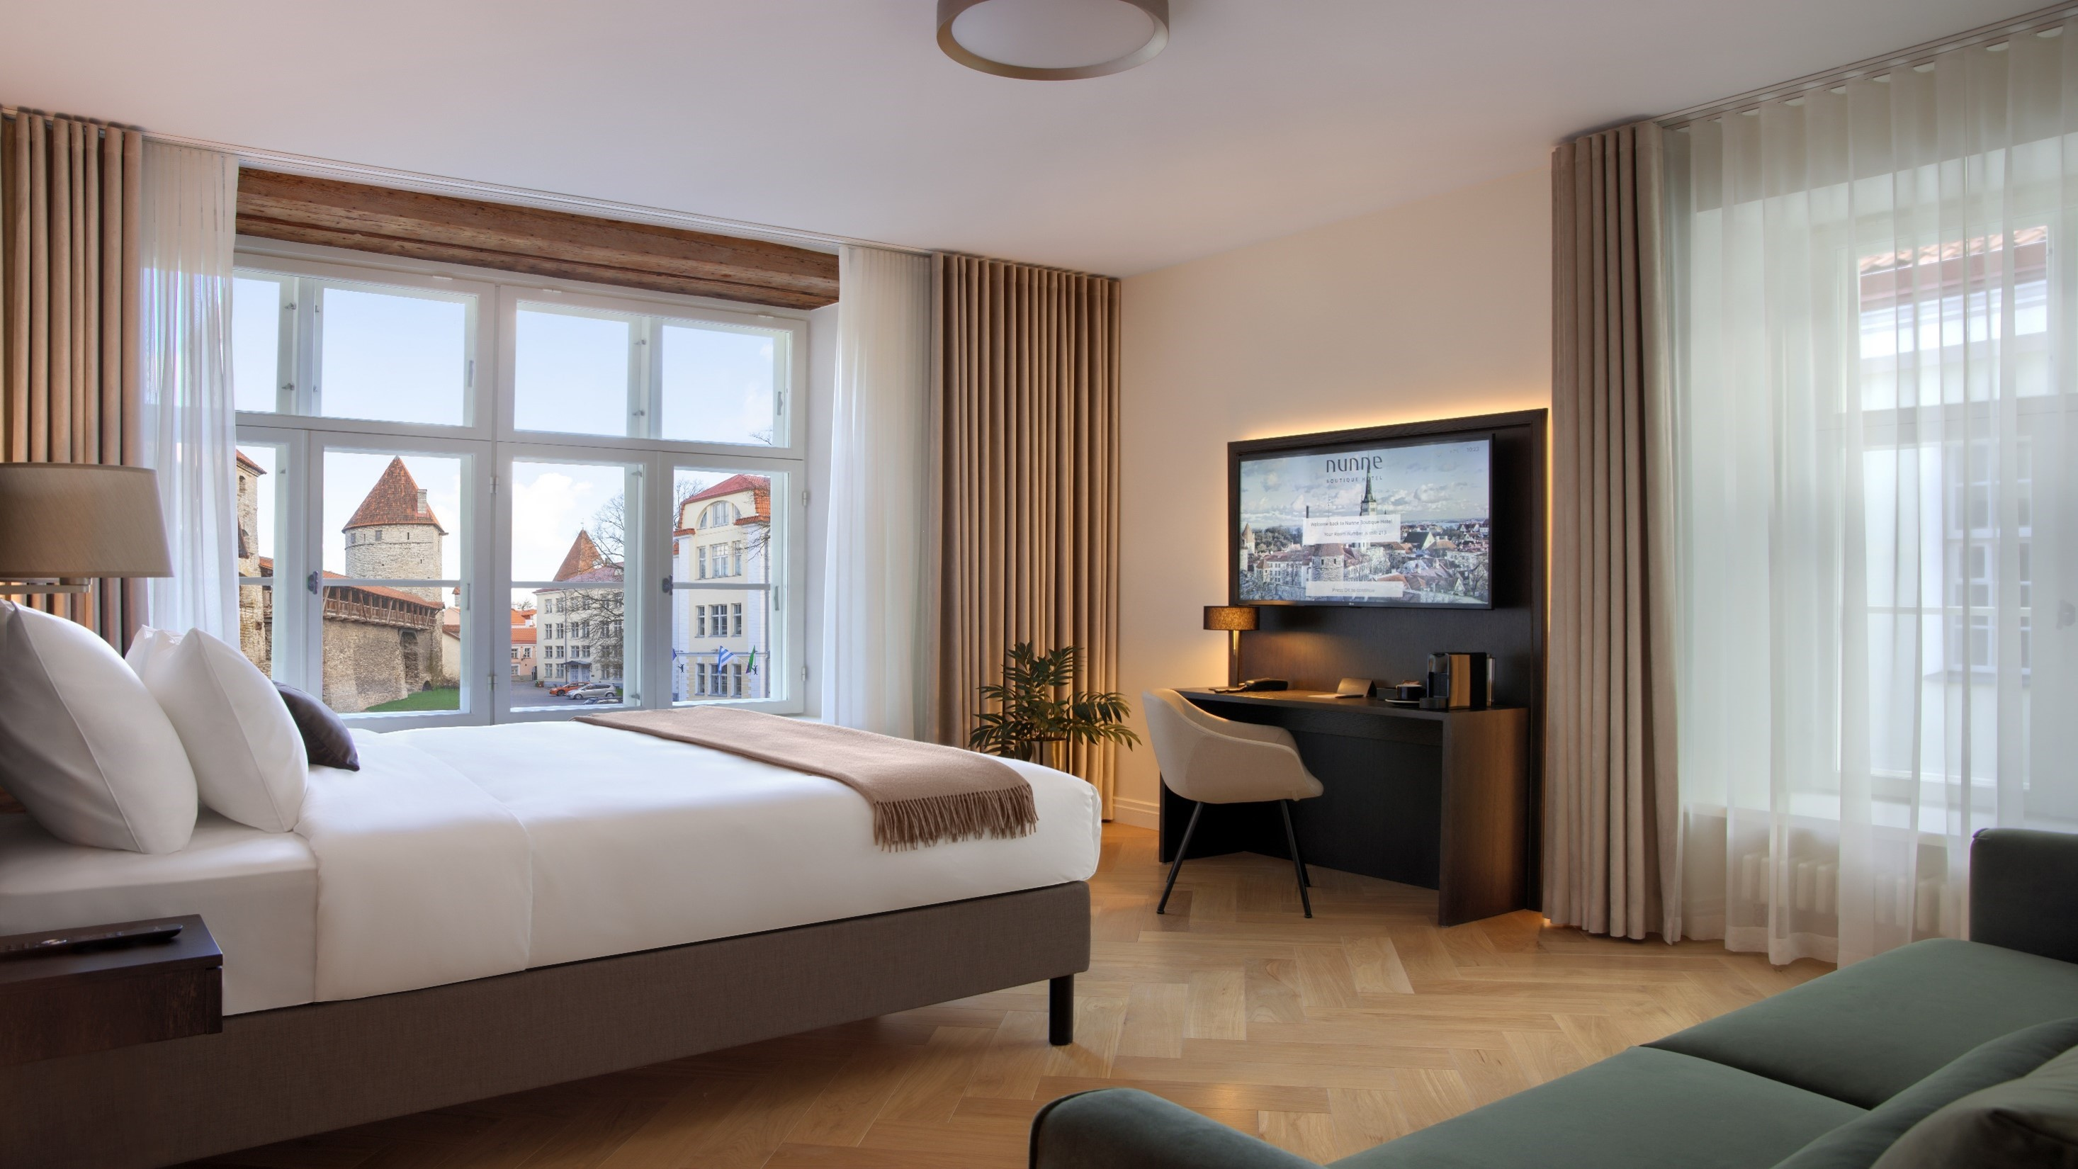
Boutique hotels in Tallinn old town
© Nunne Boutique Hotel

Slide 86
Homepage
Modern meeting facilities in hotels
© Hilton Tallinn Park, Swissôtel Tallinn, Mövenpick Hotel Tallinn
up to 530 guests theatre style;
breakout rooms for parallel sessions

Slide 87
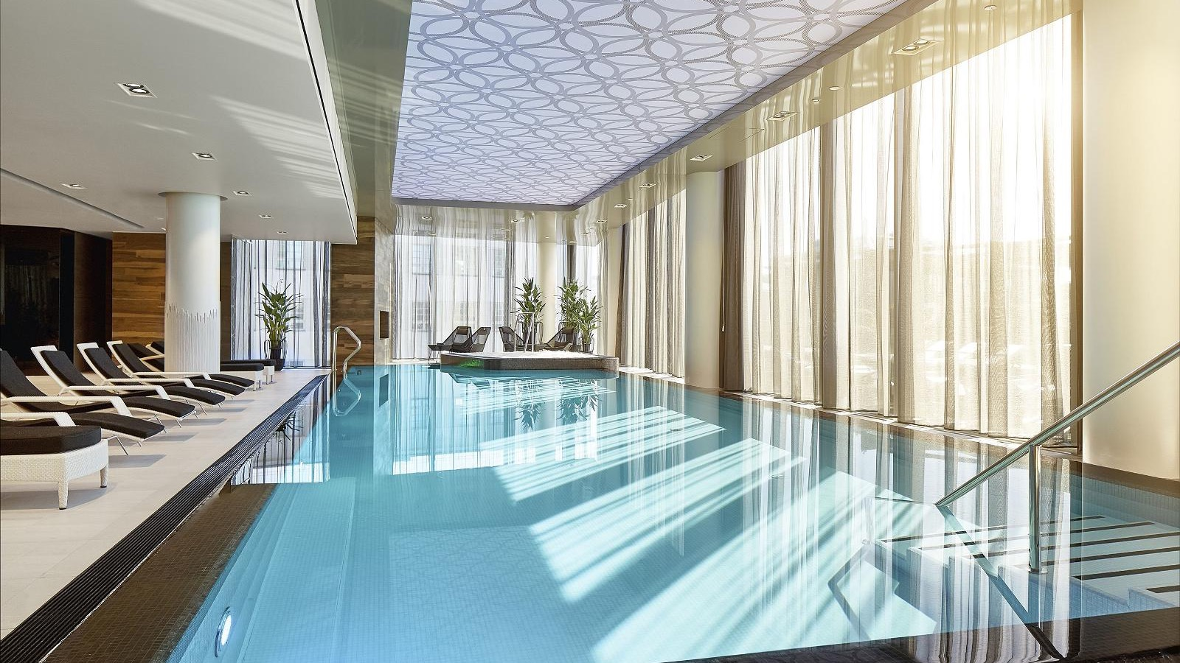
Many hotels have spa or relaxation area

Slide 88
ECB member hotels

Slide 89
ECB member hotels

Slide 90
Hilton Tallinn Park
Homepage
No. of hotel rooms: 202
No. of conference rooms: 10
Max capacity, theatre style: 535 guests
Distance to Airport: 10 min by taxi
Awarded Estonia’s leading hotel, Hilton Tallinn Park ensures excellence

Slide 91
Swissôtel Tallinn
Homepage
No. of hotel rooms: 238
No. of conference rooms: 7
Max capacity, theatre style: 500 guests
Distance to Airport: 10 min by taxi
Luxury hotel set in the heart of Estonia’s capital

Slide 92
Radisson Collection Hotel, Tallinn
Homepage
No. of hotel rooms: 287
No. of conference rooms: 8
Max capacity, theatre style: 300 guests
Distance to Airport: 10 min by taxi
Luxury lifestyle brand offers an exceptional, five-star experience

Slide 93
Radisson Blu Hotel Olümpia
Homepage
No. of hotel rooms: 390
No. of conference rooms: 13
Max capacity, theatre style: 500 guests
Distance to Airport: 10 min by taxi
Contermporary and modern landmark on the skyline of Tallinn

Slide 94
Nordic Hotel Forum
Homepage
No. of hotel rooms: 258
No. of conference rooms: 7
Max capacity, theatre style: 200 guests
Distance to Airport: 12 min by taxi
Thinking of everything, taking care of the smallest detail

Slide 95
Mövenpick Hotel Tallinn
Homepage
No. of hotel rooms: 125
No. of conference rooms: 4
Max capacity, theatre style: 196 guests
Distance to Airport: 15 min by taxi
Premium class hotel with a charming rooftop view

Slide 96
Park Inn by Radisson Meriton Conference & Spa Hotel Tallinn
Homepage
No. of hotel rooms: 465
No. of conference rooms: 12
Max capacity, theatre style: 380 guests
Distance to Airport: 15 min by taxi
Chic and contemporary with a great emphasis on sustainability

Slide 97
Tallink Spa & Conference Hotel
Homepage
No. of hotel rooms: 300
No. of conference rooms: 6
Max capacity, theatre style: 263 guests
Distance to Airport: 15 min by taxi
Combines everything you need for a relaxing holiday or active business trip

Slide 98
Tallink City Hotel
Homepage
No. of hotel rooms: 324
No. of conference rooms: 1
Max capacity, theatre style: 40 guests
Distance to Airport: 10 min by taxi
Heart of the city centre and close to the green outdoors

Slide 99
Original Sokos Hotel Viru
Homepage
No. of hotel rooms: 516
No. of conference rooms: 12
Max capacity, theatre style: 500 guests
Distance to Airport: 10 min by taxi
Vibrant city centre hotel where past and present meet

Slide 100
Centennial Nexus Hotel Tallinn
Homepage
No. of hotel rooms: 81
No. of conference rooms: 3
Max capacity, theatre style: 100 guests
Distance to Airport: 14 min by taxi
Dedicated to the 100th anniversary of the Republic of Estonia

Slide 101
Nunne Boutique Hotel
Homepage
No. of hotel rooms: 74
No. of conference rooms: 1
Max capacity, theatre style: 35 guests
Distance to Airport: 20 min by taxi
Place where history meets luxurious comfort

Slide 102
Mercure Tallinn
Homepage
No. of hotel rooms: 132
No. of conference rooms: 3
Max capacity, theatre style: 50 guests
Distance to City center: 7 min by taxi
Minutes from the airport, surrounded by serene lake views

Slide 103
LaSpa
Homepage
No. of hotel rooms: 142
No. of conference rooms: 7
Max capacity, theatre style: 200 guests
Distance to Airport: 50 min by taxi
Perfect getaway for both – serious teamwork and serious relaxation

Slide 104
Vihula Manor Country Club & Spa
Homepage
No. of hotel rooms: 75
No. of conference rooms: 9
Max capacity, theatre style: 120 guests
Distance to Airport: 1h 10 min by car
A charming 16th century estate in the Lahemaa National Park

Slide 105
Tartu

Slide 106
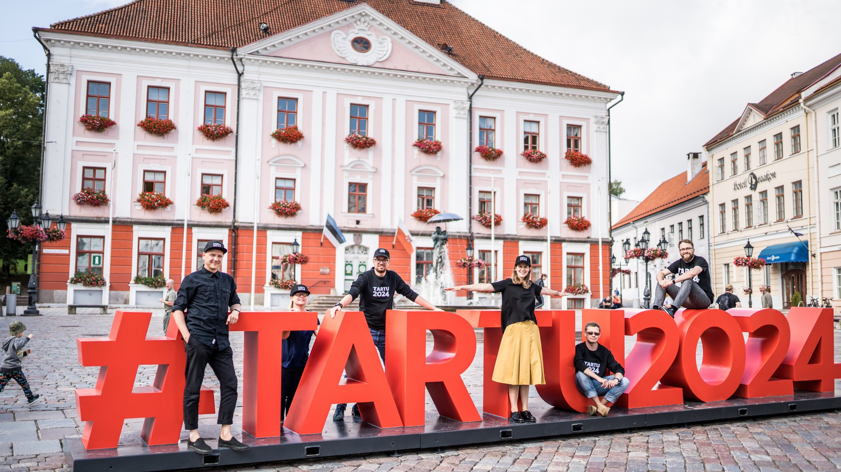
Tartu- the City of Good Thoughts
© Tartu 2024
Estonia´s 2nd largest city
Population 95,000
1,200 hotel rooms
Distance to Tallinn: 185 km

Slide 107
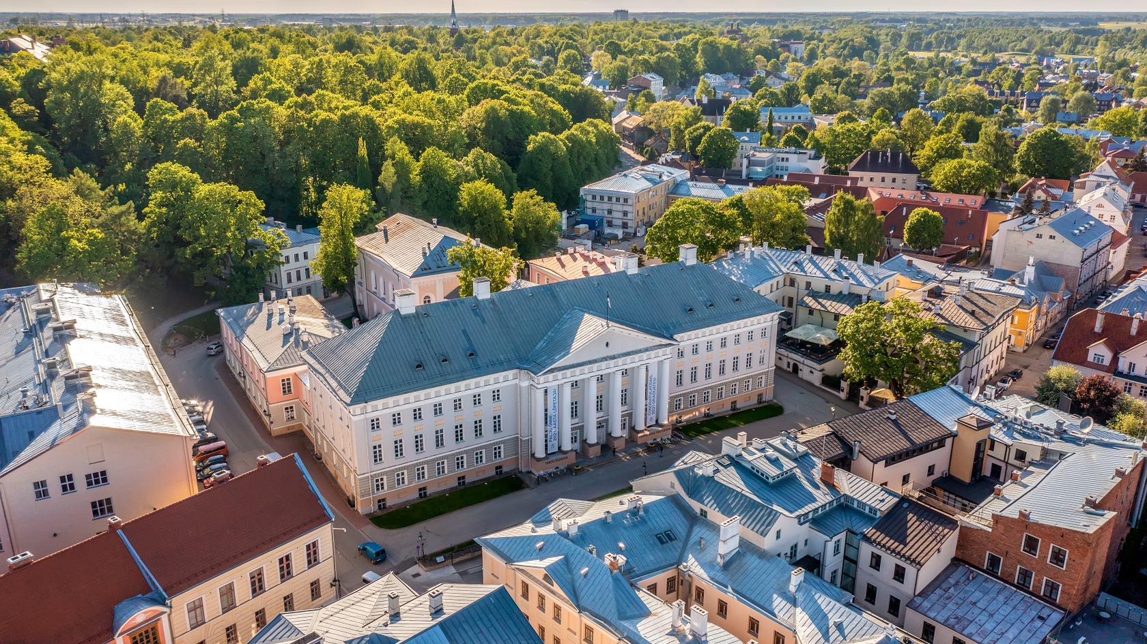
Tartu the university city
© Visit Tartu
attracts conferences related to scientific and medical fields
11 educational & research institutions
Tartu University (1632) ranks among 1% best universities in the world

Slide 108
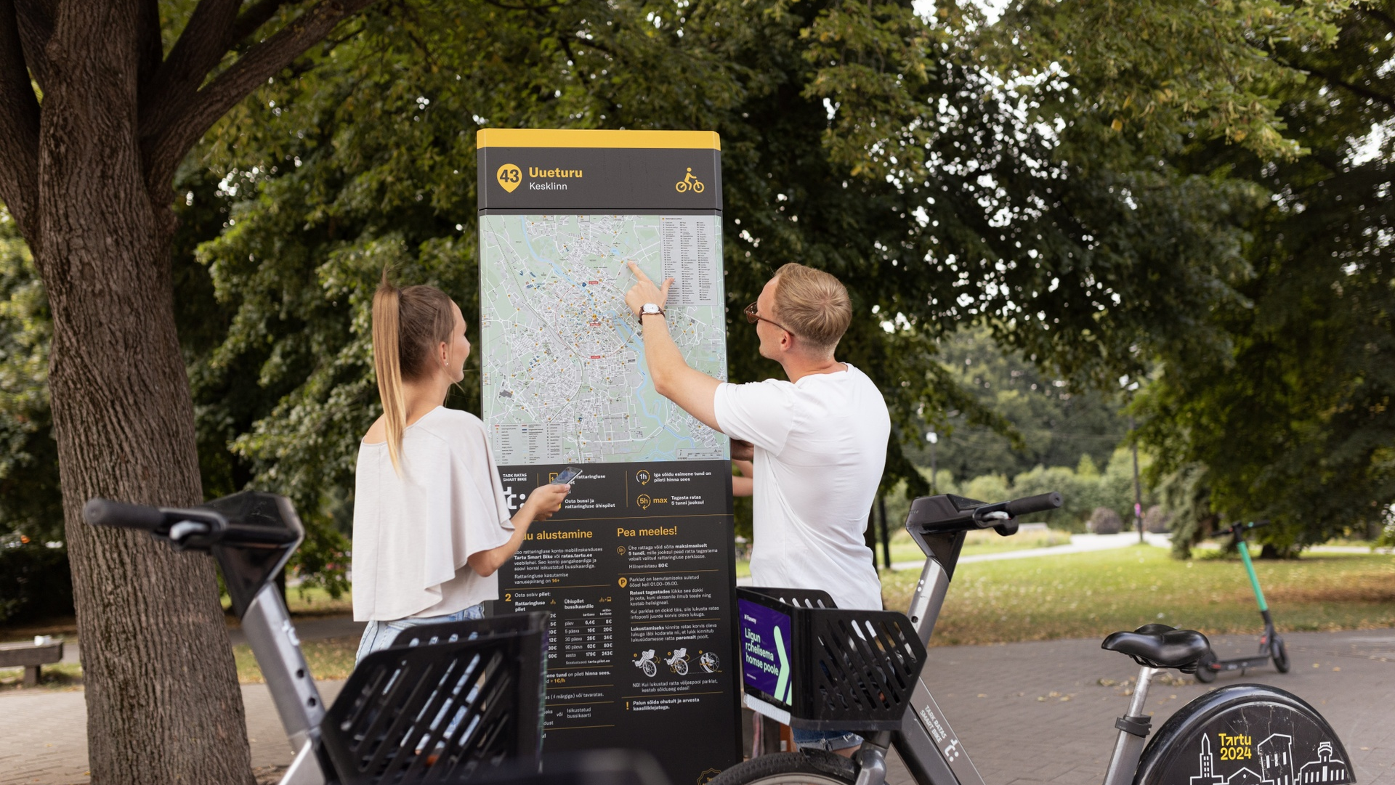
Tartu smart city
© Renee Altrov
smart bike share with electrical bicycles
old apartement buildings turned into zero energy smartovkas

Slide 109
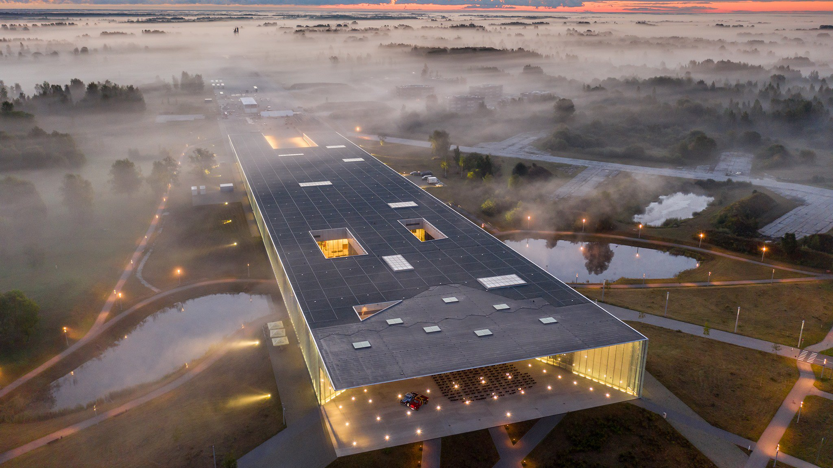
Tartu – home to Estonian National Museum
© Simo Sepp
the largest museum in Estonia with nearly 6,000 m² of exhibition space
discover the everyday life of Estonians
learn about the life of the Finno-Ugric people

Slide 110
V Spa and Conference Hotel
Homepage
No. of hotel rooms: 86
No. of conference rooms: 5
Max capacity, theatre style: 600 guests
Located in the centre of Tartu’s lively commercial district
High-quality offering in the centre of Tartu’s lively commercial district

Slide 111
Tours and
Activities

Slide 112
A Le Coq
beer museum
Estonia’s oldest brewery and largest beverage producer is located in Tartu. Visit their interactive museum, The Beer World, and explore the history of beer through hands-on experiences.
The museum is housed in a fully preserved historical malt tower, a symbol of the city and one of the rarest industrial buildings in Europe.
Discover the magic of beer brewing!

Slide 113
Emajõgi river adventure
The Emajõgi River is one of Tartu's most iconic symbols. For a fantastic way to enjoy its picturesque landscape, hop aboard a barge—an authentic replica of the wooden merchant vessels that were a common sight on the Emajõgi from Hanseatic times up to the 20th century.
Snacks and drinks can be served on board, making the experience even more delightful.
To dive deeper into the fascinating history of these unique vessels, visit the Barge Hall, home to a group of enthusiasts who renovate historical ships, offering a glimpse into a real working workshop.

Slide 114
The best of Tartu
walking tour
Tartu, the oldest city in the Baltics, naturally comes packed with old-fashioned charm. Stroll through its historic heart, from the picturesque Town Hall Square to the striking University of Tartu, one of Northern Europe’s oldest universities, founded in 1632.
Along the way, discover Tartu’s most iconic landmarks, including the Kissing Students fountain, the ruins of Tartu Cathedral, and the serene Toomemägi hill.
Photo: Riina Varol
Photo: Riina Varol
Photo: Ragnar Vutt

Slide 115
Street art tours
Tartu stands out for its flourishing street art scene and vibrant alternative culture.
Wander through art-filled neighborhoods and colorful locations, and take a quick break at local bars or design shops.

Slide 116
TYPA: The Art of Paper and Printing
Photo: Peter Paxx
Located in a former boot factory, TYPA is the only museum in the Baltics dedicated to preserving and sharing the history of paper and the art of printing.
Get hands-on with engaging workshops like handmade paper making, postcard printing, and notebook crafting.
Photo: Peter Paxx
Photo: Peter Paxx

Slide 117
Bog walk &
Nature tours
In Estonia, nature is never far away, and the most magical of these landscapes are the ancient peat bogs that dot the country.
These unique ecosystems are best explored on bog-walking tours, which require no special physical training or equipment.
The most popular bog-walking tours for Tartu conference-goers include the Valgesoo nature study trail, the Meenikunno bog and Männikjärve bog.
Photo: Giulio Gröbert
Photo: Long-Nong Huang
Photo: Giulio Gröbert

Slide 118
The onion route
Colorful cottages and golden onion fields define the area known as the Onion Route, a 30-kilometer stretch along the southern coast of Lake Peipsi.
The route takes its name from the region’s unique inhabitants—Russian Old Believers, a traditional religious minority who established their way of life here after fleeing Russia three centuries ago.
Known for their craftsmanship, fishing, and distinct cuisine, the Old Believers have preserved their language, religion, and traditions. A visit to these villages offers a glimpse into their rich heritage and timeless charm.
Photo: VisitTartu/Jüri Talts
Photo: Aron Urb
Photo: Magnus Heinmets

Slide 119
Discover the mysterious Seto people
Photo: Priidu Saart
Just a short trip from Tartu, Setomaa (or "Seto Land") offers a glimpse into a centuries-old culture that's as vibrant as its folk costumes.
Home to the indigenous Seto people, this region is a treasure trove of unique traditions, a distinct language, and unforgettable cuisine. From savoring local delicacies to exploring serene nature, this day trip promises an authentic cultural adventure.
Photo: Priidu Saart
Photo: Priidu Saart

Slide 120
Free public transport for conferences

Slide 121
Fly to Tartu
Coming to Tartu is easy, withdirect Finnair flights from Helsinki providing convenient connections to nearly a hundred destinations worldwide.
The flight takes about 45 minutes.
Check the Finnair website for schedules and tickets.

Slide 122
Pärnu

Slide 123
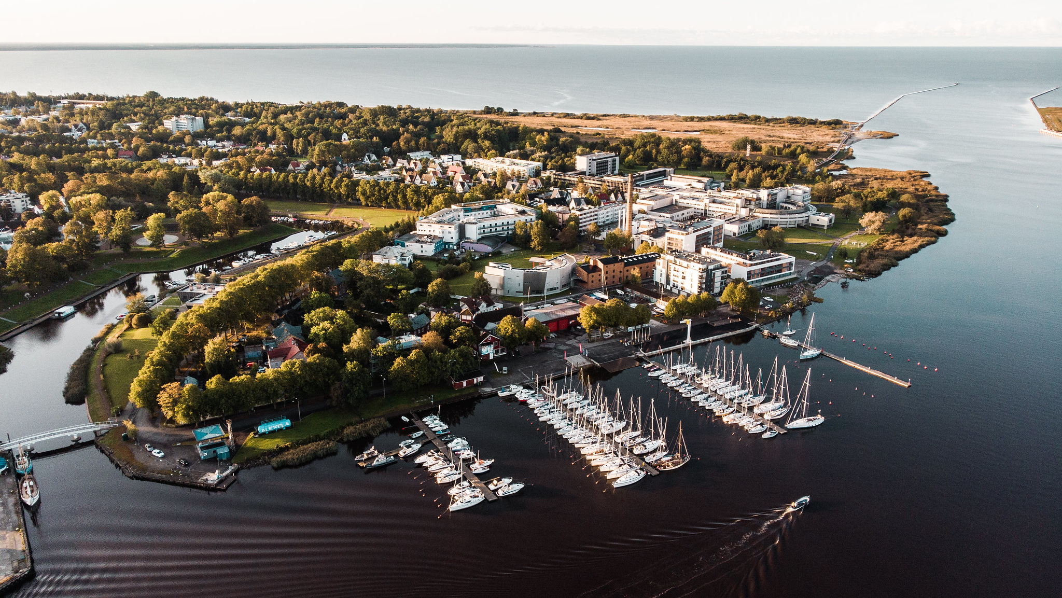
Pärnu –Feel the Summer All Year Long
© Priidu Saart
population 40,000
spa traditions since 1838
distance to Tallinn: 130 km
2, 500 hotel rooms
excellent networking activities

Slide 124
Pärnu the resort town
© Karlis Buskevics
Most of the hotels have spa facilities

Slide 125
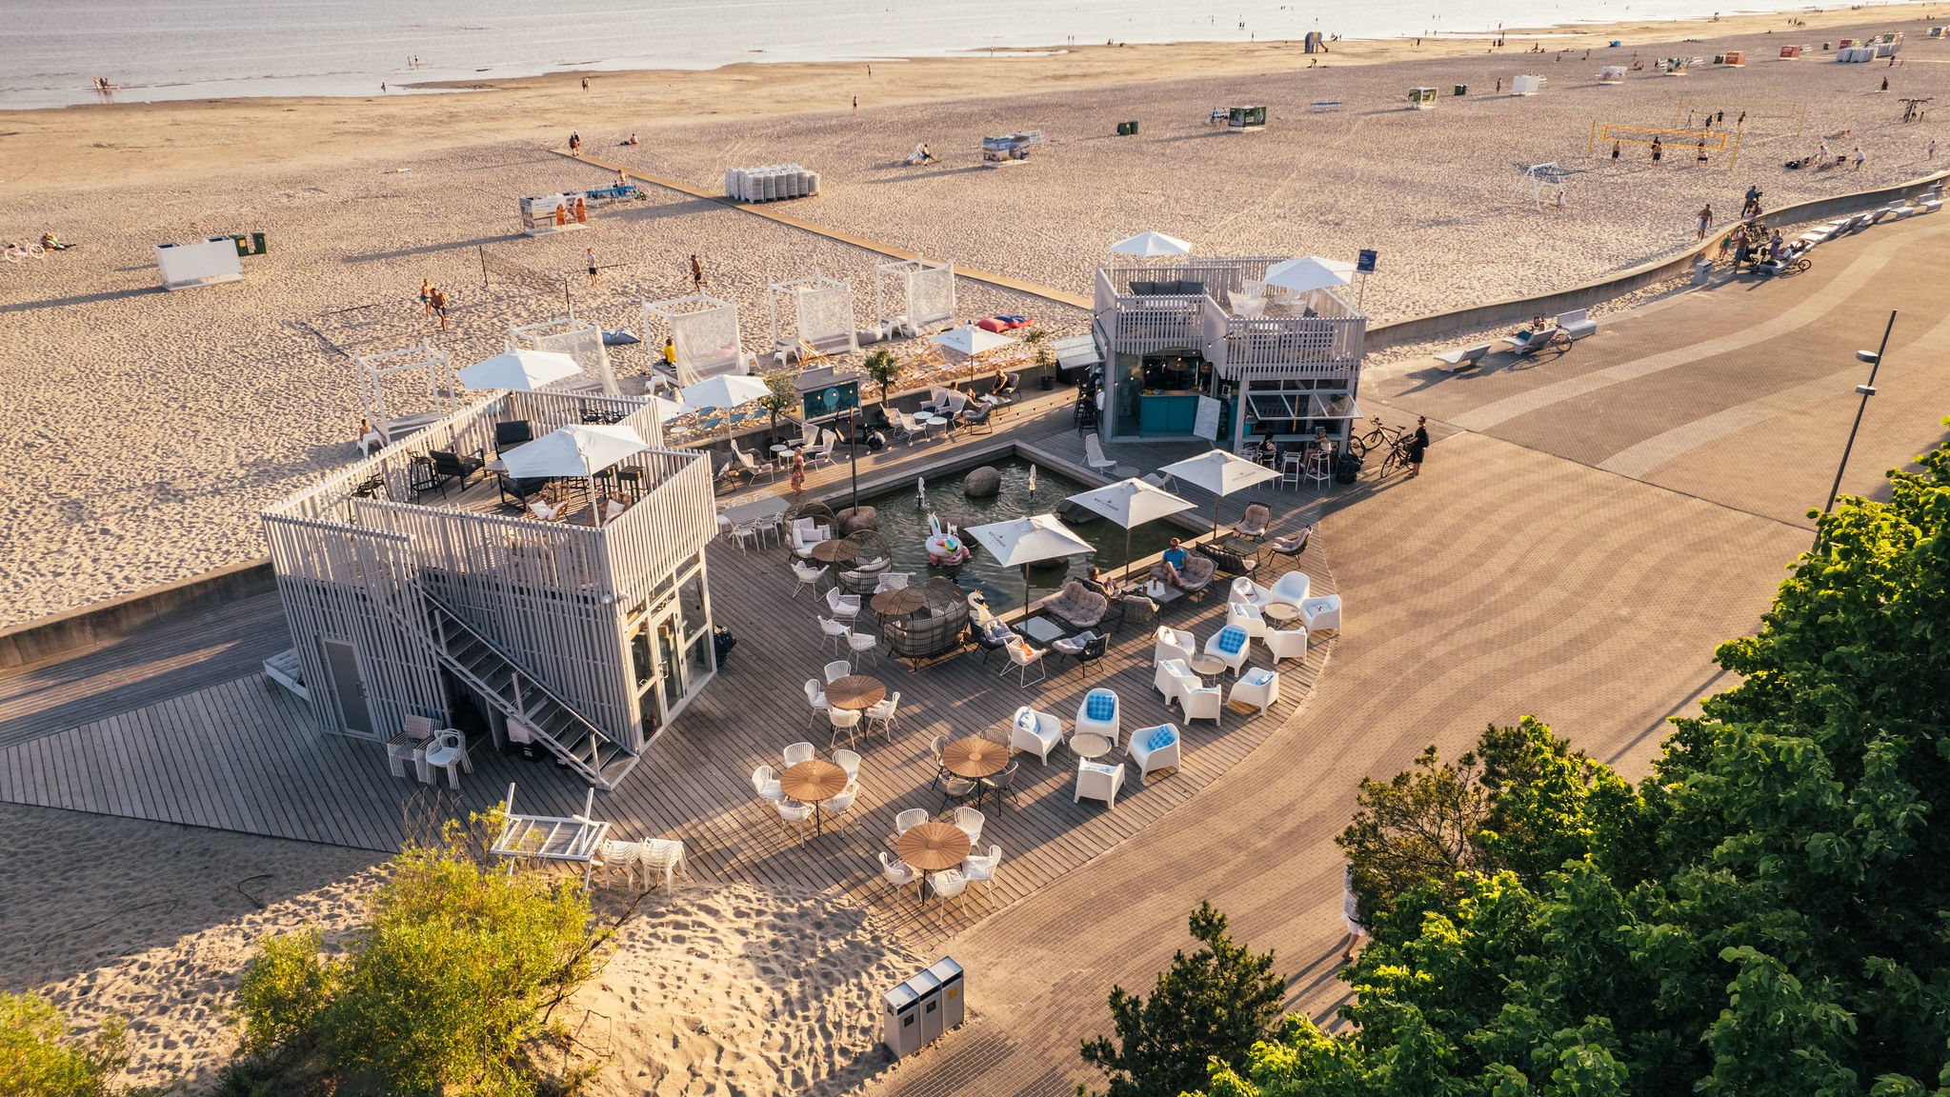
Pärnu where summer never ends
© Henri Holland
Long sandy beaches, beachside bars and cafes

Slide 126
Tours and
Activities

Slide 127
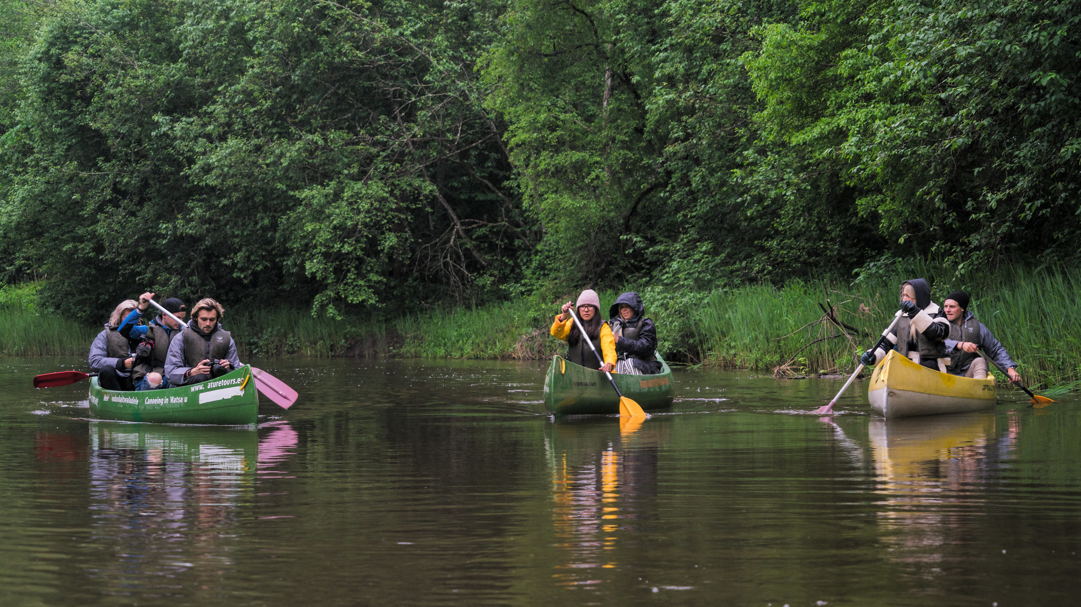
Pärnu pick your favorite water involved activity
© Innervisionteam, Visit Pärnu
fishing
sailing
kite surfing
SUP boarding
swimming

Slide 128
Porsche experience
An ideal way to feel like a real racing driver– an experience your team or guests won’t ever forget.
3.2 km layout provides an excellent and safe driving experience for both professionals and beginners.
Several ready-made packages available.
“Probably the best racetrack in Nordic” – many of the clients

Slide 129
Golf
Just a 15-minute drive outside of Pärnu lie two of the most high-level golf courses in Estonia.
Pärnu Bay Golf Links is the first links course in the Baltic region and features wide fairways and expansive sand areas, as well as multi-leveled greens with bold movement.
White Beach Golf, an 18-hole golf course, is located near Valgerand (White Beach), the most beautiful beach by Pärnu Bay.
Pärnu Bay Golf Links, is considered one of the most amazing links courses
in Northern
Europe

Slide 130
“Like a local” bike tour
The best way to get know Pärnu is by pedalling through the charming old town, hidden yards, beach parks and promenades.
Did you know that Pärnu has 70 kilometers of bike paths? This means that you can bike everywhere, which is why biking is very popular among the locals.
Photo: Priidu Saart
Photo: Priidu Saart
Photo: Priidu Saart

Slide 131
Cider farm tour
The best way to get know Pärnu is by pedalling through the charming old town, hidden yards, beach parks and promenades.
Did you know that Pärnu has 70 kilometers of bike paths?
This means that you can bike everywhere, which is why biking is very popular among the locals.
Photo: Veronika Roosimaa
Photo: Veronika Roosimaa

Slide 132
Kihnu island
daytrip
Estonia’s seventh-largest island, Kihnu, has preserved its unique culture for centuries.
Traditional dress, colourful handicrafts, lively music, and dance are part of everyday life on Kihnu.
Explore the island by truck or bike, enjoy breathtaking sea views from the Kihnu lighthouse, and admire the colourful traditions at the Kihnu Museum.
Photo: DreamBeachMedia
Photo: Innervisionteam
Photo: Julia Kivela

Slide 133
Main DMCs
conference-expert.eu
baltcoming.com
baltictours.ee
dmc-nordic.com
baltic.travel
viahansa.com
bluedrum.eu

Slide 134
Main PCOs
publicon.ee/?lang=en
conference-expert.eu
konverentsimeistrid.ee/en

Slide 135
Main Event Companies
amazing.ee/english
jolos.eu
milttonevents.ee
hype.ee/en
orangetime.ee/en

Slide 136
Main AV Companies
tehnikateenused.ee/en
rgbbaltic.com
eventcenter.ee/en

Slide 137
Main Catering Companies
pohjalacatering.ee/en
nordiccatering.ee

Slide 138
Contact Us
The Estonian Convention Bureau serves as your primary contact for planning congresses, conferences, corporate meetings or incentives in Estonia. We provide impartial advice and assistance to event organisers, backed by our extensive member network, which includes major cities, hotels, venues, PCOs, DMCs, even companies, universities, catering, and AV service providers.
Homepage
info@ecb.ee
Follow us:
EstonianCVB
estonian_cvb
estonian-convention-bureau

Slide 139
Let’s be in Touch
plant a tree
give a helping hand in local community
charity activities, fundraisers
nature cleaning hikes with educational information
www.ecb.ee
© Visit Estonia

Slide 140
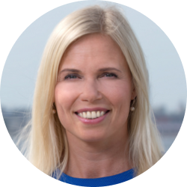
Thank you!
Dana Noormets
Kadri Karu
dana.Noormets@eas.ee
kadri.Karu@ecb.ee
www.visitestonia.com
www.ecb.ee

Slide 141
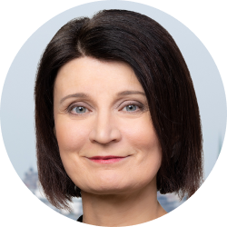
Thank you!
Riine Tiigi
Külli Teimann
riine.tiigi@ecb.ee
kylli.teimann@ecb.ee
www.ecb.ee
www.ecb.ee

Slide 142
Thank you!

